Slide 1
CS 201 - Introduction to Computing
Albert Levi
FENS 1091
levi@sabanciuniv.edu

Slide 2
Course Information
CS201 – Introduction to Computing
  Website - http://people.sabanciuniv.edu/levi/cs201
  also follow SUCourse
  an e-mail list will be used for announcements
    so you are responsible to check your e-mails (sabanciuniv account)
Instructor: Albert Levi, FENS 1091, ext. 9563, levi@sabanciuniv.edu
Schedule
  Lectures:
    Monday 13:40 – 15:30,
    Tuesday 9:40 – 10:30,
    All in FENS G077 (auditorium)
  Recitations will start first week
    See schedule for date, time and location
    Recitations will also be used as labs, so please take your laptops (with power and Ethernet cables) to recitations
  Attend all. It is to your benefit.
Weekly or Biweekly Homework Assignments (total 7 assignments)
Textbook: A Computer Science Tapestry, by Astrachan
  http://www.cs.duke.edu/csed/tapestry/

Slide 3
Course Policy
Two Midterm Exams + Final Exam + 7 homework assignments
  Midterms are each 23%
    Midterm 1: November 7, 2015, Saturday 14:00 – 16:00
    Midterm 2: December 5, 2015, Saturday 10:00 – 12:00
  Final exam (34%) will be scheduled by SR
  Homework assignments are total 20% and all will be counted
    they are not of equal weight (distribution of 20% among assignments will be determined at the end of the course)
No late homework without penalty
  One late day is allowed at cost of 10% of full grade
Plagiarism will not be tolerated
  Homeworks are to be done personally
  Cooperation is not an excuse
    If you do not know how to cooperate, don’t do it
  we use software tools to detect plagiarized homework
  first case –100 (minus hundred), second fails the course!
  Homework traders and plagiarizers are also reported to the dean's office for disciplinary actions
  read the detailed policy on the web site of the course - http://people.sabanciuniv.edu/levi/cs201/policy_plagiarism.html

Slide 4
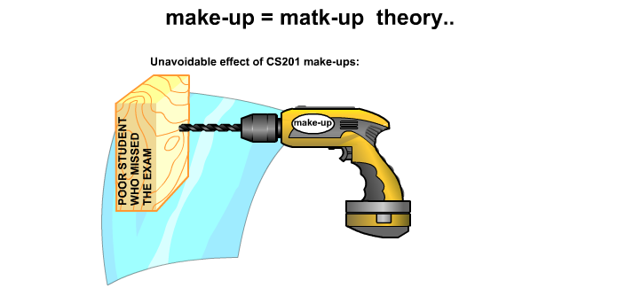
Course Policy (cont’d)
Make-ups (detailed policy is on the web)
  reports must come before or during the exam
  you must be really sick to take a make-up exam
  according to the by-laws, acceptance of report is up to the instructor
    a medical report does not guarantee taking a make-up exam
  make-ups will be harder

Slide 5
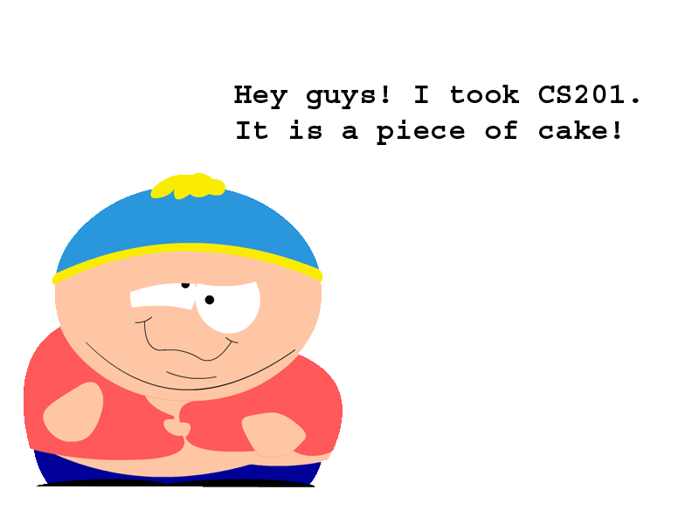
This course will give you
Basic computer science notions
Mostly C++ programming concepts
  with emphasis on computational problems
  Object oriented programming language
At the end of this course, you will be able to
  develop algorithms
  write programs using C++
  but not-so-big-applications

Slide 6



Before CS 201
Maybe you are afraid of computers
Maybe you hate
Maybe you used computers just for fun before

Slide 7
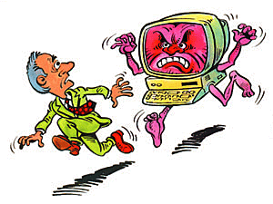





During CS 201
You may have bad dreams at the beginning
And you may think of you are going to nuts
But if you work properly and spend considerable amount of time ...

Slide 8


At the End of CS 201
Success is yours!

Slide 9
MS Visual C++ 2012
Necessary software to write and execute C++ programs
  Actually this one of the alternative systems; there are other alternatives but for the sake of standardization you have to use this
Part of MS Visual Studio .NET (2012)
I strongly recommend using under Windows OS
  If you have a Mac, install windows on it first
You will install to your laptops
Help will be available in first week labs
Check website for instructions on how to install, if you prefer to install before the labs (actually it'd be better if you install before the lab)
You can install
  over the network
    \\software\microsoft\VisualStudio\Visual_Studio_2012
  step-by-step installation screenshots are on course web site
  http://http://people.sabanciuniv.edu/levi/cs201/VisualStudioUltimate2012_Installation_Guide.pdf

Slide 10
What is Computer Science?
Hard to define
  The study of computers
    too general
  The study of managing and processing information/data
    basic idea
  The art of problem solving using computing machinery
    my definition
    involves more engineering
The discipline is called informatics in many countries
  especially in Europe

Slide 11
Computer Science
Computer Science is not only programming
  more than programming
Computer Science is a young discipline
  More than 50 years
  First graduate program at CMU (then Carnegie Tech) in 1965
  in Turkey first CS department in 1977
Turing machine (1937)
  abstract machine
  theoretically capable of any computation that we can do with modern computers today
AIM: automated computation

Slide 12
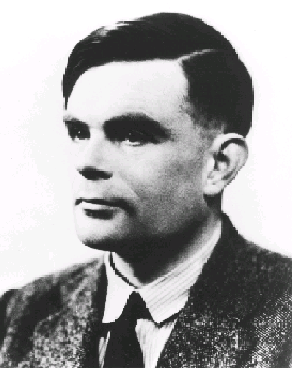
Alan Turing (1912--1954)
A scientist and mathematician
Instrumental in breaking codes during WW II
Developed mathematical model of a computer called a Turing Machine (before computers)
  solves same problems as a Pentium processor (more slowly)
Showed there are problems that cannot be solved by a computer
Was a long distance runner
committed suicide

Slide 13
Why both Science and Engineering?
Computer Science and Computer Engineering distinction
  Computer Science is mostly related to software and theoretical parts
  Computer Engineering is mostly related to hardware and systems
  In Turkey and most countries, Computer Science and Engineering departments offer a balanced curriculum
    Independent of their names

Slide 14
Computer Science and Engineering
Artificial Intelligence thinking machines, perception
Scientific Computing biocomputing
Theoretical CS analyze algorithms
Architecture hardware-software interface
Software Engineering creating software products
Hardware Engineering Microprocessor based systems
Operating Systems
Graphics animation, entertainment
Computer Security hacking, digital signatures
Computer Networks Communicating computers, Internet
…….

Slide 15
Algorithms
Arabic-originated word
Step-by-step process that solves a problem
  do this, then do that, ...
  eventually stops with an answer
  general process rather than specific to a programming language
Issues
  correctness
  complexity and efficiency
I picked a number between 1 and 100
  You will guess it
  I’ll respond “high”, “low”, “correct”.
  how many guesses needed (worst case)?

Slide 16
Example Algorithm - Find the minimum
Initial list: 4 6 7 3 9 1 4 5
Should we sort? 1 3 4 4 5 6 7 9
  About (n.log(n)) operations, where n is the number of elements
Optimal algorithm - About n operations
  Pick 4 as the minimum
  Compare 4 to 6 - min is still 4
  Compare 4 to 7- min is still 4
  Compare 4 to 3 - Pick 3 as the minimum
  Compare 3 to 9- min is still 3
  Compare 3 to 1 - Pick 1 as the minimum
  Compare 1 to 4- min is still 1
  Compare 1 to 5 - We are done and the minimum is 1

Slide 17


Example Algorithm - Find the minimum

Slide 18
Data Representation in Computers
Computers are data processing machines
All type of data are represented in numeric format
  numbers - obvious
  colors - RGB values
  characters - ASCII codes
Music files, such as .mp3 files, and video files, such as .mov files are also represented in numbers
Emails,Tweets, Whatsapp messages
Internal representation (at the lowest level) is in binary form
  0 and 1
  all arithmetic in binary too
Low level instructions are also in binary
  machine language
  not human readable and programmable!

Slide 19
Problem Solving and Computers
Computerized problem solving explicitly or implicitly require computation
For examples:
  Arithmetic problems
  Computer graphics (require geometric operations)
  Image Processing (mathematical transformations)
A program is an implementation of an algorithm
  using a specific programming language
  to execute on specific platforms
Let’s develop our first program
  In other words, let’s make use of computer for computation ☺

Slide 20
First Program
Problem: How many 3-digit positive numbers are there that are divisible by 7, but not divisible by 4?
  Think of an algorithm!
Try all 3-digit numbers between 100 and 999
  If a number is divisible by 7 but not by 4
    Increment a counter
Display the value of the counter
Now let’s see the program
  myfirstprogram.cpp

Slide 21
Themes and Concepts
Theory
  developing algorithms and evaluating them
    how fast?
    Works all the time? Tested?
Language
  needed to express the algorithms to the computers
  programming languages: C++, Java, C, Perl, Fortran, Lisp, Scheme, Visual BASIC, ...
  Assembly language, machine language
Architecture
  building blocks of a computer
  Main memory, cache memory, disk, CPU, etc.

Slide 22
Programming Languages
Formal language, with its own syntax and semantic rules, in order to express the algorithms to the computers
We cannot use natural languages (English, Turkish, Spanish, etc.) for this purpose, because they are
  vague
  ambiguous
Programming languages:
  C++, Java, C, C#, Perl, Python, Fortran, Lisp, Scheme, Visual BASIC, ...
  Assembly language, machine language

Slide 23
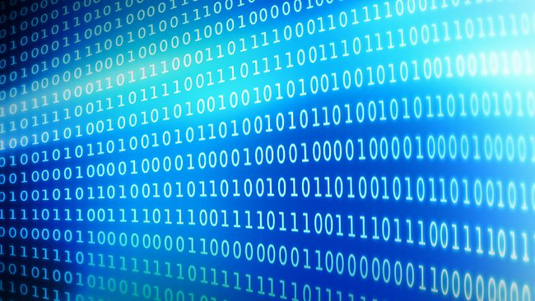
High-level Languages and Assembly
Rather than instruct computers at the level of 0s and 1s, higher level languages have been developed.
  Flexible and easier programming
  int main()
  {
    int x, y, z;
    x = 7;
    y = 12;
    z = x * y;
    return 0;
  }
main:
pushl %ebp
movl %esp,%ebp
subl $12,%esp
movl $7,-4(%ebp)
movl $12,-8(%ebp)
movl -4(%ebp),%eax
imull -8(%ebp),%eax
movl %eax,-12(%ebp)
xorl %eax,%eax
jmp .L1
.align 4
xorl %eax,%eax
jmp .L1
high-level
low-level (assembly)
lowest-level (binary)

Slide 24
High-level Languages and Assembly
Compilers translate a high level language, such as C++, into machine-specific executable program (0s and 1s)
  The compiler is a program, input is C++ program, output is an executable program
  In theory, C++ source code works on any machine given a compiler for the machine
  for other languages different compilers are needed
Between machine code and high-level languages: assembly language
  human understandable form of machine code instructions

Slide 25
Levels of Programming Language - high level
int main()
{
  int x, y, z;
  x = 7;
  y = 12;
  z = x*y;
  return 0;
}

Slide 26
Levels of Programming Language - assembly
Machine specific assembly language, Sparc on left, Pentium on right, both generated from the same C++ code
main: main:
save %sp,-128,%sp pushl %ebp
mov 7,%o0 movl %esp,%ebp
st %o0,[%fp-20] subl $12,%esp
mov 12,%o0 movl $7,-4(%ebp)
st %o0,[%fp-24] movl $12,-8(%ebp)
ld [%fp-20],%o0 movl -4(%ebp),%eax
ld [%fp-24],%o1 imull -8(%ebp),%eax
call .umul,0 movl %eax,-12(%ebp)
nop xorl %eax,%eax
st %o0,[%fp-28] jmp .L1
mov 0,%i0 .align 4
b .LL1 xorl %eax,%eax
nop jmp .L1

Slide 27
Basic Program Development Steps
Analyze Problem
Source Code
Develop Algorithm
Compile & Build
Correct it
Syntax
Errors?
Design Program
Yes
Write code on
paper
No
Run
Correct
(Debug)
Code over the
computer
Correct
Results?
No
Yes - Done

Slide 28
A Simple Program
Input three integer numbers and display their sum
Algorithm
  display a prompt for data entry
  input (number₁, number₂, number₃)
  sum ← number₁ + number₂ + number₃
  output (sum)
Program
  First we will write the program and run it using MS Visual C++ (sum3num.cpp)
  Then we will see an animation about the steps taken during the execution

Slide 29
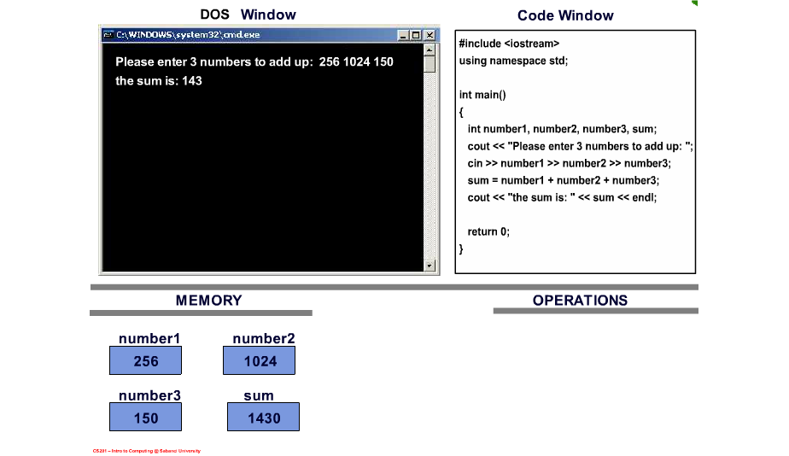
A Simple Program – Execution steps

Slide 30
Architecture
Von Neumann Model
  John von Neumann
    founder of game theory
    part of the Manhattan Project (atomic bomb)
    ENIAC
  Stored program concept
    Program is also stored as the data

Slide 31
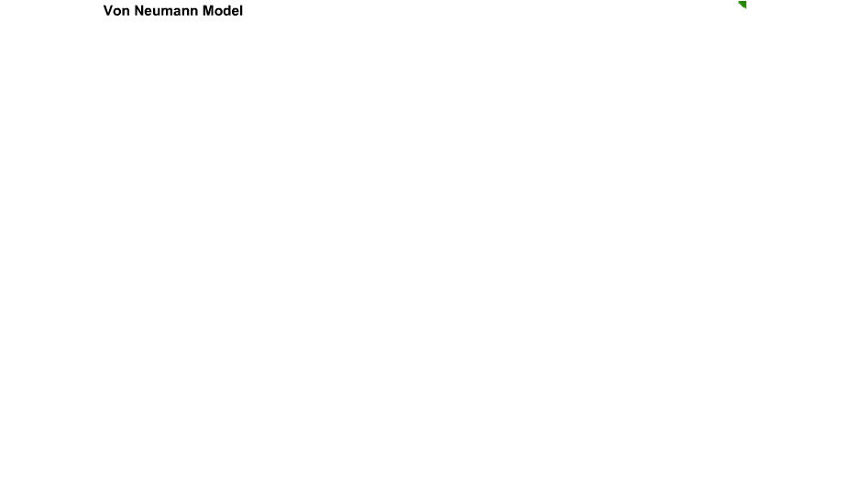
Von Neumann Model

Slide 32
Von Neumann Model
Memory Unit
Input Unit
  Provides instructions and data to system
  keyboards
  mouse
  Scanners
  Storage Units like DVD-ROMs, Harddisks, USB sticks, etc.
Input Unit
Arithmetic and Logical Unit (ALU)
Output Unit
Control Unit

Slide 33
Von Neumann Model
Memory Unit
Output Unit
  Returns data from system
  monitors
  Printers
  Storage Units like DVD-ROMs, Harddisks, USB sticks, etc.
Input Unit
Arithmetic and Logical Unit (ALU)
Output Unit
Control Unit

Slide 34
Von Neumann Model
Memory Unit
Memory
  Storage for instructions and data
Input Unit
Arithmetic and Logical Unit (ALU)
Output Unit
Control Unit

Slide 35
Von Neumann Model
Memory Unit
ALU
  Processes data
Input Unit
Arithmetic and Logical Unit (ALU)
Output Unit
Control Unit

Slide 36
Von Neumann Model
Memory Unit
Control Unit
  Directs processing
Input Unit
Arithmetic and Logical Unit (ALU)
Output Unit
Control Unit

Slide 37
Von Neumann Model
Memory Unit
CPU
  ALU and Control Unit combined
CPU
Input Unit
Arithmetic and Logical Unit (ALU)
Output Unit
Control Unit

Slide 38
Memory
Primary memory is generally RAM (Random Access Memory)
  fast data access
  volatile
    power goes, data go
  expensive
Secondary memory (storage)
  Disks, tapes, CD-ROMs, DVD-ROMs, usb sticks
  non-volatile
  slow data access
  cheap
ROM (Read-only memory) - Flash memory
  BIOS (Basic Input Output System) - to start the system (before the operating system)

Slide 39
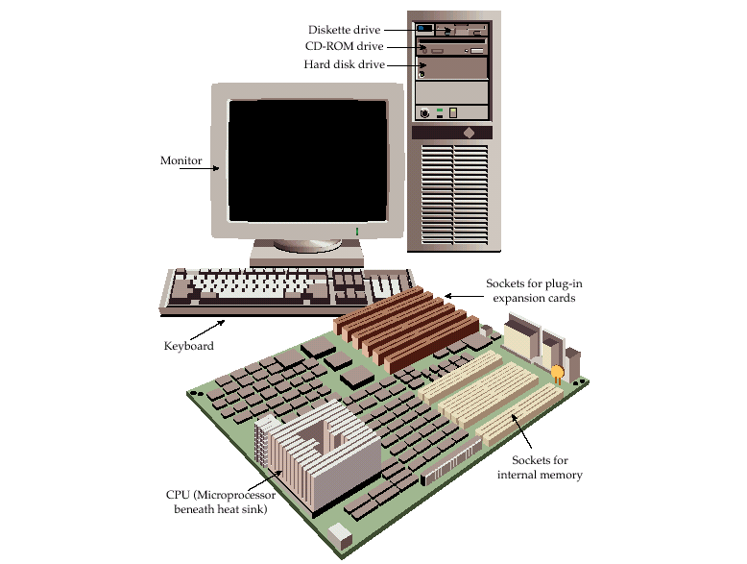
A Typical Computer System

Slide 40
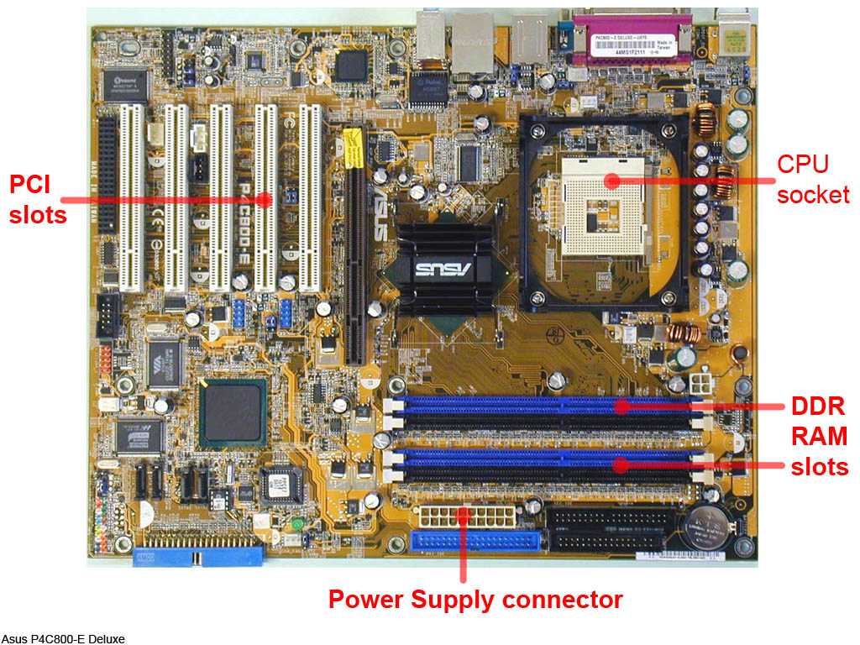
A Motherboard

Slide 41
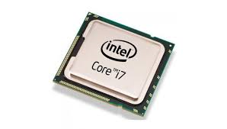
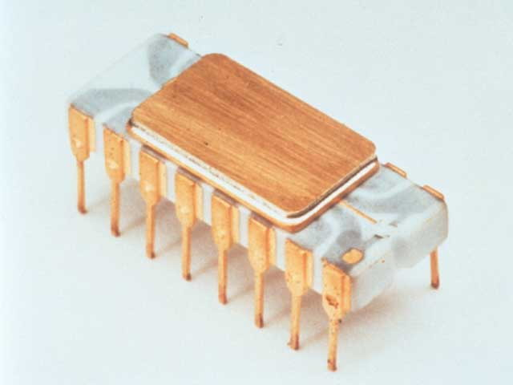
Central Processing Unit (CPU)
CPU chips
  Core 2 Duo (top)
  Intel 4004 (bottom)
Moore’s Law
  chip “size” (# transistors) doubles every 12--18 months for the same price (formulated in 1965)
  processing power increases
  Intel 4004: 2,300 transistors
  Intel Core i7: up to 1.4 billion transistors
Intel Core i7
  Intel 4004

