Slide 1

Computer Science and Engineering
Faculty of Engineering and Natural Sciences

Slide 2
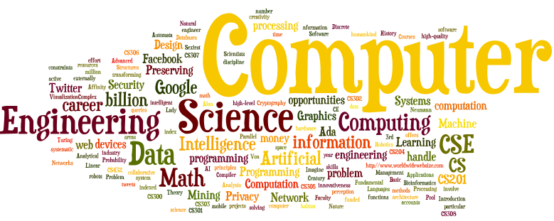
What is Computer Science?
Computer science (CS) is the study of algorithmic methods for representing, transforming and processing information

Slide 3
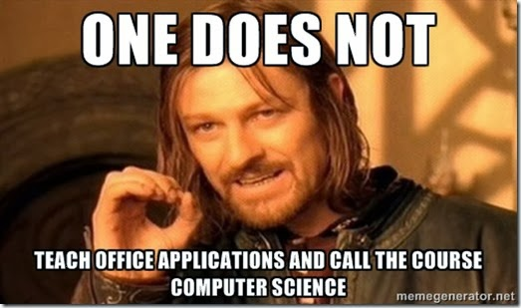
What is Computer Engineering?
An engineering discipline
  design and implementation of information processing systems
  using hardware and software
  for the good of humankind, habitat, etc.
  given time, money, space, etc. resources

Slide 4

1800s
The first time the term "Computer" appeared in the New York Times was in May 2, 1892; the ad by the US Civil Service Commission stated:
"A Computer Wanted. [...] The examination will include the subjects of algebra, geometry, trigonometry, and astronomy."

Slide 5

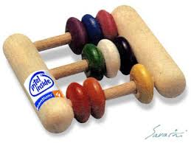
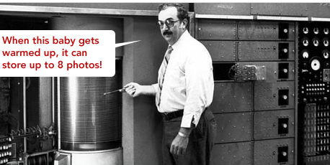
1940-1960s

Slide 6

It is not easy to predict the future…
“I think there is a world market for maybe five computers.’’
                The president of IBM, 1943

Slide 7
but sometimes we do get it right…
“Computers in the future may weigh no more than
1.5 tons’’
                Popular Mechanics, 1949

Slide 8
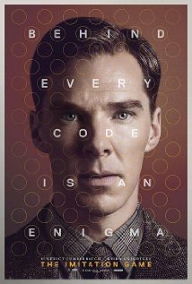
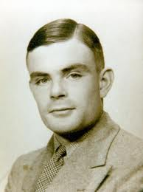
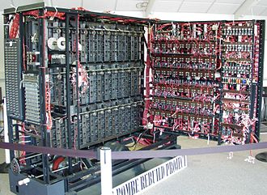
Heroes in Computer Science
The “Bombe” by Alan Turing
(and Gordon Welchman)
Alan Turing designed Bombe for
a) The first computer game
b) Deciphering the German cryptos during World War II

Slide 9
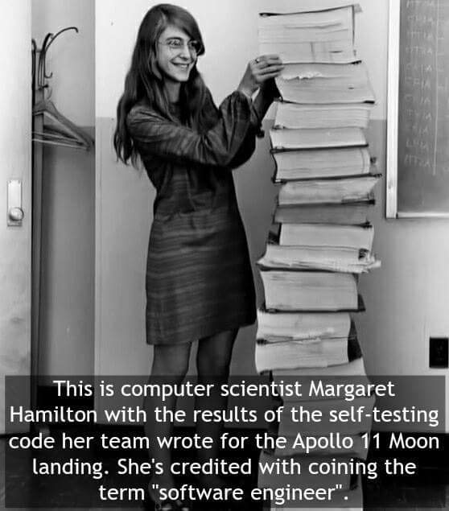
Heroes in Computer Science

Slide 10

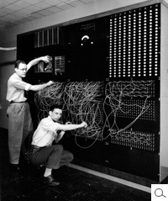
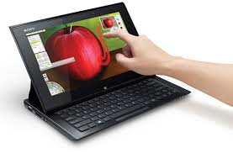

Past
Today you know
Today in CSE Labs

Slide 11
A real-life CSE Problem
Making two Google searches produces about the same amount of CO₂ as boiling a kettle!!!
Do you want to reduce the energy consumption and pollution?
    By changing how companies store the data,
    ... changing how they query the data,
    ... making the answers more relevant,
    .... or INNOVATE

Slide 12
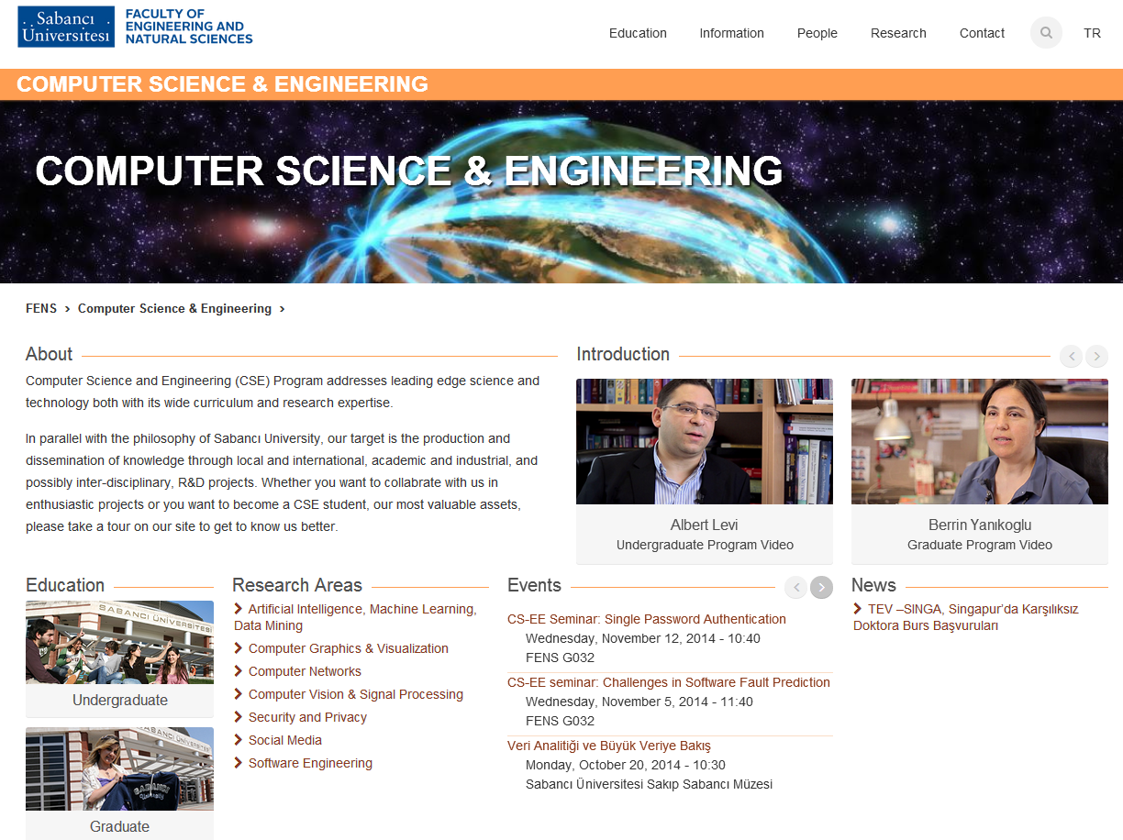
CSE@SU
http://fens.sabanciuniv.edu/
http://cs.sabanciuniv.edu/

Slide 13
FACULTY MEMBERS AT A GLANCE
Kemal İnan, Ph.D. Electrical Eng., University of California, Berkeley
Berrin Yanıkoğlu, Ph.D. in Computer Science, Dartmouth College, USA
Hüsnü Yenigün, Ph.D. in Electrical Engineering, Middle East Technical University,
Yücel Saygın, Ph.D. in Computer Science, Bilkent University, Turkey
Albert Levi, Ph.D. in Computer Engineering, Boğaziçi University, Turkey
Erkay Savaş, Ph.D. in Electrical and Computer Engineering, Oregon State University, USA
Selim Balcısoy, Ph.D. in Computer Science, Swiss Federal Institute of Technology, Lausanne – EPFL, Switzerland
Esra Erdem, Ph.D. in Computer Science, University of Texas at Austin, USA
Cemal Yılmaz, Ph.D. in Computer Science, University of Maryland,
College Park, USA
Kamer Kaya, Ph.D. in Computer Science, Bilkent University, Turkey
Gülşen Demiröz, M.Sc. in Computer Science, Bilkent University, Turkey
(joint appointment with the IT program)

Slide 14
Interdisciplinary Nature of CS
Computer Science and Engineering
@ Sabanci University
Bioengineering
Bioinformatics
Data Mining
Speech Processing
Text Processing
Biometrics
Electronics
Distributed Systems
Computer Networks
Computer Security Network Security
Web Technologies
Design Verification
Formal Methods
Software Engineering
Simulation
Material
Science
Computer-aided
Modeling
Machine Learning
Parallel Processing
Algorithm Design
Artificial
Intelligence
Virtual Reality
Manufacturing
Computer Graphics
Mechatronics
Optimization
Notes:
14

Slide 15
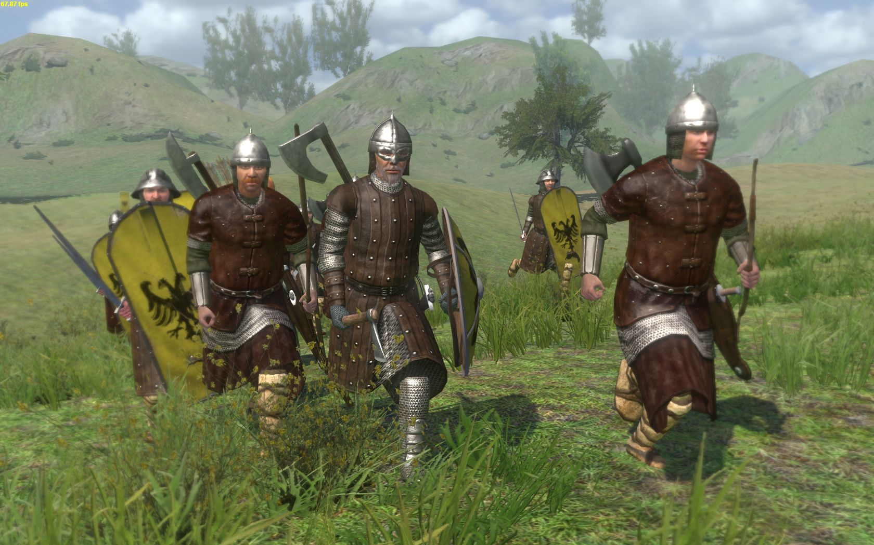
Computer Graphics and Virtual Reality

Slide 16
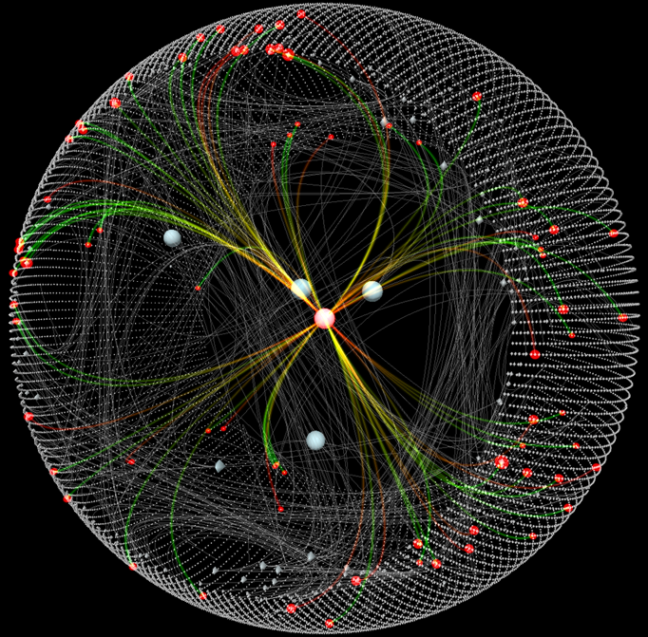
Visualization of Complex Data

Slide 17
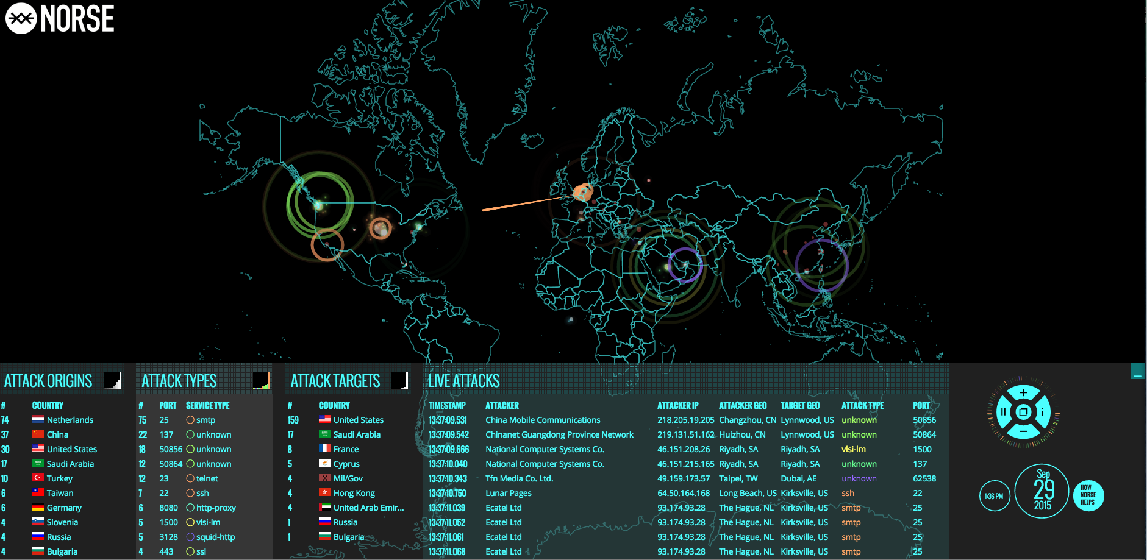
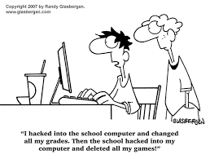
Cryptology, Network Security

Slide 18

Parallel and High Perf. Computing
National Super Computer Center in Guangzhou, China Tianhe-2 (MilkyWay-2) – 120.000 cores, 17,808 KW (1KW = seven nights of light with a 60W bulb) –
390 million$

Slide 19
Privacy Preserving Data Management
  In August 2006, AOL releases user
  search data that includes
  An anonymous user with
  id 4417749 searched
    “numb fingers”
    “60 single men”
    “dog that urinates on everything”
    “landscapers in Lilburn, Ga”
    Several people with name “Arnold”

Slide 20
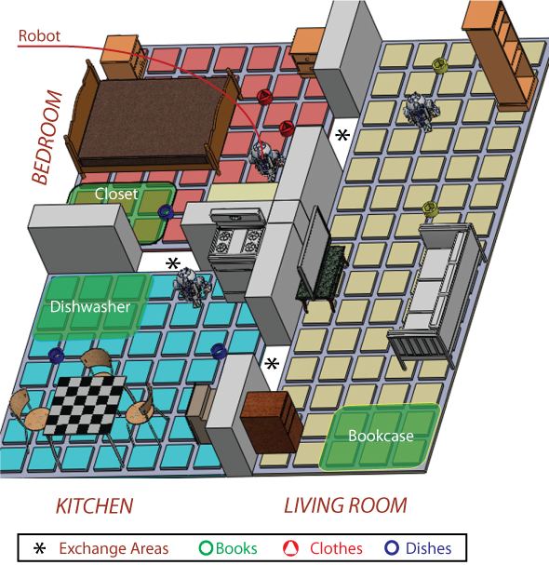
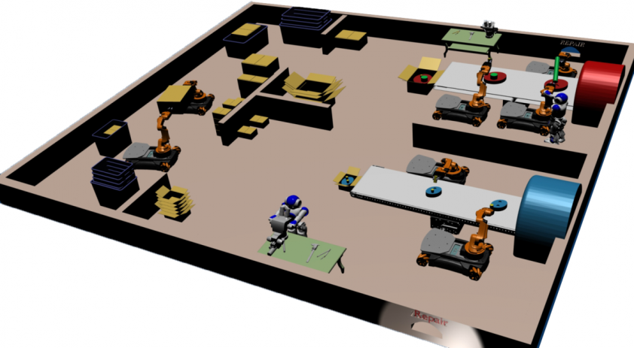
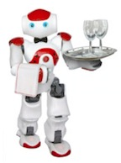
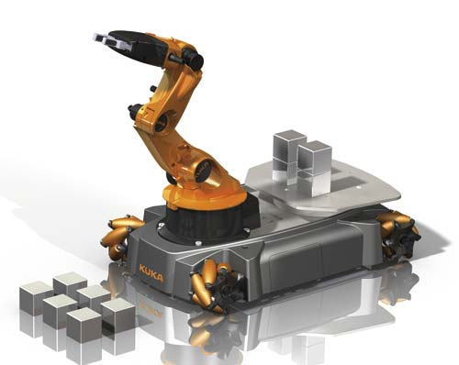
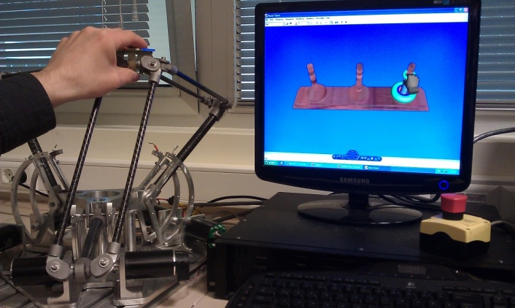
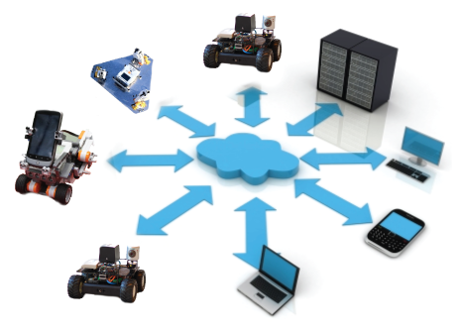
Artificial Intelligence and Cognitive Robotics
Goal: To endow robots with higher level cognitive functions that involve reasoning about goals, perception, actions, etc., so that they can give high-level decisions to act intelligently in a dynamic world.
Cognitive factories
Intelligent robots at home
Cognitive rehabilitation robotics
Cloud robotics

Slide 21
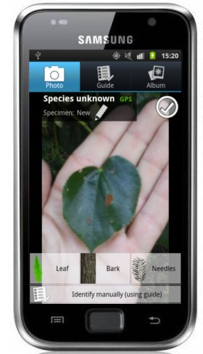
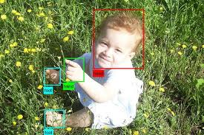
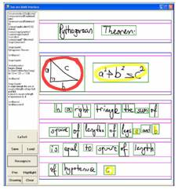
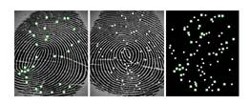
Computer Vision and Machine Learning
Plant identification
Handwriting & sketch recognition
Biometrics: signature and fingerprint verification

Slide 22





Data Mining
GB = 10⁹ (giga)
TB = 10¹² (tera)
PB = 10¹⁵ (peta)
EB = 10¹⁸ (exa)
ZB = 10²¹ (zetta)
Size of the data we gathered in 2014: 2.7 ZB
2015 prediction: 7.9 ZB
2.2 million TB new data every day
The data we gathered in the last 2 years is 90% of what we have
Number of smart phones: > 1.75 billion
Every minute
277,000
logins
1,3 million video
streams
4.4 million
queries
600,000
tweets

Slide 23
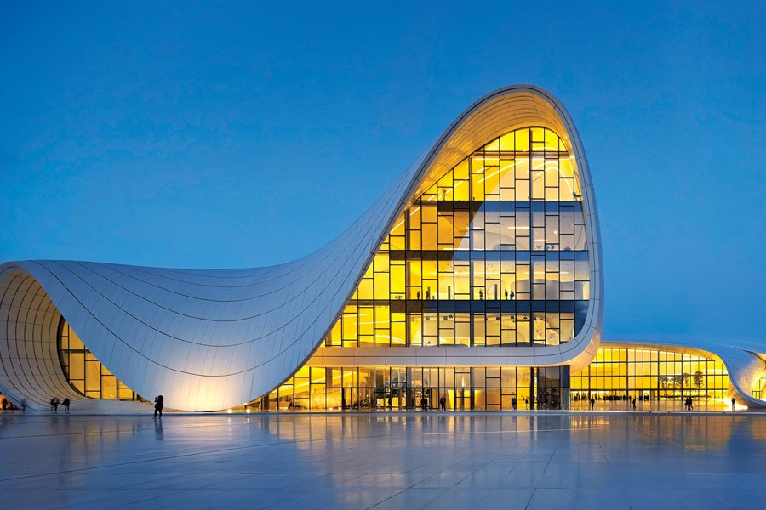
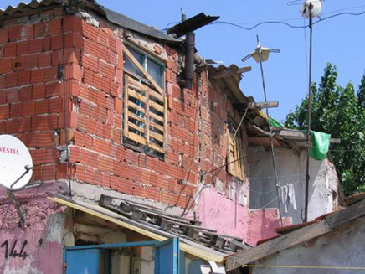
Anybody can program. Yes, but…
Software Engineer
Self educated
programmer

Slide 24
Skills that are good to have
Analytical, problem solving, and math skills
Affinity to programming or algorithms is a plus
  Even though we don’t do programing every day...
  Even though some of us don’t do programing ever...
If you do not know whether you are affine to programming or not, just take CS201.

Slide 25
2nd Year Course Pool for CS
CS201 – Introduction to Computing
  If possible, take in the first year
CS204 – Advanced Programming
  Taking CS204 in the first year or during the summer before 2nd year is a plus
Math 201 – Linear Algebra
Math 203 – Probability
Math 204 – Discrete Math
(all required courses)

Slide 26
Basic Courses (3rd year)
CS300 – Data Structures (if CS204 is taken before, take it in 2nd year)
CS301 – Algorithms
CS302 – Automata Theory (no prerequisites, may be taken in 2nd year)
CS303 – Logic Design (no prerequisites, may be taken in 2nd year)
CS305 – Programming Languages
CS306 – Databases (some people take it in 2nd year)
CS307 – Operating Systems
CS308 – Software Engineering
CS310 – Mobile Computing

Slide 27
Basic Courses (4th year)
Depending on prereqs, some can be taken in 3rd year
CS400 – Logic in Computer Science
CS401 – Computer Architecture
CS402 – Compiler Design
CS403 – Distributed Systems
CS404 – Artificial Intelligence
CS405 – Computer Graphics
CS406 – Parallel Computing
CS407 – Theory of Computation
CS408 – Computer Networks
CS411 – Cryptography
CS412 – Machine Learning
CS432 – Computer and Network Security

Slide 28
Minor Honor Programs (mostly MATH minor)
Required courses (2 more left):
MATH 201 Linear Algebra (already required for CSE)
MATH 301 Introduction to Mathematical Analysis
MATH 311 Introduction to Algebra
Other Minor Programs:
•Art Theory and Criticism
•Business Analytics
•Chemistry
•Energy
•Entrepreneurship
•Finance
•Gender Studies
•Philosophy
•Physics
•Psychology
4 courses out of (2 more left):
MATH 203 Introduction to Probability (already required for CSE)
MATH 204 Discrete Mathematics (already required for CSE)
CS 409 Introduction to Scientific Computing
MATH 202 Differential Equations
MATH 206 Vector Calculus
MATH 302 Integration
MATH 305 Complex Calculus
MATH 307 Dynamical Systems
MATH 317 Elementary Number Theory
MATH 318 Introduction to Combinatorics
MATH 322 Partial Differential Equations
MATH 401 Introduction to Functional Analysis
MATH 402 Hilbert Space Techniques
MATH 409 Proofs from the Notebook
MATH 410 Introduction to Stochastic Calculus
MATH 414 Finite Fields and Applications
MATH 417 Introduction to Number Theory

Slide 29
Double Major Programs
Only CSE: 125 SU credits
Double Major CSE: 155 SU credits (around 10 more courses)
[CSE & Another Program] / [Another Program & CSE]
with the courses you have taken (summing upto at least 155 SU credits), you need to be eligible to graduate both from CS and from this other program
+
additional requirements (GPA, rank, application, …)

Slide 30
Why Computer Science?
Computing offers great opportunities for true creativity and innovativeness
Computing offers many types of lucrative careers.
You can work from anywhere
    from home, from the beach, from a plane, even from the office...
Sector-independent career for true Computer Scientists and Engineers
Salary is good ☺
  Computer Engineering (CE) Rank: 6 - Mid-career salary: $106,000
  Computer Science (CS) Rank: 8 - Mid-career salary: $102,000*
                *PayScale College Salary Report 2013
CNBC says that “The Sexiest Job of the 21st Century: Data Analyst” (http://www.cnbc.com/id/100792215#.)

Slide 31
Some of our graduates
Giray Ozil: Blizzard (One of World of Warcraft chief programmer) LA.
Alp Yücebilgin, 2K Sports, USA, http://www.2kgames.com
Emre Koç: Founder of Gravi (http://www.gravi.com.tr/tr/)
Hüseyin Ergun: founder OBSS, more than 50 employees
Gizem Gezici, İnanç Arın: co-founders of SOMATECH
Çağatay Türkay: Faculty Member, City Univ. of London
Ali İnan: Faculty Member, Işık University
Can Yıldızlı, IntelRAD (a security company)
Can Serhat Leloğlu, LinkedIn
and
Your name goes here…

Slide 32

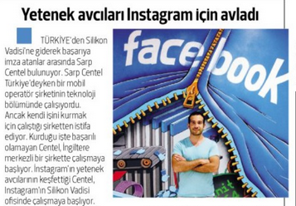
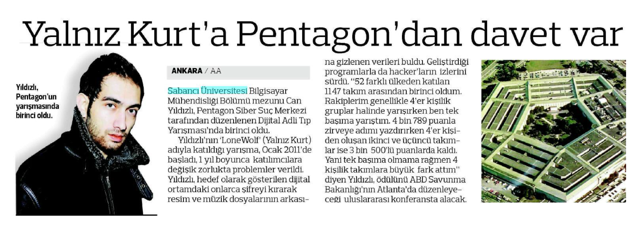
Some of our graduates

Slide 33

Questions?

