Slide 1
CS 512 Machine Learning
Berrin Yanikoglu
Slides are expanded from the
Machine Learning-Mitchell book slides
Some of the extra slides thanks to T. Jaakkola, MIT and others

Slide 2
CS512-Machine Learning
Please refer to http://people.sabanciuniv.edu/berrin/cs512/
for course information. This webpage is also linked from SuCourse.
We will use SuCourse mainly for assignments and announcements. You are responsible of checking SuCourse for announcements.
Undergraduates are required to attend the course; graduates are strongly encouraged to.

Slide 3
Important Info
Grading:
  2 midterms for a total of 50%;
  In-class final: 25%;
  Homeworks: 15%
  Group project: 10%;
Missed Exams:
  You can miss up to one midterm (no proof is required), in which case the weight of the final will increase (to 50%). If you miss two midterms, you get an F.
  To encourage exam participation, some brownie points will be given to those who attend both midterm exams (otherwise those taking a good grade in Mt1 does not attend Mt2). I do consider Mt attendance if someone is at the border of a grade cluster.
  If you miss the final exam, you MUST have a legitimate excuse/report.
Passing Grade:
  To pass the course you grade as calculated above must be at least 35 (strict) and Final grade should be above 30/100.

Slide 4
What is Learning...

Slide 5
What is learning?
It is very difficult to pin down what learning is. As our programs/agents/robots start doing more and more things, we do not find them intelligent anymore.
Some definitions from famous people in CS/AI history:
  “Learning denotes changes in a system that ... enable a system to do the same task more efficiently the next time.” –Herbert Simon
  “Learning is any process by which a system improves performance from experience.” –Herbert Simon
  “Learning is constructing or modifying representations of what is being experienced.”
  –Ryszard Michalski
  “Learning is making useful changes in our minds.” –Marvin Minsky

Slide 6
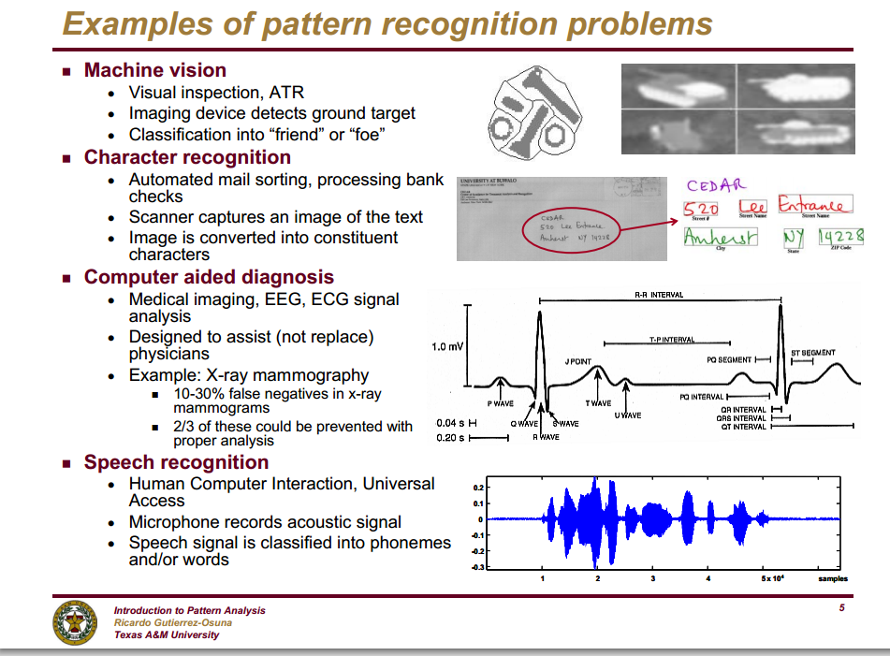

Slide 7
Why learn?
Build software agents that can adapt to their users or to other software agents or to changing environments
  Mars robot
Develop systems that are too difficult/expensive to construct manually because they require specific detailed skills or knowledge tuned to a specific task
  Large, complex AI systems cannot be completely derived by hand and require dynamic updating to incorporate new information.
Discover new things that were previously unknown to humans
  Examples: data mining, scientific discovery

Slide 8
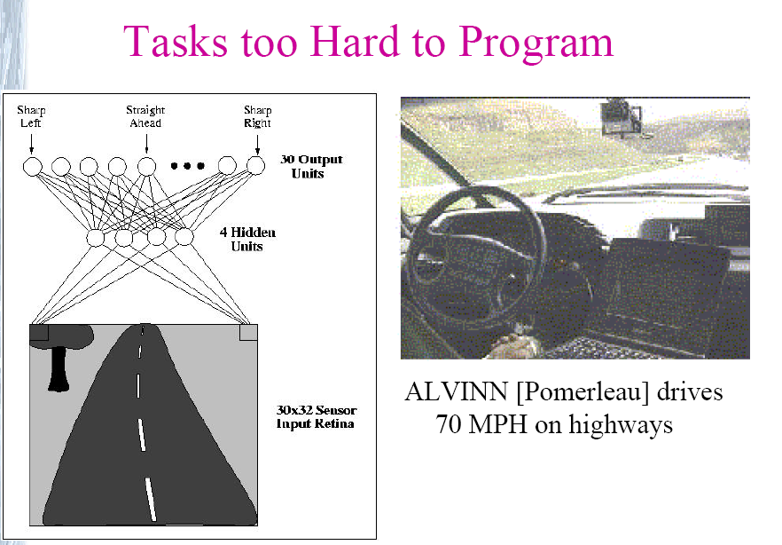

Slide 9
Related Disciplines
The following are close disciplines:
  Artificial Intelligence
    Machine learning deals with the learning part of AI
  Pattern Recognition
    Concentrates more on “tools” rather than theory
  Data Mining
    More specific about discovery
The following are useful in machine learning techniques or may give insights:
  Probability and Statistics
  Information theory
  Psychology (developmental, cognitive)
  Neurobiology
  Linguistics
  Philosophy

Slide 10
History of Machine Learning
1950s
  Samuel’s checker player
  Selfridge’s Pandemonium
1960s:
  Neural networks: Perceptron
  Minsky and Papert prove limitations of Perceptron
1970s:
  Expert systems and the knowledge acquisition bottleneck
  Mathematical discovery with AM
  Symbolic concept induction
  Winston’s arch learner
  Quinlan’s ID3
  Michalski’s AQ and soybean diagnosis
  Scientific discovery with BACON

Slide 11
History of Machine Learning (cont.)
1980s:
  Resurgence of neural networks (connectionism, backpropagation)
  Advanced decision tree and rule learning
  Explanation-based Learning (EBL)
  Learning, planning and problem solving
  Utility theory
  Analogy
  Cognitive architectures
  Valiant’s PAC Learning Theory
1990s
  Data mining
  Reinforcement learning (RL)
  Inductive Logic Programming (ILP)
  Ensembles: Bagging, Boosting, and Stacking

Slide 12
History of Machine Learning (cont.)
2000s
  Kernel methods
    Support vector machines
  Graphical models
  Statistical relational learning
  Transfer learning
  Deep learning
    Deep Blue (chess-IBM), AlphaGO (Go-Deepmind),...
Applications
  Adaptive software agents and web applications
  Learning in robotics and vision
  E-mail management (spam detection)
  …

Slide 13
Different Learning Paradigms

Slide 14
Major paradigms of machine learning
Rote learning – “Learning by memorization.”
  Employed by first machine learning systems, in 1950s
    Samuel’s Checkers program
Supervised learning – Use specific examples to reach general conclusions or extract general rules
    Classification (Concept learning)
    Regression
Unsupervised learning (Clustering) – Unsupervised identification of natural groups in data
Reinforcement learning– Feedback (positive or negative reward) given at the end of a sequence of steps
Analogy – Determine correspondence between two different representations
Discovery – Unsupervised, specific goal not given

Slide 15
Rote Learning is Limited
Memorize I/O pairs and perform exact matching with new inputs
If a computer has not seen the precise case before, it cannot apply its experience
We want computers to “generalize” from prior experience
  Generalization is the most important factor in learning

Slide 16
The inductive learning problem
Extrapolate from a given set of examples to make accurate predictions about future examples
Supervised versus unsupervised learning
  Learn an unknown function f(X) = Y, where X is an input example and Y is the desired output.
  Supervised learning implies we are given a training set of (X, Y) pairs by a “teacher”
  Unsupervised learning means we are only given the Xs.
  Semi-supervised learning: mostly unlabelled data

Slide 17
Classification, Regression

Slide 18
Types of supervised learning
Classification:
  We are given the label of the training objects: {(x1,x2,y=T/O)}
  We are interested in classifying future objects: (x1’,x2’) with the correct label.
      I.e. Find y’ for given (x1’,x2’).
x2=color
Tangerines Oranges
x1=size
b) Concept Learning:
  We are given positive and negative samples for the concept we want to learn (e.g.Tangerine): {(x1,x2,y=+/-)}
  We are interested in classifying future objects as member of the class (or positive example for the concept) or not.
    I.e. Answer +/- for given (x1’,x2’).

Slide 19
Types of Supervised Learning
Regression
  Target function is continuous rather than class membership
  For example, you have some the selling prices of houses as their sizes (sq-mt) changes in a particular location that may look like this. You may hypothesize that the prices are governed by a particular function f(x). Once you have this function that “explains” this relationship, you can guess a given house’s value, given its sq-mt. The learning here is the selection of this function f() .
  Note that the problem is more meaningful and challenging if you imagine several input parameters, resulting in a multi-dimensional input space.
y=price
f(x)
60 70 90 120 150 x=size

Slide 20
Classification
Assign object/event to one of a given finite set of categories.
  Medical diagnosis
  Credit card applications or transactions
  Fraud detection in e-commerce
  Spam filtering in email
  Recommended books, movies, music
  Financial investments
  Spoken words
  Handwritten letters

Slide 21
Classification System
Input Classifier Output
(Features or Feature Vector)
A
B
C
D
.
.
.
Z
x₁
x₂
x₃
.
.
x_{d}

Slide 22
Regression System
Input Classifier Output
(Features or Feature Vector)
x₁
x₂
x₃
.
.
x_{d}
f(x₁, x₂, x₃, ..., x_{d})

Slide 23
Learning: Key steps
Now that we have learned the the main supervised learning paradigms and the beginning terminology, let us look at the learning problem in a bit more detail.

Slide 24
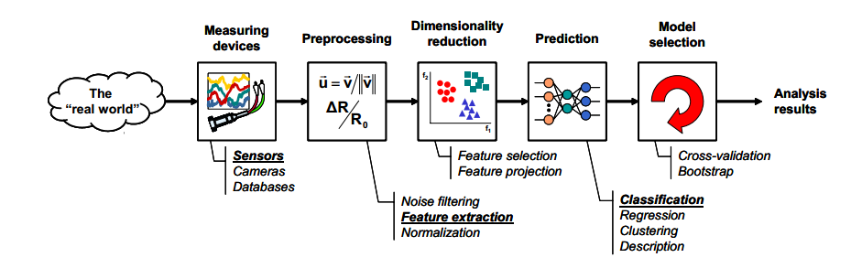
Learning: Key Steps
• data and assumptions
  – what data is available for the learning task?
  – what can we assume about the problem?
• representation
  – how should we represent the examples to be classified
• method and estimation
  – what are the possible hypotheses?
  – what learning algorithm to use to infer the most likely hypothesis?
• evaluation
  – how well are we doing?
…

Slide 25
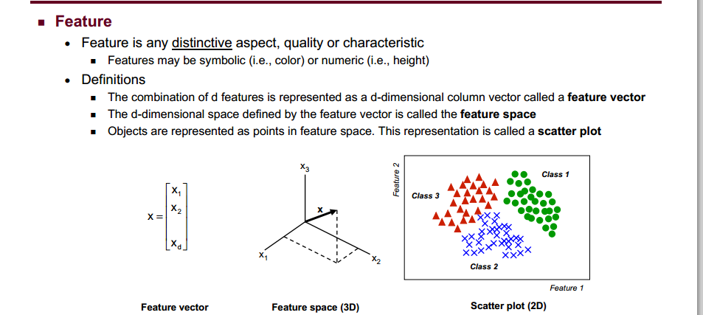

Slide 26
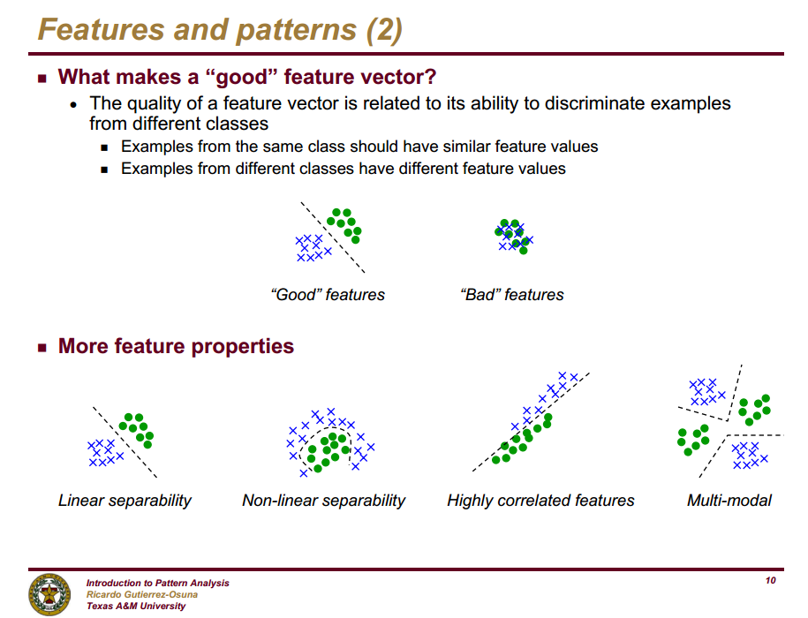

Slide 27
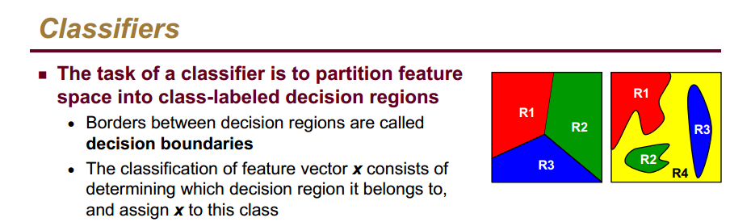

Slide 28
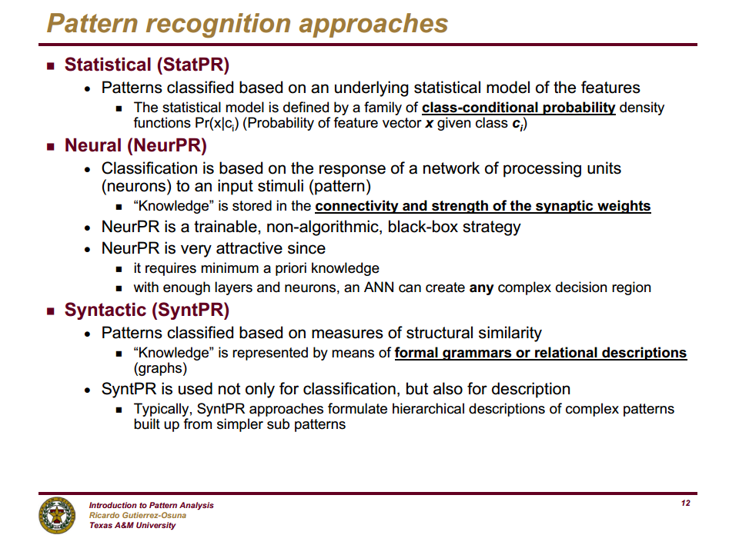

Slide 29
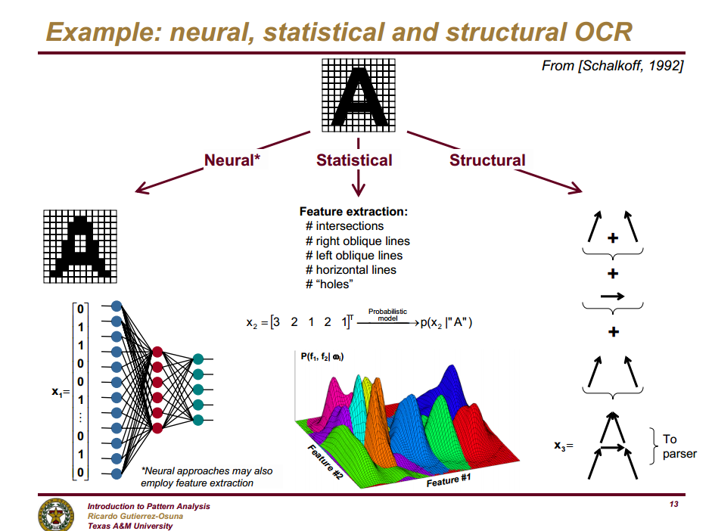

Slide 30
Evaluation of Learning Systems
Experimental
  Conduct controlled cross-validation experiments to compare various methods on a variety of benchmark datasets.
  Gather data on their performance, e.g. test accuracy,
  training-time, testing-time…
  Maybe even analyze differences for statistical significance.
Theoretical
  Analyze algorithms mathematically and prove theorems about their:
    Ability to fit training data
    Computational complexity
    Sample complexity (number of training examples needed to learn an accurate function)

Slide 31

Measuring Performance
Performance of the learner can be measured in one of the following ways, as suitable for the application:
  Accuracy
    Number of mistakes (in classification problems)
    Mean Squared Error (in regression problems)
    Loss functions (more general, taking into account different costs for different mistakes)
  Solution quality (length, efficiency)
  Speed of performance
  …

Slide 32
Cross-Validation
You have some data to learn from and you need some test data to test your learnt system. A standard approach to evaluation is to use k-fold cross-validation (we will see later).
For now, lets assume we have a validation set, so that we can train on the train set and evaluate performance on the validation set.

Slide 33
The next slides review the design cycle as a whole process
from Gutierrez-Osuna, Texas A&M

Slide 34
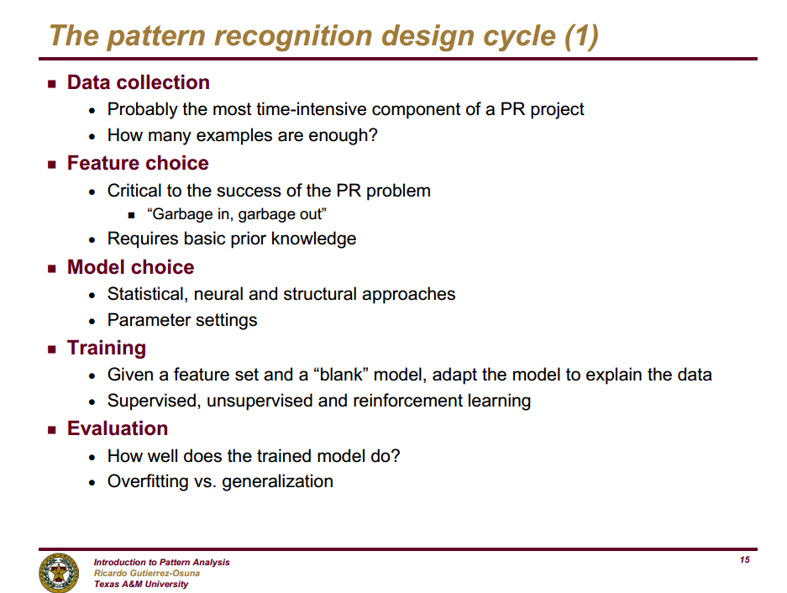

Slide 35
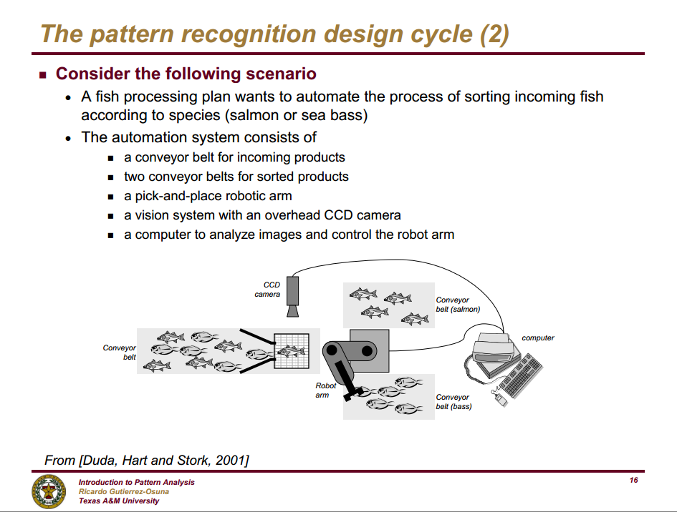

Slide 36
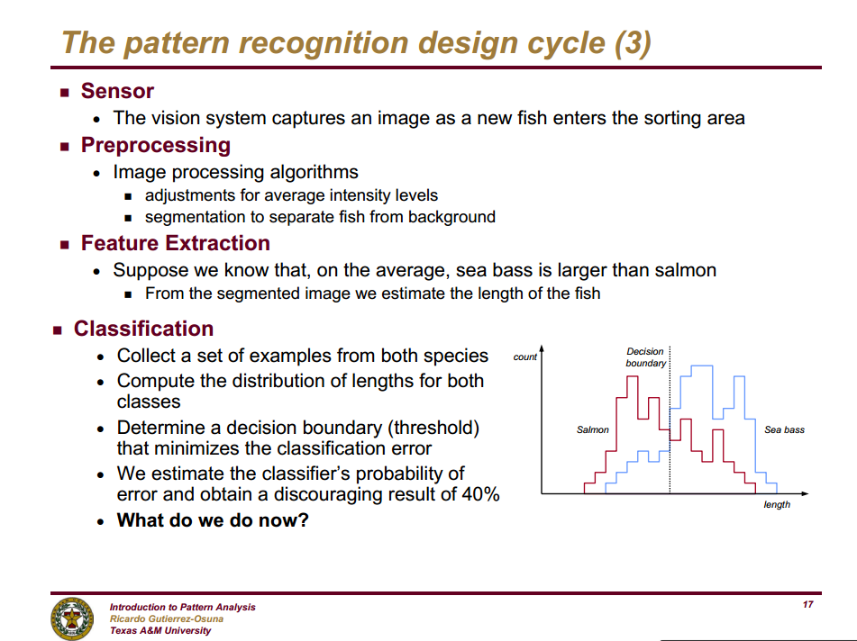

Slide 37
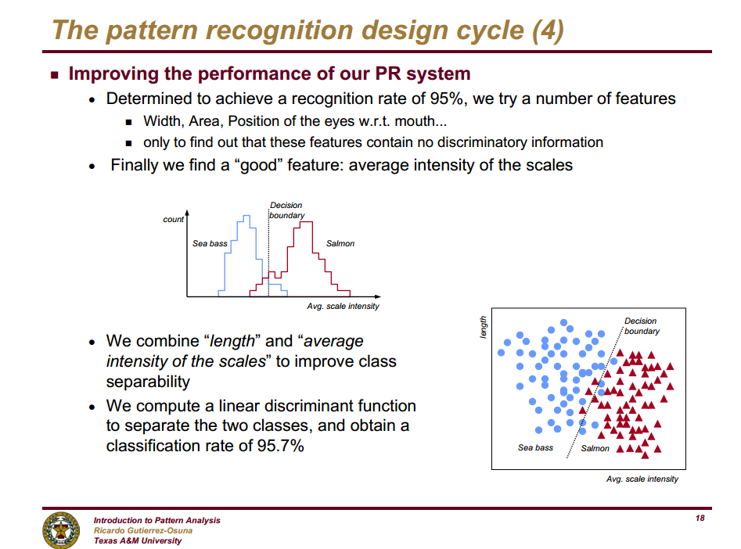

Slide 38
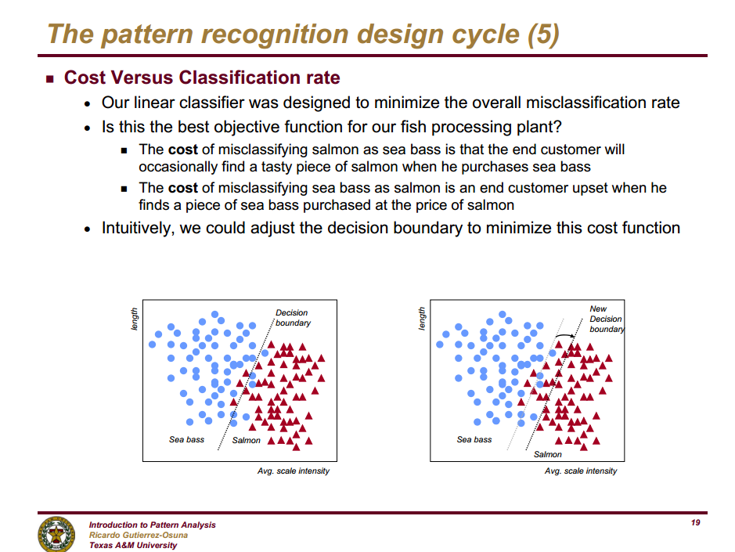

Slide 39
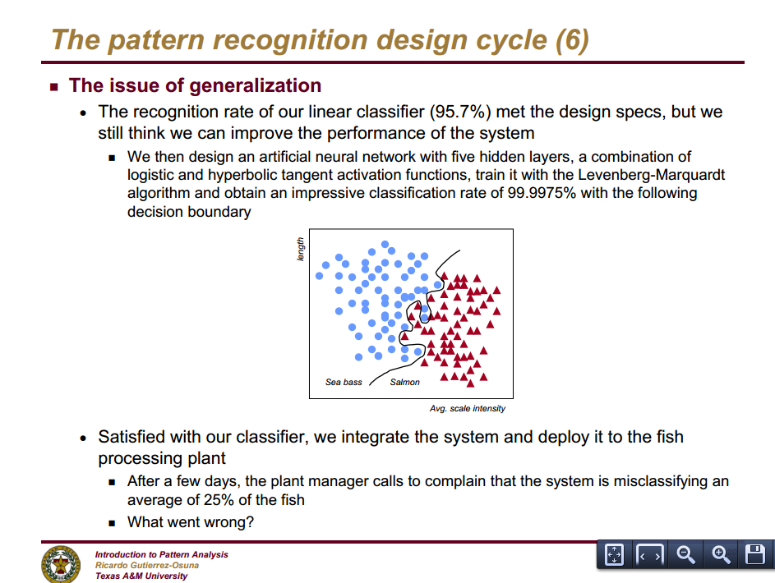

Slide 40
Generalization and over-fitting are at the core of machine learning

Slide 41
Introduction to Overfitting

Slide 42
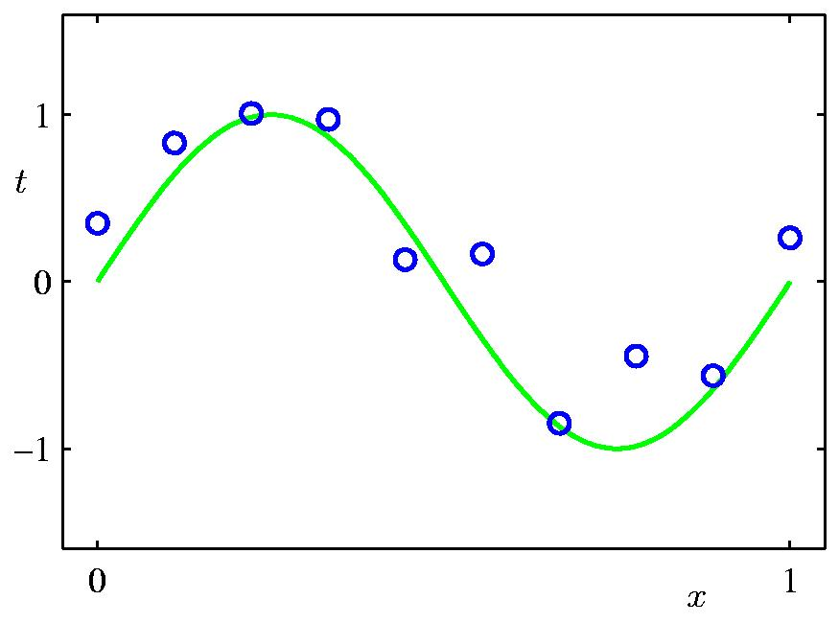
Overfitting and Model Complexity
Imagine that we have some training data (blue dots in the next slides), and we want to learn the underlying function between the independent variable x and the target values t.

Slide 43
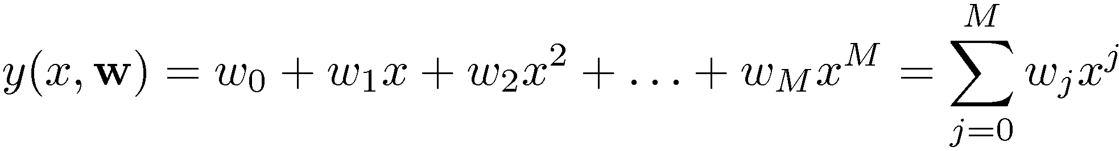
Overfitting and Model Complexity
We can fit polynomials in varying degrees: lines to higher degree polynomials.
Higher degrees make the polynomial very capable to bend/flex to match the data as it has many parameters to change/adapt.

Slide 44
Polynomial Curve Fitting

Slide 45
Overfitting and Model Complexity
We can fit polynomials in varying degrees: lines to higher degree polynomials.
Higher degrees make the polynomial very capable to bend/flex to match the data as it has many parameters to change/adapt.

Slide 46
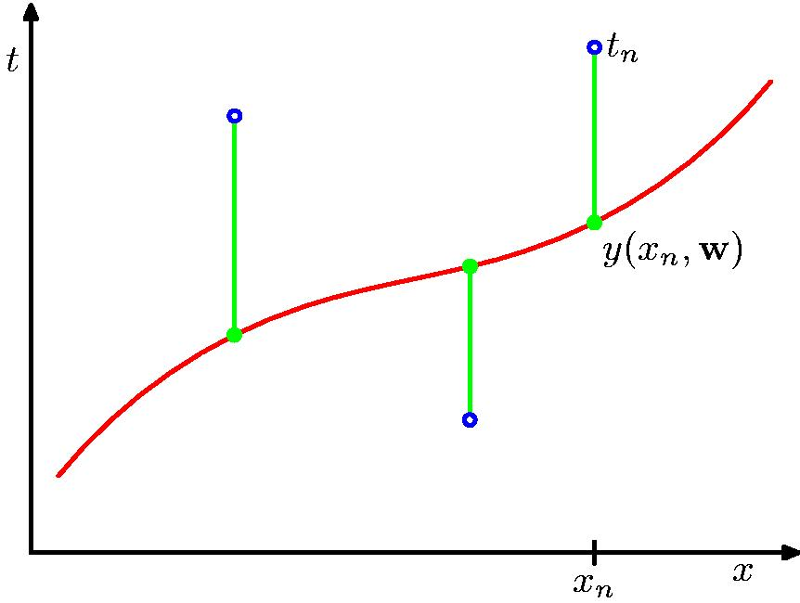
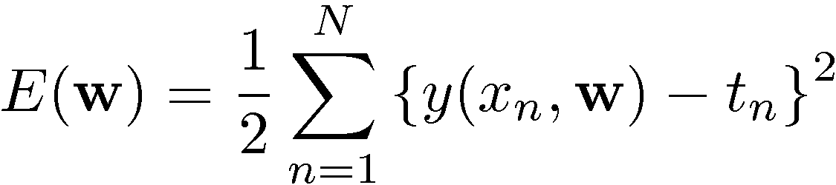
Sum-of-Squares Error Function

Slide 47
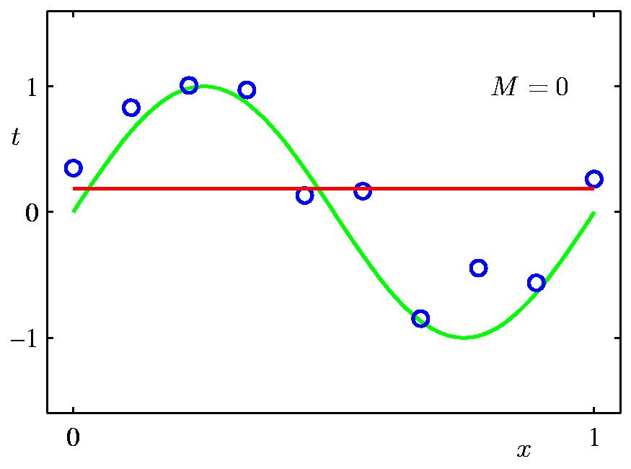
0th Order Polynomial

Slide 48
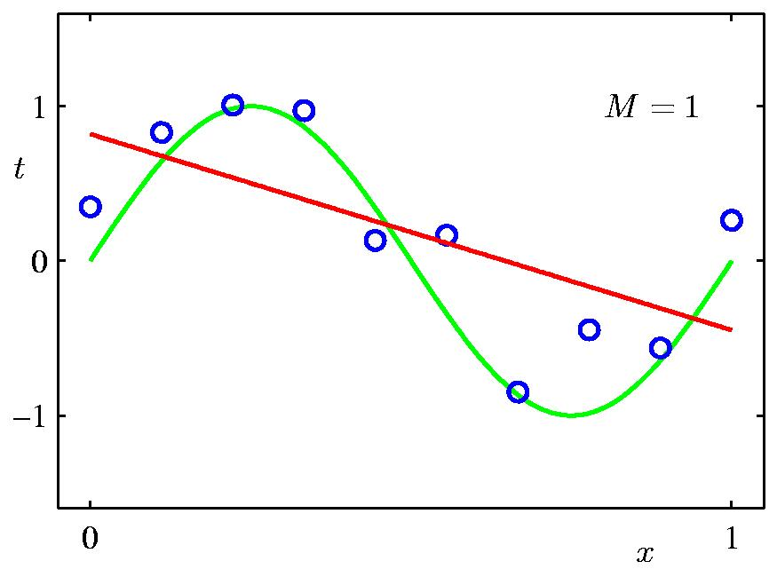
1st Order Polynomial

Slide 49
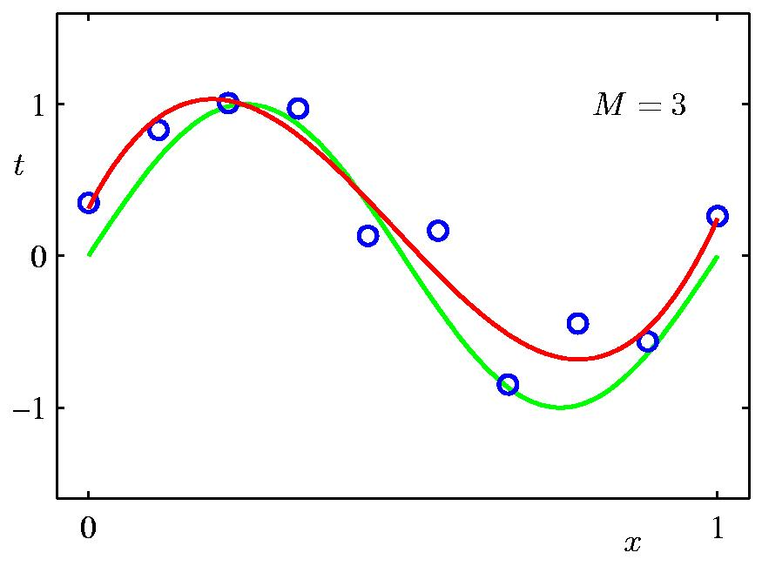
3rd Order Polynomial

Slide 50
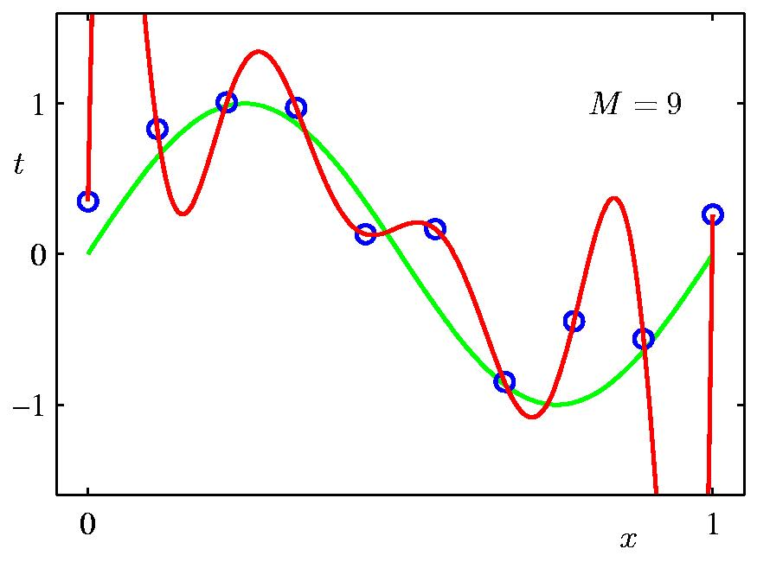
9th Order Polynomial

Slide 51
We do not know yet which is the best model, maybe the 9th degree polynomial after all.

Slide 52
Summar of Week 1
This was an introduction of the concepts, we will cover each issue more in depth in the coming weeks.
To Know from Lecture 1:
  Course information, expectations
  What is learning, different types of learning
    supervised learning, classification, regression...
    know a little about the history of learning and where ML is used
  All terminology and concepts
    raw data vs featuresfeature qualities
    training, testing, error measures
    classifier; decision boundaries/regions
    over-fitting
    ...

