Slide 1
Regression
Some slides from Prof. Milos Hauskrecht

Slide 2
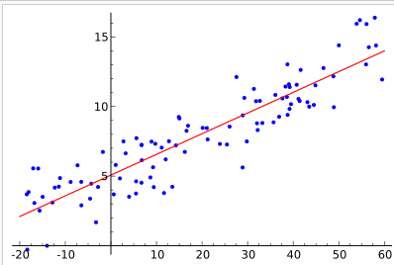
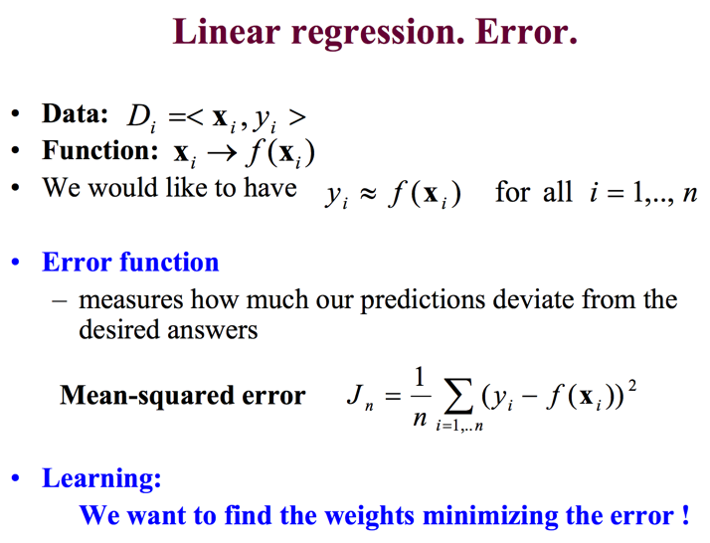
We are given some data, indicating the mapping between an independent variable x and a dependent variable y, where y_{i} = f(x_{i}) + ε_{i}, for i=1,..n
    The independent variable maybe one or more dimensional
    (denoted as x or x, respectively)
  We would like to learn f() such that

Slide 3
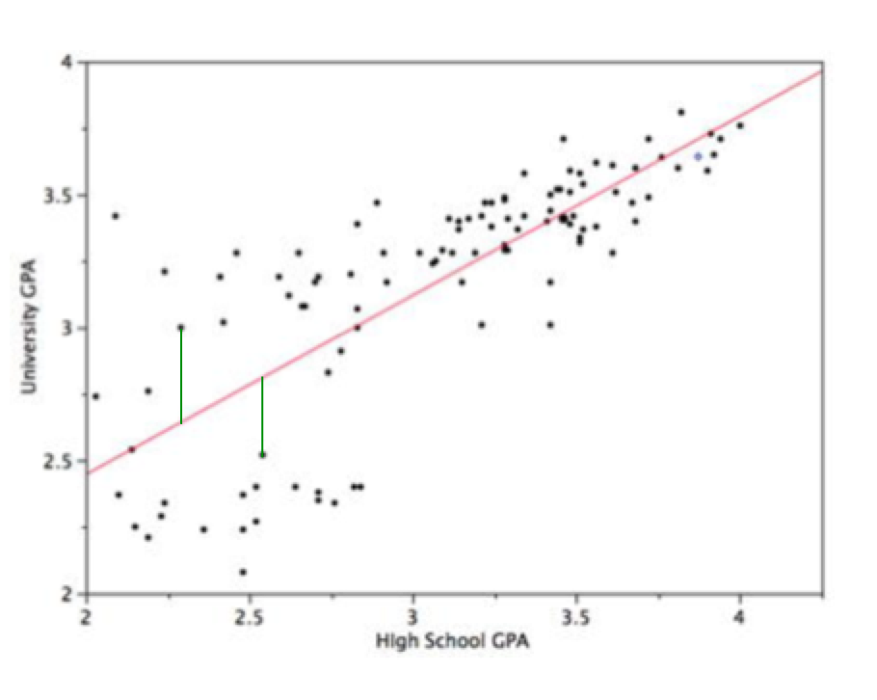
Goal
Find the function f() that minimizes the mean squared error between the estimates and the data:

Slide 4
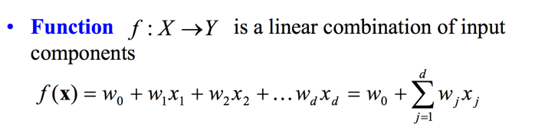
Linear Regression
In linear regression, we assume the underlying function is a linear function of the input components :
In vector notation with extended input vector x:
= x w^{T}

Slide 5
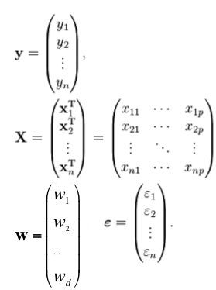
Linear Regression
We can put these together for
the whole dataset to obtain:
x
+
=

Slide 6
Given how to find w:
Many alternative solutions with different assumptions or slightly different results:
  E.g. minimize the sum of squared residuals ||y-Xw||² to find w:
  w = X⁺y = (X^{T}X)⁻¹X^{T}y
  where X+ is pseudo-inverse of X.
  Proof: Differentiate w.r.t w and remember: AA^{T} is always symmetric.
  Properties of the pseudoinverse:
    The pseudoinverse is defined and unique for all matrices.
    If X is invertible, then its pseudoinverse is the same as its inverse.
    Pseudoinverse can be computed using the singular value decomposition, or other methods
    XX⁺X=X (XX⁺)^{T}=XX⁺
    X⁺XX⁺=X⁺ (X⁺X^{)T}=X⁺X

Slide 7
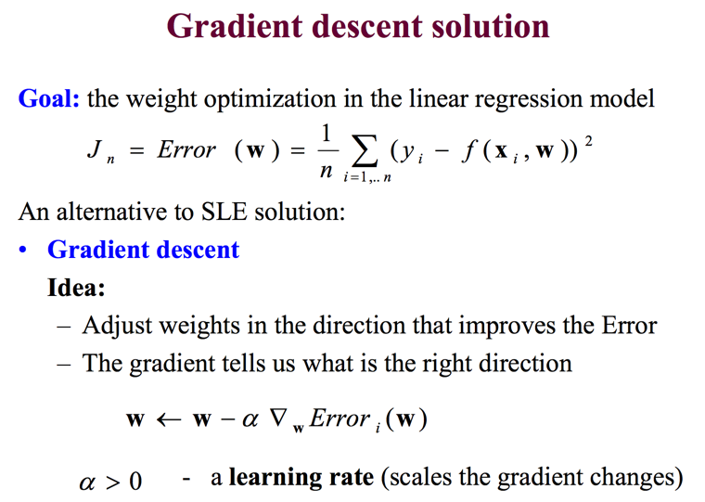
Alternative: Gradient Descent

Slide 8
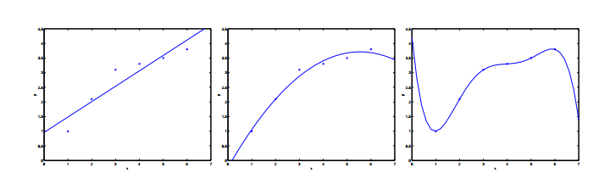
Underfitting: What if a line isn’t a good fit?
We can add more features => overfitting
  ➔ Regularization

Slide 9

Higher Order Terms
Add higher-order (product) terms:

Slide 10
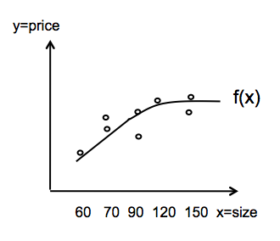
Regression
Linear regression:
Polinomial regression (of Mth degree):
Multiple linear regression:
Single independent variable, x
(ex. m2)
Multiple independent variables (features),
x
(ex. m2, floor, loc.)

Slide 11
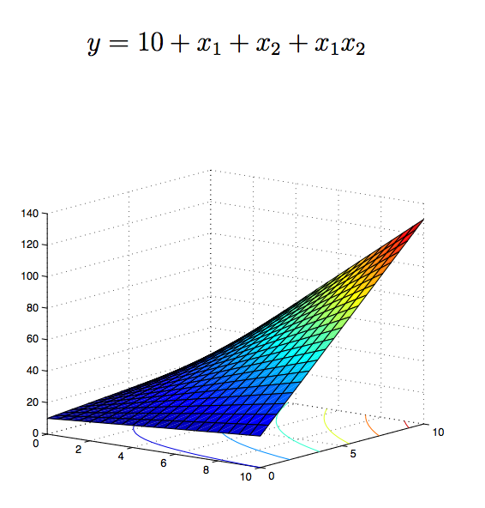
Multiple Linear Regression

Slide 12
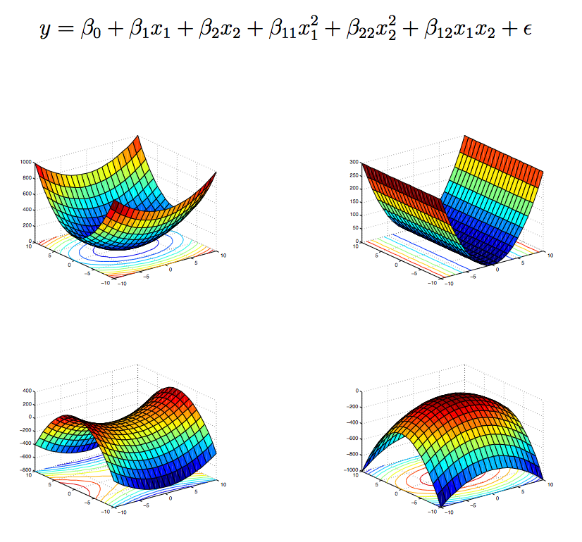
2 independent variables – 2nd degree polynomial

