Slide 1
WEKA
Machine Learning Toolbox

Slide 2
You can install Weka on your computer from
http://www.cs.waikato.ac.nz/ml/weka/downloading.html

Slide 3
See train_mnist.arff or train_iris.arff, note the format
Click Explorer button on WEKA
  Open file iris_train.arff
    You should see the screen on the next page
  On the top-right, there is an edit window where you can view, edit the arff file
  On the bottom-left, you see the attributes screen
    You can select to remove some features
  On the bottom-right (slide 4), you see the “Visualize all” sub window that shows you the distribution of features and classes

Slide 4
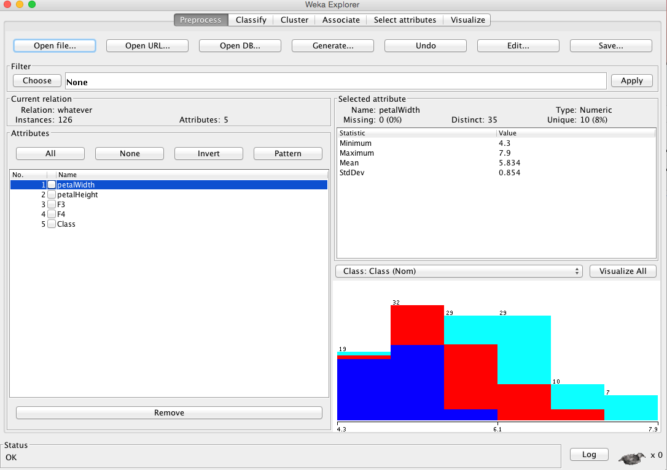

Slide 5
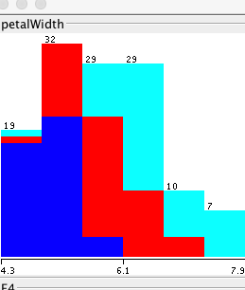
Here we see that there are 19 samples total in the first bin, most of them coming from the blue class and 1 (in this case) each from the other two classes.

Slide 6
Training
Choose Classify from Top tabs
Choose Classifier -> Trees -> J48
  You may edit parameters
    You will see what the parameters are when you hover over them; leave that for later
Test options
  You have a train file, now you can say how the testing should be:
    Using training set: This will give you training error after doing a test after training. Should be done just to see training error; does not indicate generalisation performance!
    Supplied test set: Use the training set for train AND a separate test set (e.g. iris-test.arff) for testing. Those two files must match in number of features etc.
    Cross-validation: Use k-fold CV on the training data (5 or 10 fold is often good)
    % split: Split part of the training for testing. Do this only if you have lots and lots of data. Note that the split is random, so I don’t suggest. If you want to split a part for test, do it yourself, so it is not random and you can do it stratified (making sure to take samples from each class, not just randomly)
  Choose Supplied test set and enter iris-test.arff

Slide 7
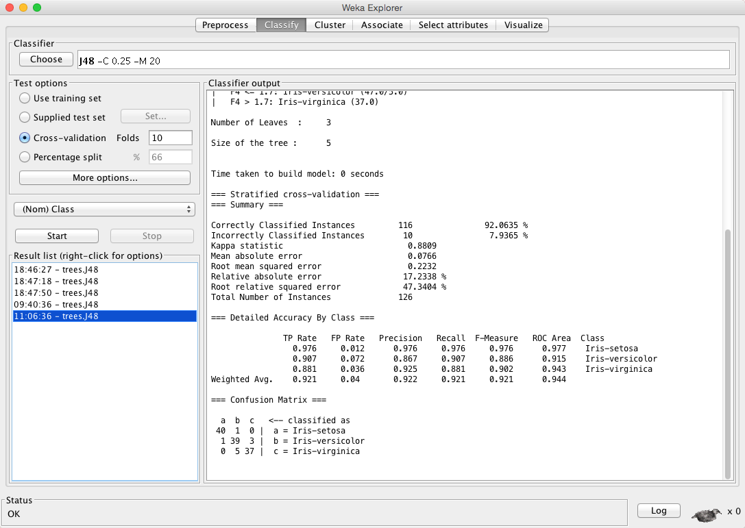

Slide 8
Interpreting the Output
After you hit Start, training starts and ends with testing. You see the whole info on the right hand side:
  === Run information ===
  Scheme:weka.classifiers.trees.J48 -C 0.25 -M 20 //The classifier used
  Relation: whatever
  Instances: 126 //number of samples/instances in the training data
  Attributes: 5
  petalWidth
  petalHeight
  F3
  F4
  Class
  Test mode:10-fold cross-validation
  === Classifier model (full training set) ===
  J48 pruned tree //This is the resulting tree (because I said have at least 20 samples in each leaf, the tree is pretty simple)
  F4 <= 0.6: Iris-setosa (42.0/1.0) //42 samples of the label (=iris-setosa) and 1 other label (whatever it is)
  F4 > 0.6
  | F4 <= 1.7: Iris-versicolor (47.0/5.0)
  | F4 > 1.7: Iris-virginica (37.0)
  Number of Leaves : 3
  Size of the tree : 5
  Time taken to build model: 0 seconds
  === Stratified cross-validation === //so it does actually stratified, which is good
  Correctly Classified Instances 116 92.0635 %
  Incorrectly Classified Instances 10 7.9365 %
  Relative absolute error 17.2338 %
  Root relative squared error 47.3404 %
  Total Number of Instances 126
  === Detailed Accuracy By Class ===
  TP Rate FP Rate Precision Recall F-Measure ROC Area Class
  0.976 0.012 0.976 0.976 0.976 0.977 Iris-setosa
  0.907 0.072 0.867 0.907 0.886 0.915 Iris-versicolor
  0.881 0.036 0.925 0.881 0.902 0.943 Iris-virginica
  Weighted Avg. 0.921 0.04 0.922 0.921 0.921 0.944
  === Confusion Matrix ===
  a b c <-- classified as
  40 1 0 | a = Iris-setosa
  1 39 3 | b = Iris-versicolor
  0 5 37 | c = Iris-virginica

Slide 9
Understanding Error Rates & Confusion Matrices
These are per-class accuracies. True Positive rate (TP) for iris-setosa means:
TP_{iris-setosa} = # correctly classified as iris-setosa / over all iris-setosas = 0.976 = 40/41
FP_{iris-setosa} = # falsely classified as iris-setosa / over all NON-iris-setosas = 0.012 = 1/ 85
(yani iris-setosa olmayanların arasından kaçına yanlışlıkla iris-setosa dedi)
=== Detailed Accuracy By Class ===
TP Rate FP Rate Precision Recall F-Measure ROC Area Class
0.976 0.012 0.976 0.976 0.976 0.977 Iris-setosa
0.907 0.072 0.867 0.907 0.886 0.915 Iris-versicolor
0.881 0.036 0.925 0.881 0.902 0.943 Iris-virginica
Weighted Avg. 0.921 0.04 0.922 0.921 0.921 0.944
=== Confusion Matrix ===
a b c <-- classified as
40 1 0 | a = Iris-setosa //Out of the 41 iris-setosas, 40 are classified as iris-setosa, 1 classified as i-versicolor
1 39 3 | b = Iris-versicolor //Out of the 43 iris-versicolor, 39 are classified as iris-versicolor, 1 classified as i-setosa…
0 5 37 | c = Iris-virginica …

Slide 10
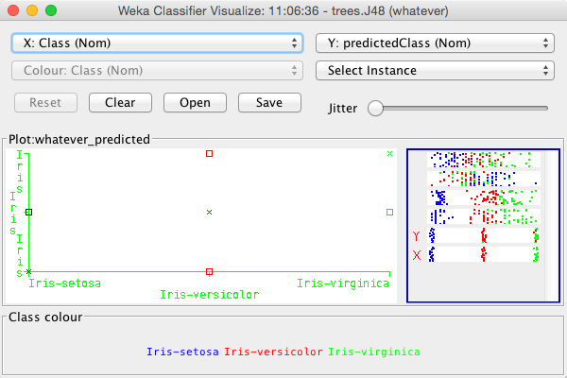
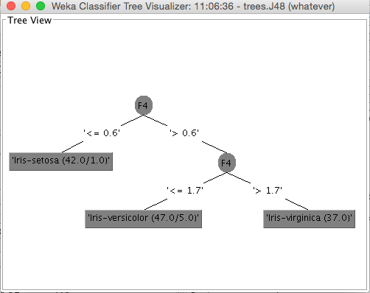
Result-list
All of your runs can be viewed in the bottom-left window
  They are ordered by time
  Click on one and you can see its results (on the right hand window)
  Furthermore, you can right-click on a run, to see several options:
    Visualize classifier error (see X axis as “actual” class and y-axis as predicted class on the bottom-left image)
    Visualize tree

Slide 11
Other sources for help:
  WEKA - Neural Network Tutorial Video
  https://www.youtube.com/watch?v=mo2dqHbLpQo
  or the full WEKA-Reference-tutorial under Lectures/

Slide 12
What To Know
File Open (in future, prepare ARFF files)
Choose a classifier
Specify test set, CV etc.
Be able to understand the output (most relevant parts for now):
  Scheme:weka.classifiers.trees.J48 -C 0.25 -M 2
    the used parameter set
  The given (sideways) tree
  Error measures:
    Correctly Classified Instances 23 95.8333 %
    Incorrectly Classified Instances 1 4.1667 %
    Total Number of Instances 24
  Confusion matrix

Slide 13
Results-List Righ-Click Options ctd.
Load and Save models are useful when training takes a long time (e.g. neural network or SVM trainings); or when you want to compare a model to a previous run.
  Note that if a learning algorithm is non-deterministic (e.g. NN starting from different initial weights)

