Slide 1
Regression

Slide 2
We have talked about regression problems before, as the problem of estimating the mapping f(x) between an independent variable x and a dependent variable y.
We assume we have a dataset D={(x_{i},t_{i})} from which to estimate this mapping.

Slide 3
In these slides, we will see:
  the expected loss in regression;
  suitable loss functions (e.g. squared error between the estimate and the actual values): (f(x) – t_{i})²
  that best estimate for f(x) that will minimize the squared error is to let y(x) = E[t|x]
  the concept of inherent noise
  simple linear regression as a specific example
You should understand everything (except hidden slides or slides marked as ADVANCED).

Slide 4
Loss for Regression

Slide 5
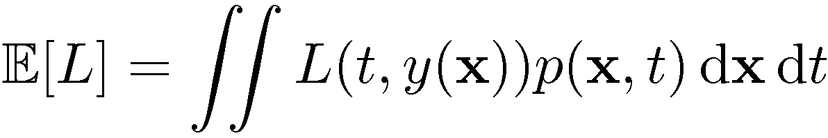
Decision Theory for Regression
Loss function for regression:

Slide 6
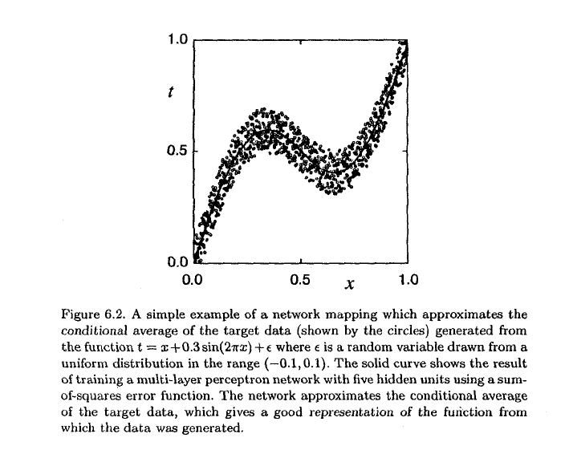
Regression
Lets first define the conditional expectation of t given x:
E[t|x] = Σ t.p(t|x)
t

Slide 7
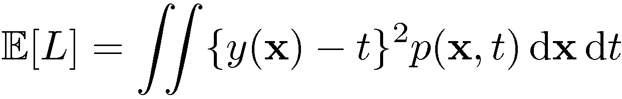
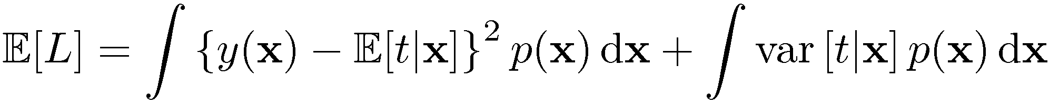
The Squared Loss Function
If we used the squared loss as loss function:
After some calculations (next slides), we can show that:
here var[t|x] = Integral {E[t|x]-t}²dt

Slide 8
Explanation: ADVANCED
Consider the first term inside the loss:
This is equal to:
since dx doesn’t depend on t,
we can move out of the integral; then the integral
∫p(x,t)dt
amounts to 1
as we are summing prob.s
through all possible t

Slide 9
Explanation: ADVANCED
Consider the second term inside the loss:
This is equal to zero:
since doesn’t depend on t,
we can move out of the integral

Slide 10
Explanation for last step: ADVANCED
E[t|x] does not vary with different values of t, so it can be moved out.
Notice that you could also immediately see that the expected value of differences from the mean for the random variable t is 0 (first line of the formula).

Slide 11
Explanation: ADVANCED
Consider the third term:

Slide 12

IMPORTANT RESULTS
Hence we have:
The first term is minimized when we select y(x) as
The second term is independent of y(x) and represents the intrinsic variability of the target
  It is called the intrinsic error.

Slide 13
Alternative approach/explanation
Using the squared error as the loss function:
We want to choose y(x) to minimize the expected loss:

Slide 14
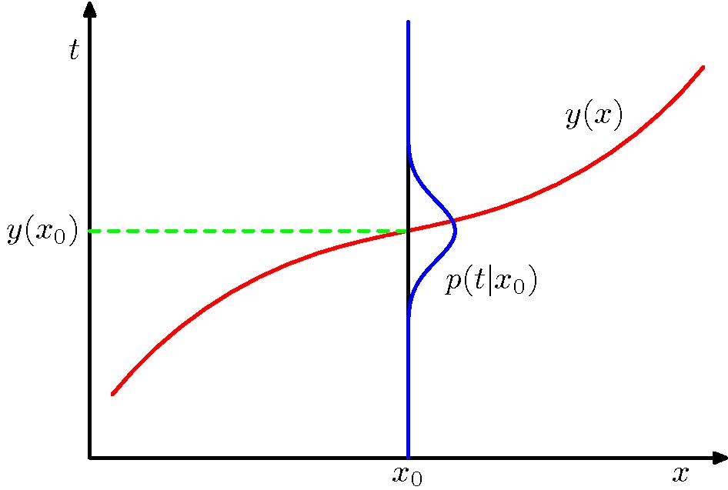
Solving for y(x), we get:

Slide 15
Inverse Problems

Slide 16
Linear Regression
Some content from
Milos Hauskrecht
in this section.
milos@cs.pitt.edu

Slide 17
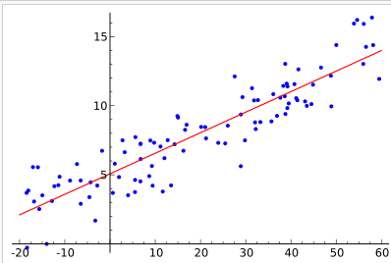
y
y_{i}=h(x_{i}) + noise
x

Slide 18

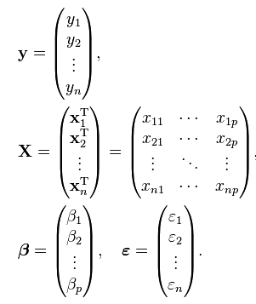
We have a regression problem where we would like to estimate the scalar dependent variable y in terms of a linear function of the independent variable x as:
We can put these together for
the whole dataset to obtain:
  y = Xβ + ε

Slide 19
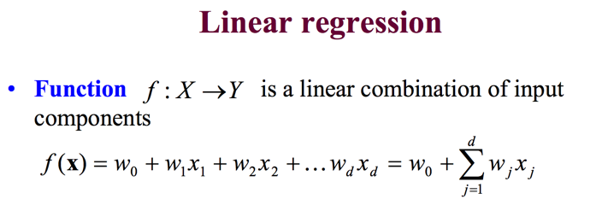
In vector notation with extended input vector x:

Slide 20
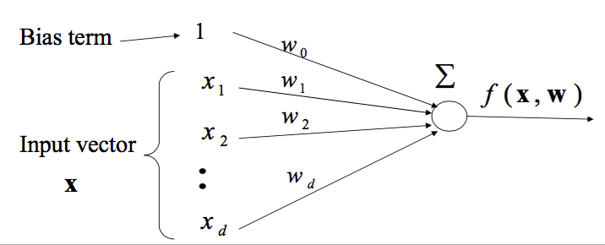
Note the similarity to a linear neuron:

Slide 21
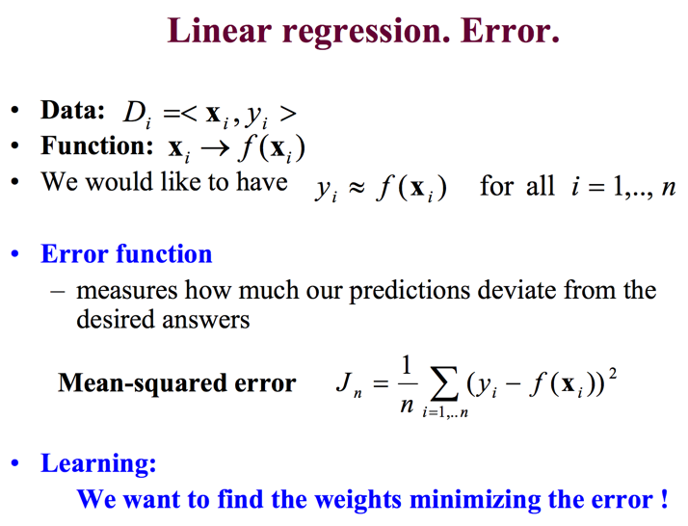

Slide 22
Many alternative solutions with different assumptions or slightly different results:
  Ordinary Least Squares minimizes the sum of squared residuals ||y-Xβ||² to find β as
  β = (X^{T}X)⁻¹X^{T}y = X⁺y
  where
  y=Xβ+ε
  and X+ is pseudo-inverse of X.
  Maximum Likelihood estimation
  Gradient descent
  ...

Slide 23
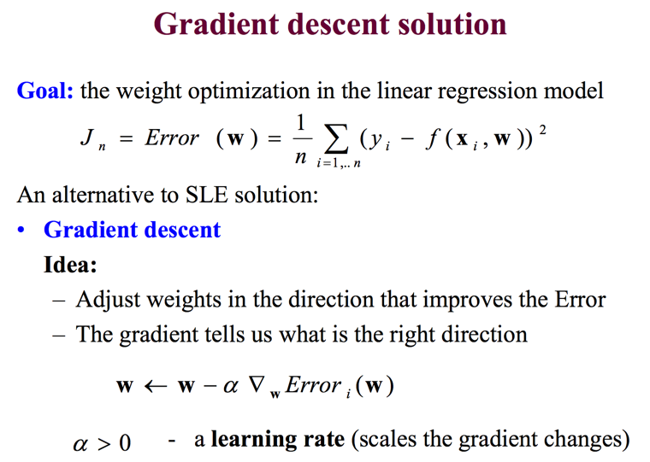

Slide 24
Bias Variance Decomposition
REST NOT COVERED

Slide 25
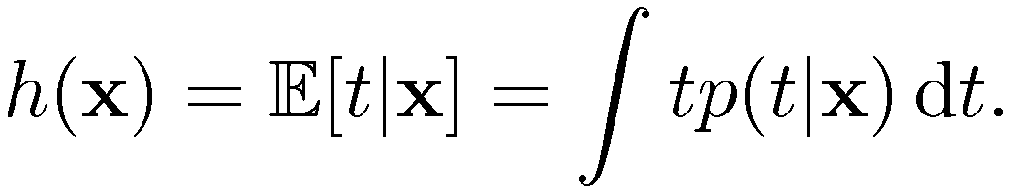
The Bias-Variance Decomposition (1)
Recall the expected squared loss,
where
We said that the second term corresponds to the noise inherent in the random variable t.
What about the first term?

Slide 26
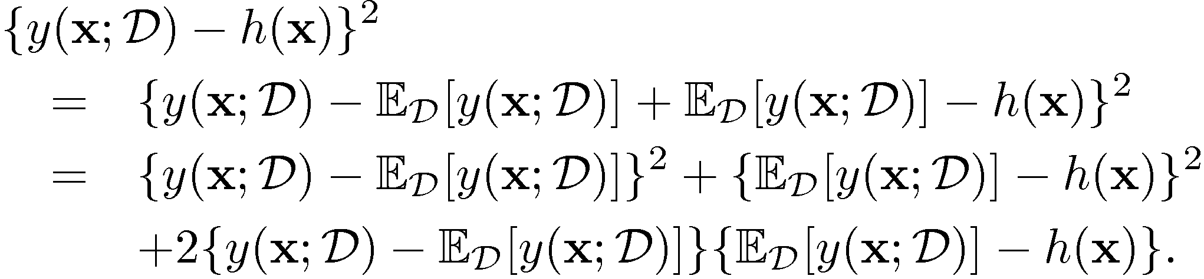
The Bias-Variance Decomposition (2)
Suppose we were given multiple data sets, each of size N.
Any particular data set, D, will give a particular function y(x; D).
Consider the error in the estimation:

Slide 27
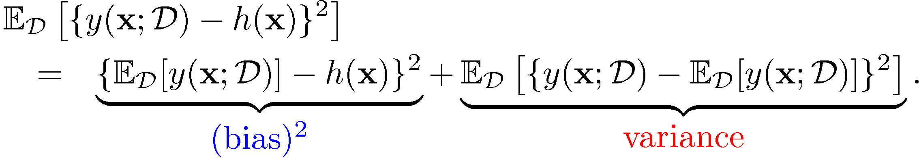
The Bias-Variance Decomposition (3)
Taking the expectation over D yields:

Slide 28
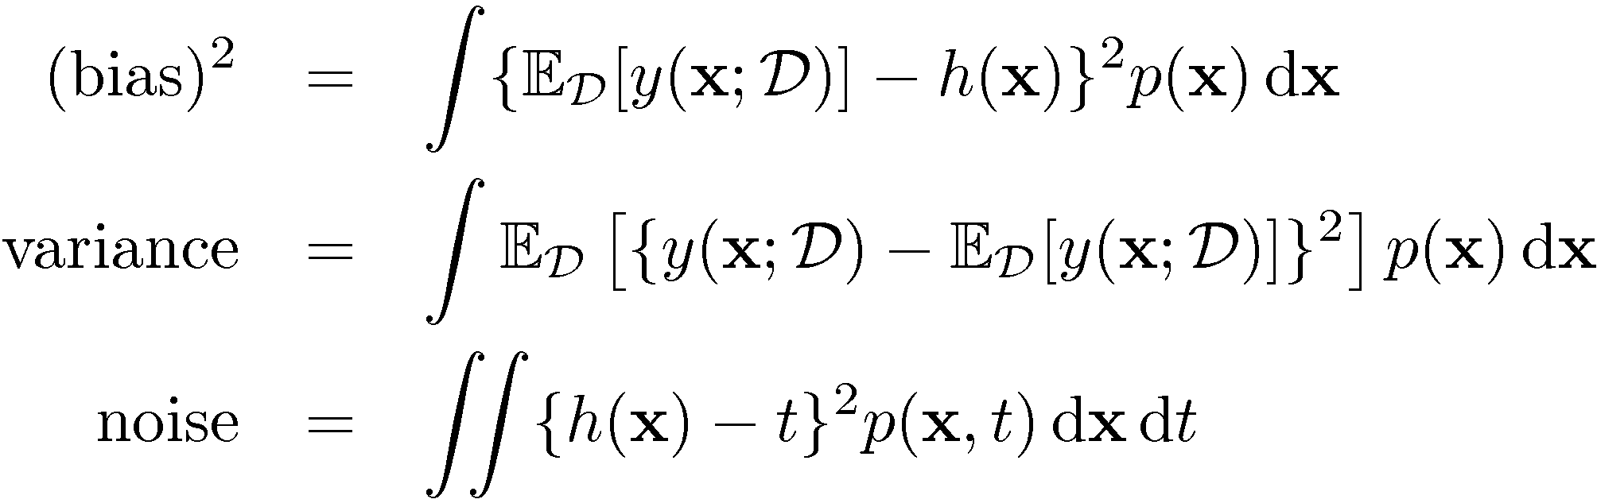
The Bias-Variance Decomposition (4)
Thus we can write
where

Slide 29
Bias measures how much the prediction (averaged over all data sets) differs from the desired regression function.
Variance measures how much the predictions for individual data sets vary around their average.
There is a trade-off between bias and variance
As we increase model complexity,
bias decreases (a better fit to data) and
variance increases (fit varies more with data)

Slide 30
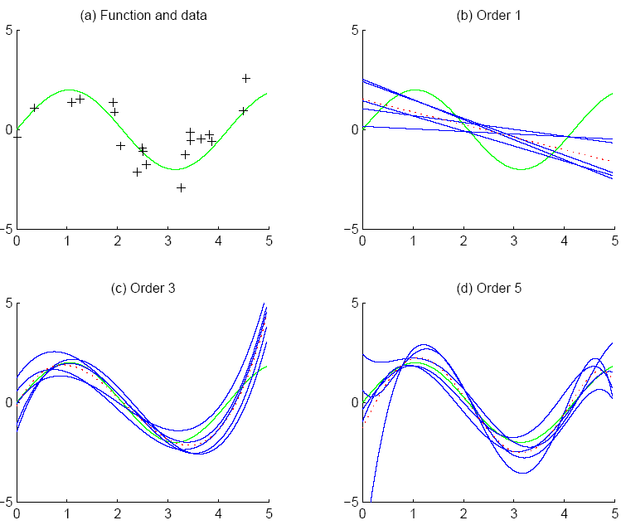
f
f
bias
g_{i}
g
variance

