Slide 1
Bayesian Learning
Machine Learning by Mitchell-Chp. 6
Ethem Chp. 3 (Skip 3.6)
Pattern Recognition & Machine Learning by Bishop Chp. 1
Berrin Yanikoglu
last edited Oct 2017

Slide 2
Basic Probability

Slide 3
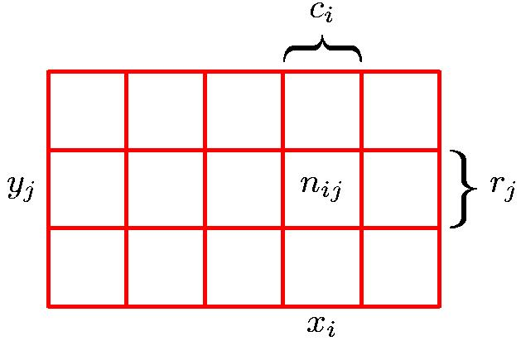
Probability Theory
Marginal Probability of X
Conditional Probability of Y given X
Joint Probability of X and Y

Slide 4
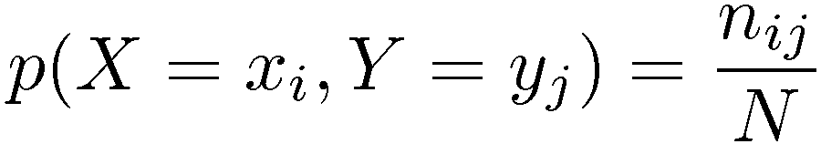
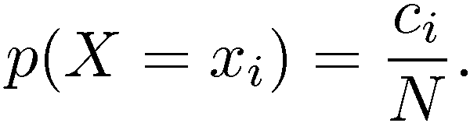
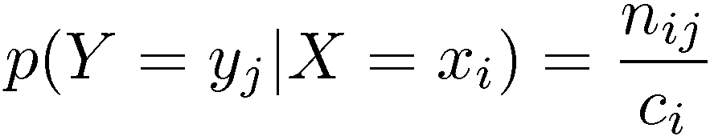
Probability Theory
Joint Probability of X and Y
Marginal Probability of X
Conditional Probability of Y given X

Slide 5
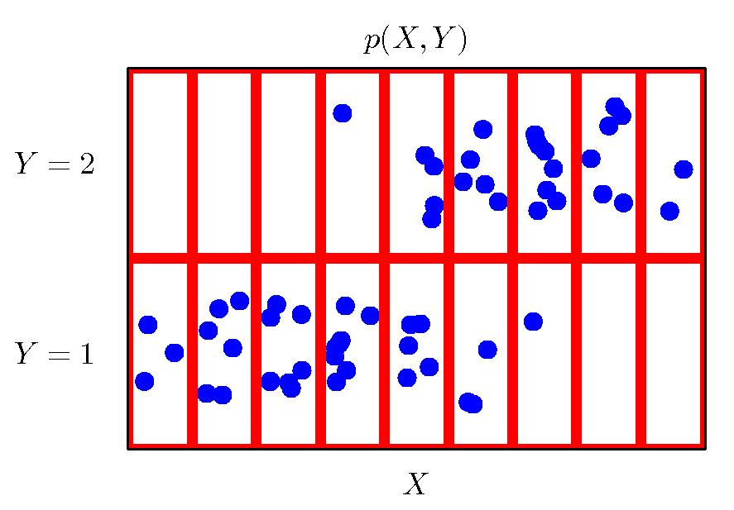
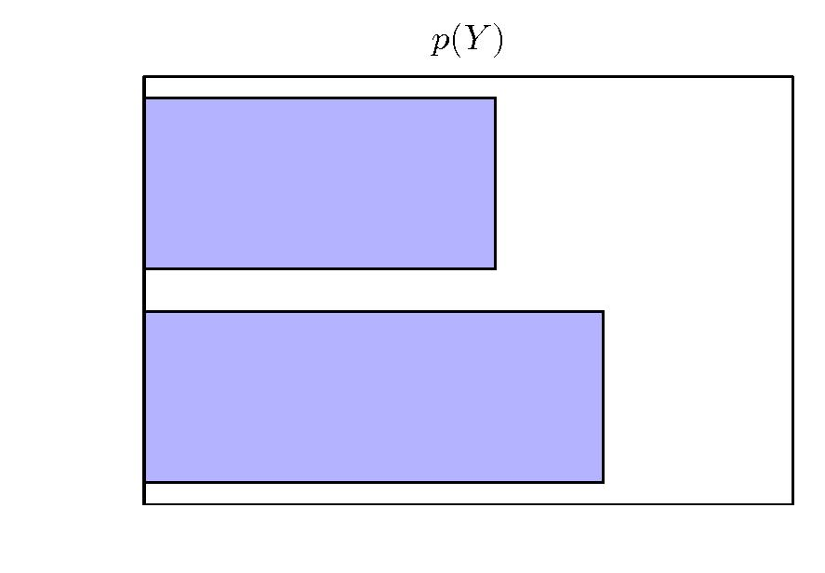
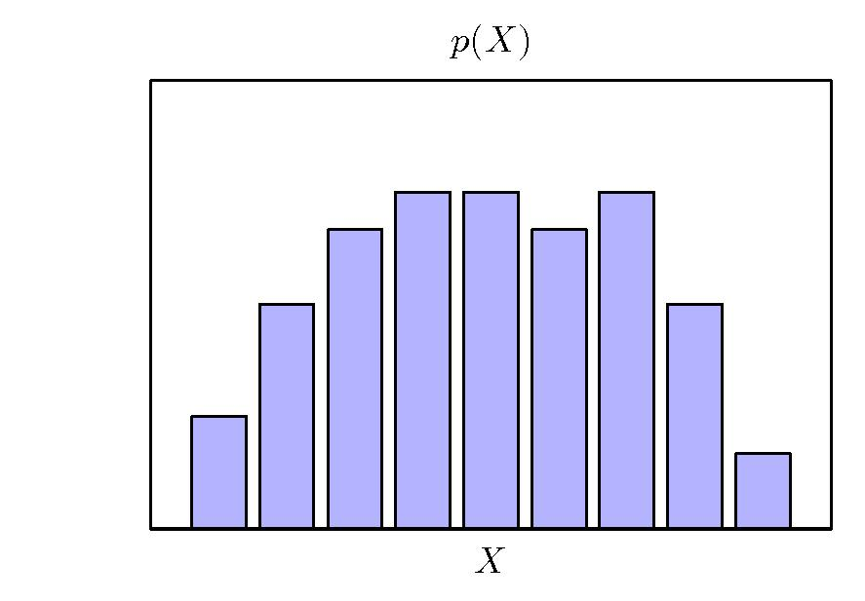
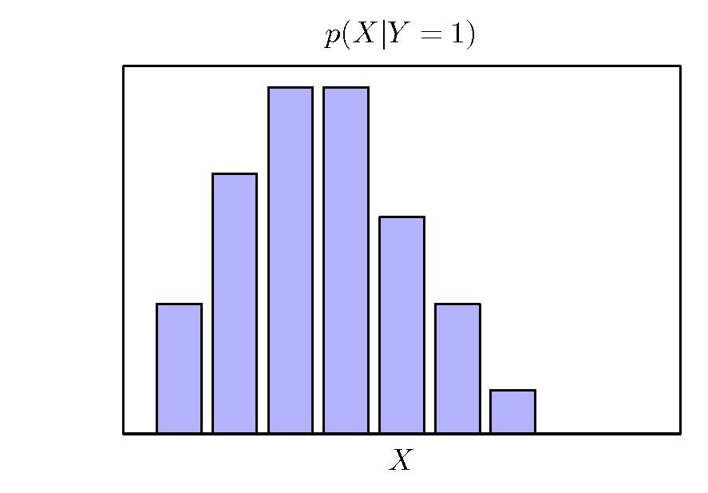
Probability Theory

Slide 6
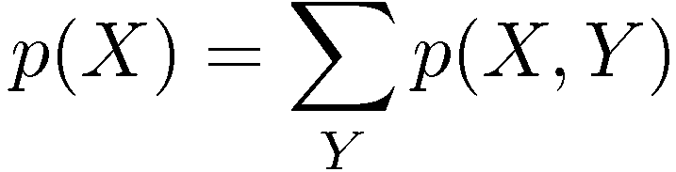

Probability Theory
Sum Rule
Product Rule
Notes:
6

Slide 7
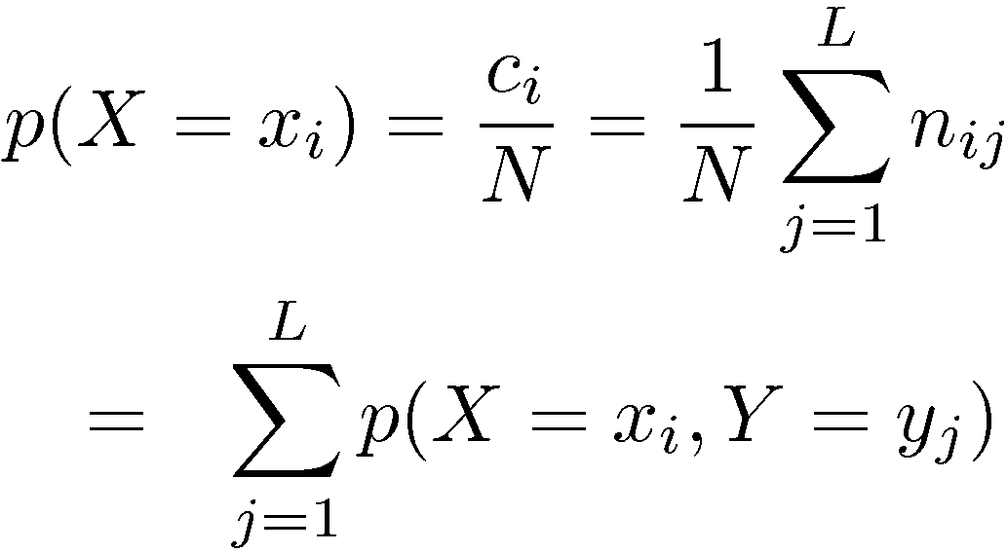
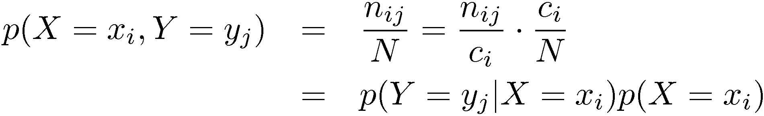
Probability Theory
Sum Rule
Product Rule

Slide 8
Bayesian Decision Theory

Slide 9
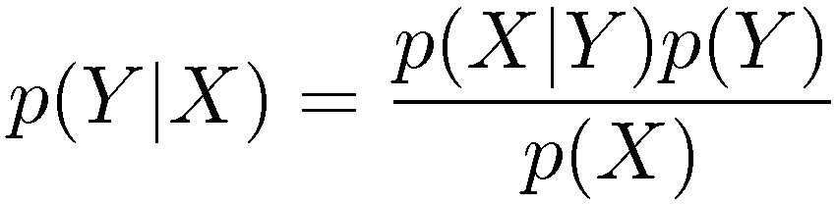
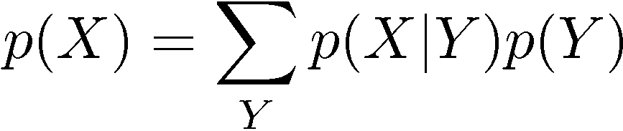
Bayes’ Theorem
Using this formula for classification problems, we get
P(C| X) = P (X |C) P(C) / P(X)
posterior probability = α x class conditional probability x prior

Slide 10
Bayesian Decision
Consider the task of classifying a certain fruit as Orange (C₁) or Tangerine (C₂) based on its measurements, x. In this case we will be interested in finding P(C_{i}| x). That is how likely for it to be an orange/tangerine given its features?
If you have not seen x, but you still have to decide on its class Bayesian decision theory says that we should decide by prior probabilities of the classes.
  Choose C₁ if P(C₁) > P(C₂) :prior probabilities
  Choose C₂ otherwise

Slide 11

Bayesian Decision
2) How about if you have one measured feature X about your instance?
e.g. P(C₂ |x=70)
10 20 30 40 50 60 70 80 90

Slide 12
Definition of probabilities
27 samples in C₂
19 samples in C₁
Total 46 samples
P(C₁,X=x) = num. samples in corresponding box
num. all samples
//joint probability of C₁ and X
P(X=x|C₁) = num. samples in corresponding box
num. of samples in C₁-row
//class-conditional probability of X
P(C₁) = num. of of samples in C₁-row
num. all samples
//prior probability of C₁
P(C1,X=x) = P(X=x|C₁) P(C₁)
Bayes Thm.

Slide 13

Bayesian Decision
Histogram representation better highlights the decision problem.

Slide 14
Bayesian Decision
You would minimize the number of misclassifications if you choose the class that has the maximum posterior probability:
    Choose C₁ if p(C₁|X=x) > p(C₂|X=x)
    Choose C₂ otherwise
  Equivalently, since p(C₁|X=x) =p(X=x|C₁)P(C₁)/P(X=x)
    Choose C₁ if p(X=x|C₁)P(C₁) > p(X=x|C₂)P(C₂)
    Choose C₂ otherwise
  Notice that both p(X=x|C₁) and P(C₁) are easier to compute than P(C_{i}|x).

Slide 15
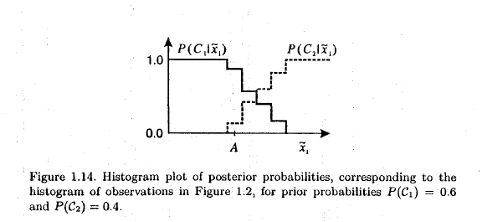
Posterior Probability Distribution

Slide 16
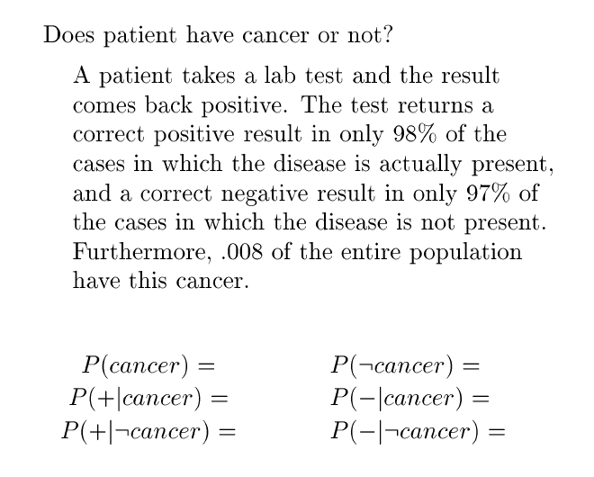
Example to Work on

Slide 17
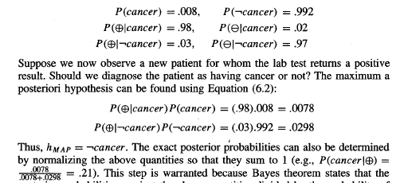

Slide 18
You should be able:
  E.g. derive marginal and conditional probabilities given a joint probability table.
  Use them to compute P(Ci |x) using the Bayes theorem
  Solve problems that are verbally stated as in the previous slide
  ...

Slide 19
PROBABİLİTY DENSİTİES FOR CONTİNUOUS VARİABLES

Slide 20
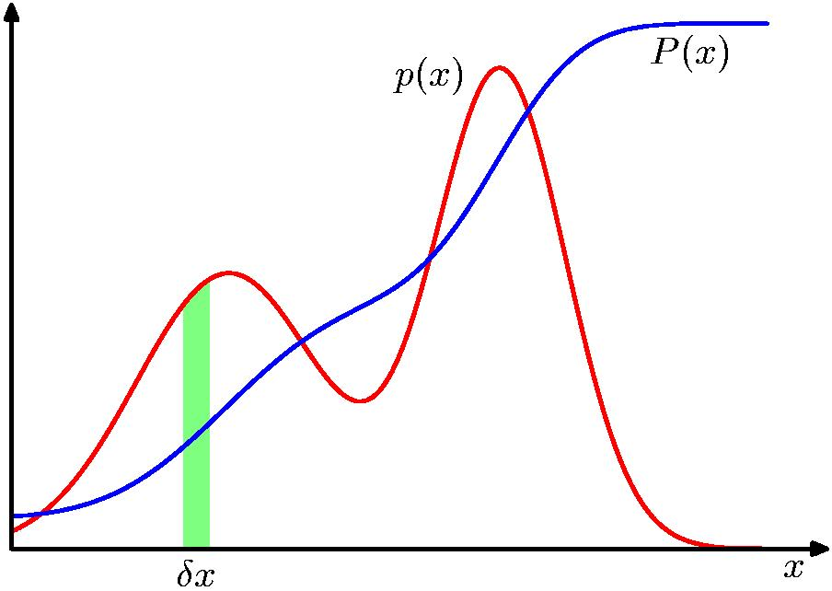
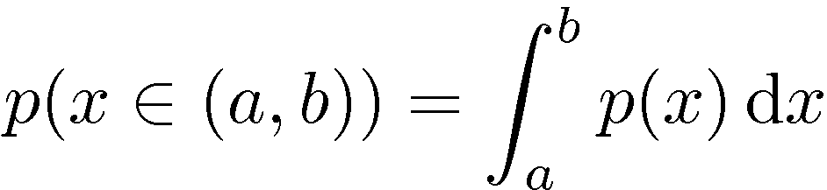
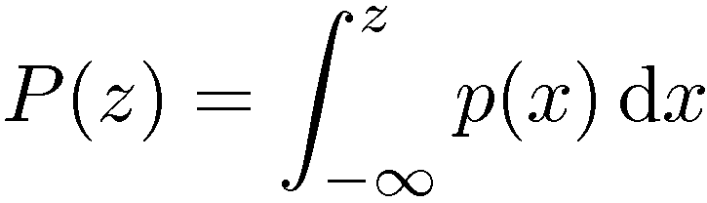
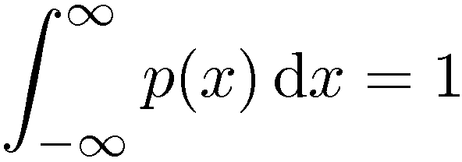

Probability Densities
Cumulative Probability

Slide 21

Probability Densities
P(x ∈ [a, b]) = 1 if the interval [a, b] corresponds to the whole of X-space.
Note that to be proper, we use upper-case letters for probabilities and lower-case letters for probability densities.
For continuous variables, the class-conditional probabilities introduced above become class-conditional probability density functions, which we write in the form p(x|C_{k}).

Slide 22

Multible attributes
If there are d variables/attributes x₁,...,x_{d}, we may group them into a vector x =[x₁,... ,x_{d}]^{T} corresponding to a point in a d-dimensional space.
The distribution of values of x can be described by probability density function p(x), such that the probability of x lying in a region R of the d-dimensional space is given by
Note that this is a simple extension of integrating in a 1d-interval, shown before.

Slide 23



Bayes Thm. w/ Probability Densities
The prior probabilities can be combined with the class conditional densities to give the posterior probabilities P(C_{k}|x) using Bayes‘ theorem (notice no significant change in the formula!):
p(x) can be found as follows (though not needed) for two classes which can be generalized for k classes:

Slide 24
Curse of Dimensionality

Slide 25
Curse of Dimensionality
In a learning task, it seems like adding more attributes would help the learner, as more information never hurts, right?
In fact, sometimes it does, due to what is called
curse of dimensionality.

Slide 26
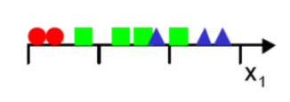
In a toy learning problem (tx to Gutierrez-Osuna), our algorithm:
  divides the feature space uniformly into bins and
  for each new example that we want to classify, we just need to figure out the bin the example falls into and find the predominant class in that bin as the label.
  One feature where the input space is divided into 3 bins:
  Noticing the overlap, we add one more feature:

Slide 27
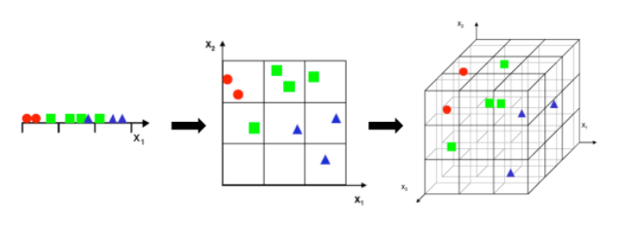
Now the problem is apparent: With increasing dimensionality, the number of bins required to cover the feature space increases exponentially and there won’t be enough data to populate each bin.
  Finding the predominant class in each bin or finding the class condional probabilities (p(x given C) is very difficult in high dimensional spaces.

Slide 28
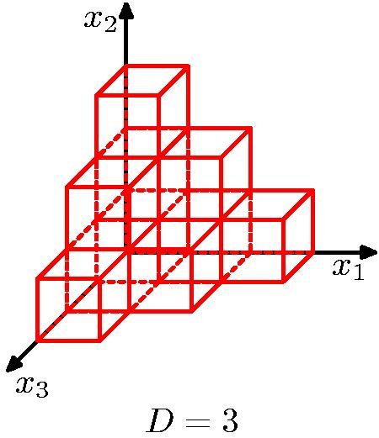
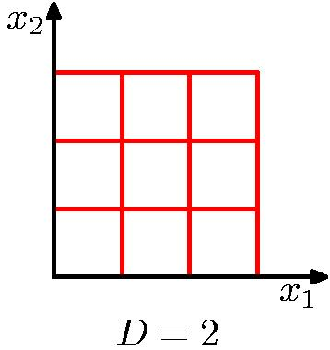
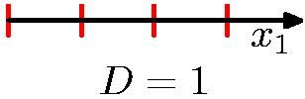
Curse of Dimensionality
As dimensionality D increases, the amount of data needed increases
exponentially with D.

Slide 29
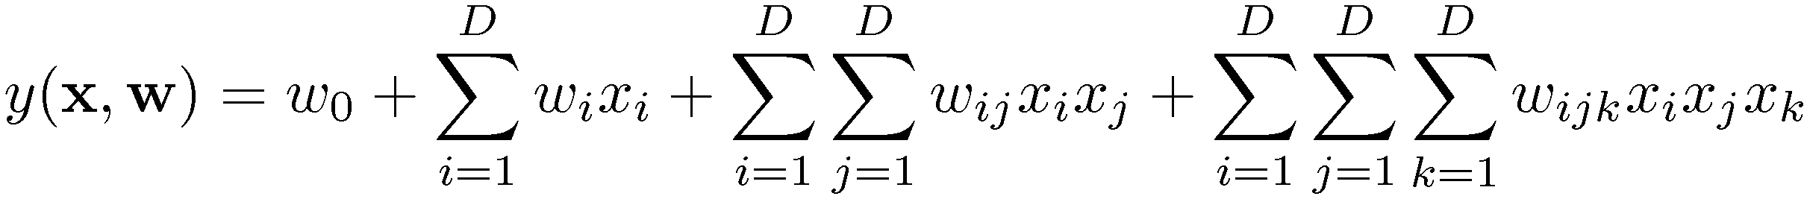
Curse of Dimensionality
Polynomial curve fitting, M = 3
Number of independent coefficients grows proportionally to D³ where D is the number of variables
More generally, for an M dimensional polynomial, number of coefficients are D^{M}
The polynomial becomes unwieldy very quickly.

Slide 30
We can still find effective techniques applicable to high-dimensional spaces
  Real data will often be confined to a region of the space having
  lower effective dimensionality
  Real data will typically exhibit smoothness properties
Feature selection
Dimensionality reduction
Controlling model complexity
Different classifiers may be significantly affected by the curse of dimensionality or not.

Slide 31
DECİSİON REGIONS AND DISCRIMINANT FUNCTIONS

Slide 32

Decision Regions
Assign a feature x to C_{k} if C_{k}=argmax (P(C_{j}|x))
j
Equivalently, assign a feature x to C_{k} if:
This generates c decision regions R₁…R_{c} such that a point falling in region R_{k} is assigned to class C_{k}.
Note that each of these regions need not be contiguous.
The boundaries between these regions are known as decision surfaces or decision boundaries.

Slide 33


Discriminant Functions
Although we have focused on probability distribution functions, the decision on class membership in our classifiers has been based solely on the relative sizes of the probabilities.
This observation allows us to reformulate the classification process in terms of a set of discriminant functions y₁(x),...., y_{c}(x) such that an input vector x is assigned to class C_{k} if:
We can recast the decision rule for minimizing the probability of misclassification in terms of discriminant functions, by choosing:

Slide 34
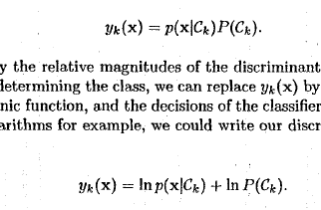
Discriminant Functions
We can use any monotonic function of y_{k}(x) that would simplify calculations, since a monotonic transformation does not change the order of y_{k}’s.

Slide 35
Classification Paradigms
In fact, we can categorize three fundamental approaches to classification:
Generative models: Model p(x|C_{k}) and P(C_{k}) separately and use the Bayes theorem to find the posterior probabilities P(C_{k}|x)
  E.g. Naive Bayes, Gaussian Mixture Models, Hidden Markov Models,…
Discriminative models:
  Determine P(C_{k}|x) directly and use in decision
  E.g. Linear discriminant analysis, SVMs, NNs,…
Find a discriminant function f that maps x onto a class label directly without calculating probabilities
Advantages? Disadvantages?

Slide 36

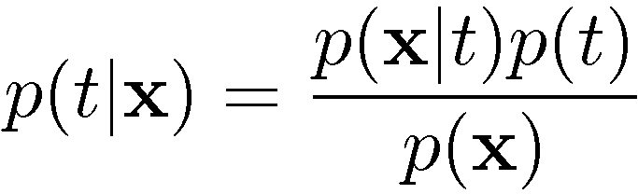

Generative vs Discriminative
In more general terms covering regression as well:
Generative approach:
Model
Use Bayes’ theorem
Discriminative approach:
Model directly

Slide 37
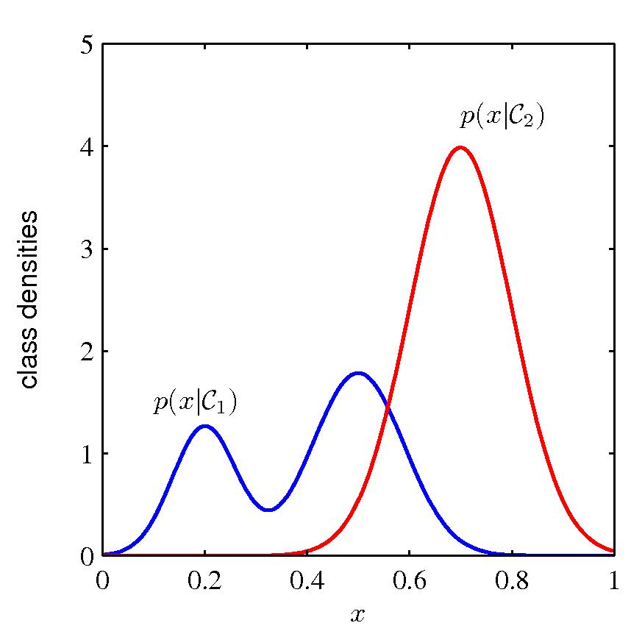
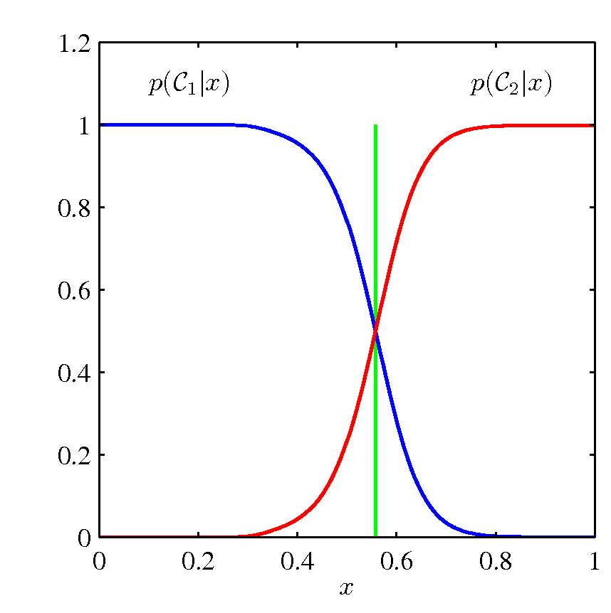
Generative vs Discriminative Model Complexities

Slide 38
Why Separate Inference and Decision?
Having probabilities are useful (greys are material not yet covered):
Minimizing risk (loss matrix may change over time)
  If we only have a discriminant function, any change in the loss function would require re-training
Reject option
  Posterior probabilities allow us to determine a rejection criterion that will minimize the misclassification rate (or more generally the expected loss) for a given fraction of rejected data points
Unbalanced class priors
  Artificially balanced data
  After training, we can divide the obtained posteriors by the class fractions in the data set and multiply with class fractions for the true population
Combining models
  We may wish to break a complex problem into smaller subproblems
    E.g. Blood tests, X-Rays,…
  As long as each model gives posteriors for each class, we can combine the outputs using rules of probability. How?

Slide 39
Naive Bayes Classifier
Mitchell [6.7-6.9]

Slide 40
Naïve Bayes Classifier
Assume we want to classify x described by attributes [a₁,...a_{n}].
Bayes theorem tells us to find Cj for which this is maximum:
    P(C_{j} | x) = P (x | C_{j}) P(C_{j})
This is expressed as
    C = argmax P (x | C_{j}) P(C_{j})
    j

Slide 41
Naïve Bayes Classifier
But it requires a lot of data to estimate (roughly O(|A|^{n}) parameters for each class):
P(a₁,a₂,…a_{n}| C_{j})
Naïve Bayesian Approach: We assume that the attribute values are conditionally independent given the class v_{j} so that
P(a₁,a₂,..,a_{n}|C_{j}) =∏_{i} P(a_{i}|C_{j})
Naïve Bayes Classifier:
C_{NB} = argmax_{Cj∈ C} P(C_{j}) ∏_{i} P(a_{i}|C_{j})

Slide 42
Independence
If P(X,Y)=P(X)P(Y)
the random variables X and Y are said to be independent.
Since P(X,Y)= P(X | Y) P(Y) by definition, we have the equivalent definition of P(X | Y) = P(X)
Independence and conditional independence are important because they significantly reduce the number of parameters needed and reduce computation time.
Consider estimating the joint probability distribution of two random variables A and B:
  10x10=100 vs 10+10=20 if each have 10 possible outcomes
  100²=10,000 vs 100+100=200 if each have 100 possible outcomes

Slide 43
Conditional Independence
We say that X is conditionally independent of Y given Z if the probability distribution governing X is independent of the value of Y given a value for Z.
(∀x_{i},y_{j},z_{k}) P(X=x_{i}|Y=y_{j},Z=z_{k})=P(X=x_{i}|Z=z_{k})
Or simply: P(X|Y,Z)=P(X|Z)
Using Bayes thm, we can also show:
P(X,Y|Z) = P(X|Z) P(Y|Z) since:
P(X|Y,Z)P(Y|Z)
P(X|Z)P(Y|Z)

Slide 44
Naive Bayes Classifier - Derivation
P(F₁,F₂,F₃| C) = P(F₃|F₁,F₂,C) P(F₂|F₁,C) P(F₁|C)
44
Use repeated applications of the definition of conditional probability.
Expanding just using the Bayes theorem:
Assume that each is conditionally independent of every other for given C:
Then with these simplifications, we get:
P(F1,F2,F3| C) = P(F3|C) P(F2|C) P(F1|C)

Slide 45
Mitchell book uses a target value v_{j} rather than target class C_{j} in the following slides:

Slide 46
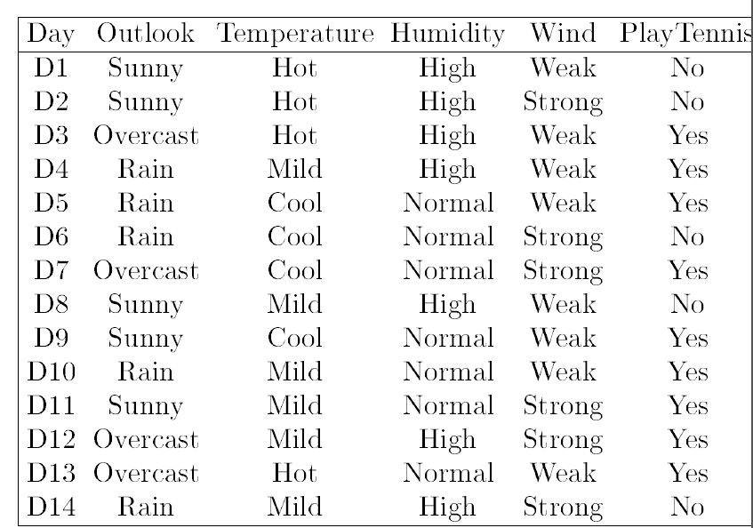
Example from Mitchell Chp 3.

Slide 47
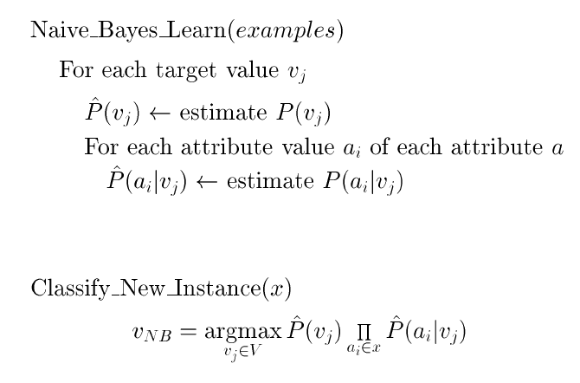
Naïve Bayes Classifier-Algorithm
I.e. Estimate P(v_{j}) and P(a_{i}|v_{j}) –
possibly by counting occurence of each class an each attribute in each class among all examples

Slide 48
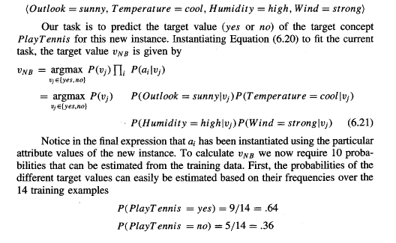
Naïve Bayes Classifier-Example

Slide 49
Illustrative Example

Slide 50
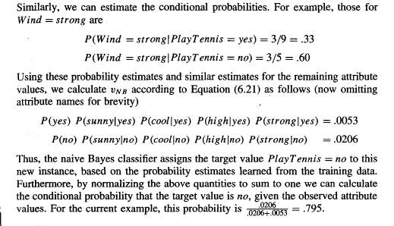
Illustrative Example

Slide 51
Estimating the PROBABILITIES

Slide 52
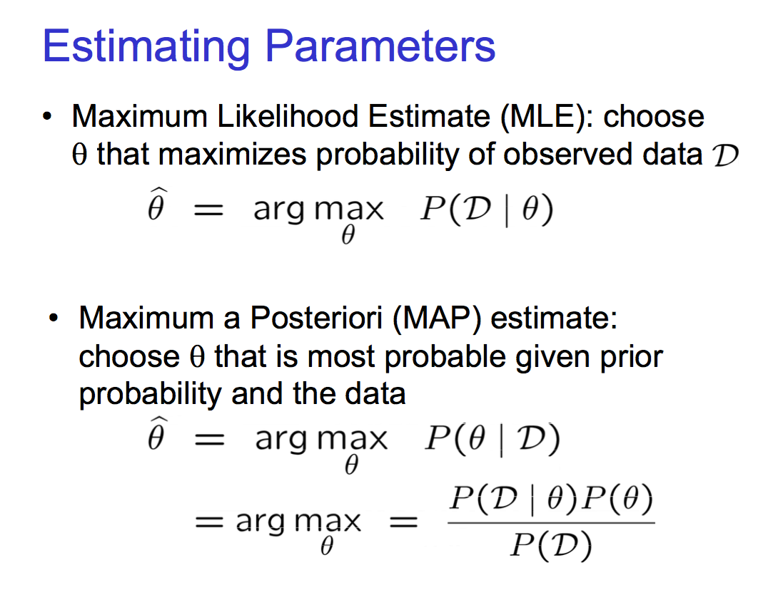

Slide 53
Binomial Distribution
n independent trials each of which results in success with probability of p (each a Bernouilli trial),
binomial distribution gives the probability distribution of the number of successes (x out of n)
        P(x) = (n choose x) p^{x} (1-p)^{(n-x)}
      e.g. You flip a coin 10 times with P_{Heads}=0.6
      What is the probability of getting 8 H, 2T?
        P(8) = (10 choose 8) p⁸ (1-p)²

Slide 54

Multinomial Distribution
Generalization of Binomial distribution
n independent trials, each of which results in one of the k outcomes with probabilities p_{k}
multinomial distribution gives the probability of any particular combination of numbers of successes for the various categories k.
    e.g. You have balls in three colours in a bin (3 balls of each color => p_{R}=p_{G}=p_{B}), from which you draw n=9 balls with replacement. What is the probability of getting 8 Red, 1 Green, 0 Blue. e.g. p(8,1,0)=?
    P(x₁,x₂,x₃) =

Slide 55
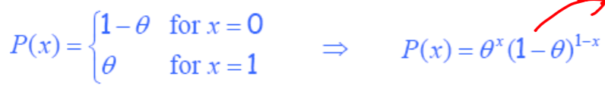
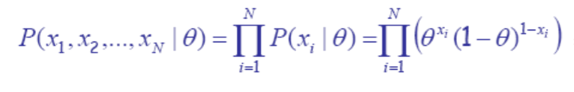
Estimating the parameters of a Bernoulli model
Assume we do a coin flipping experiment where we get
5H and 2T in n i.i.d coin tosses
The parameter to estimate is Θ=p (probability of Heads)
The probability of a single outcome x is
Likelihood of Θ given the dataset D=(x₁,...,x_{N}) is:
L(Θ) =

Slide 56
Setting the gradient of the log likelihood to zero, and solving for Θ, we get
Θ_hat = Number of heads / Number of trials = 5 / 7
Similar calculations for estimating the parameters of a Gaussian, or the parameters of the Multinomial distribution... (more on these later).
You should read more about MLE in parameter_estimation slides.

Slide 57
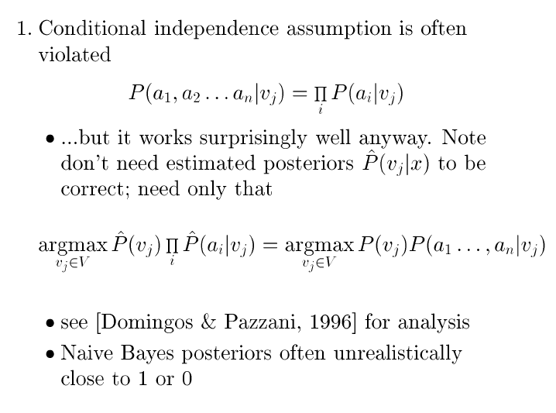
Naive Bayes Subtleties

Slide 58
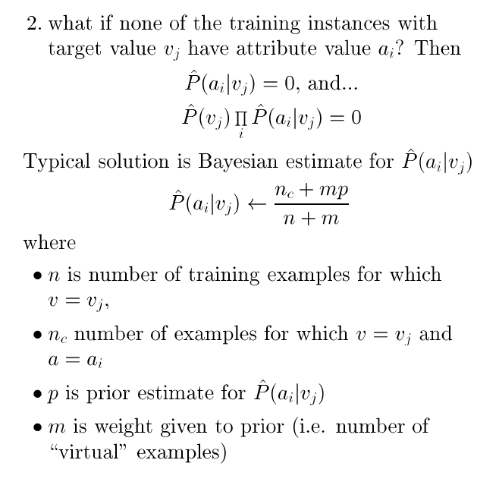
Naive Bayes Subtleties

Slide 59
Recap and Notational Variations

Slide 60
Classification w/ BinaryFeatures
Binary features: j=1..d
If x_{j} are conditionally independent (Naive Bayes’ assumption):
------------------------------------------------------------------------------
Estimated parameters
r^{t}_{i}=1 if x^{t} in C_{i}
0 otherwise

Slide 61
Other notation for Binary Random Vars.
Fraction of samples in class i (x^{t} where y^{t}=i) ,
with feature x^{t}_{j} =1

Slide 62
Classification with Discrete Features
Multinomial (1-of-n_{j}) features: x_{j} ∈ {v₁, v₂,..., v_{nj}}
if x_{j} are conditionally independent
-------------------------------------------------------------------------------
Estimated parameters:
It is OK if you dont get
this notation with zjk,
but you should understand the calculation of the probabilities pijk given below –as done with weather example.

Slide 63
Probability of Error

Slide 64
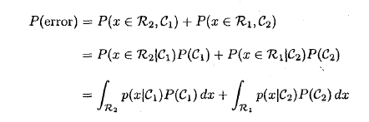
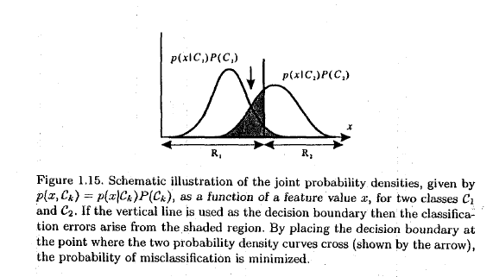
Probability of Error
For two regions R1 & R2 (you can generalize):
probability of x being in R₂ & but from Class C₁
probability of x being in R₁ & but from Class C₂
Arrow (not the vertical line) indicates ideal decision boundary (not necessarily the case if priors were not taken into account!).
Notice that shaded region would diminish with the ideal decision.

Slide 65
Justification for the Decision Criteria based on Max. Posterior Probability

Slide 66
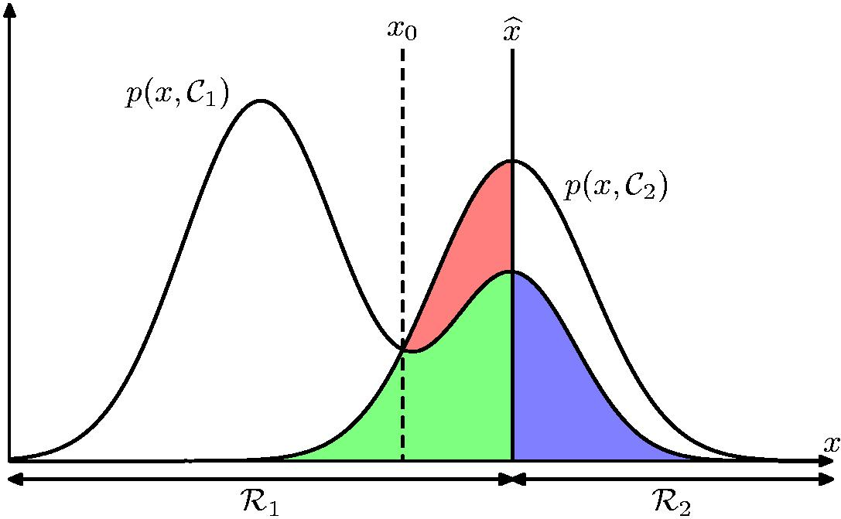
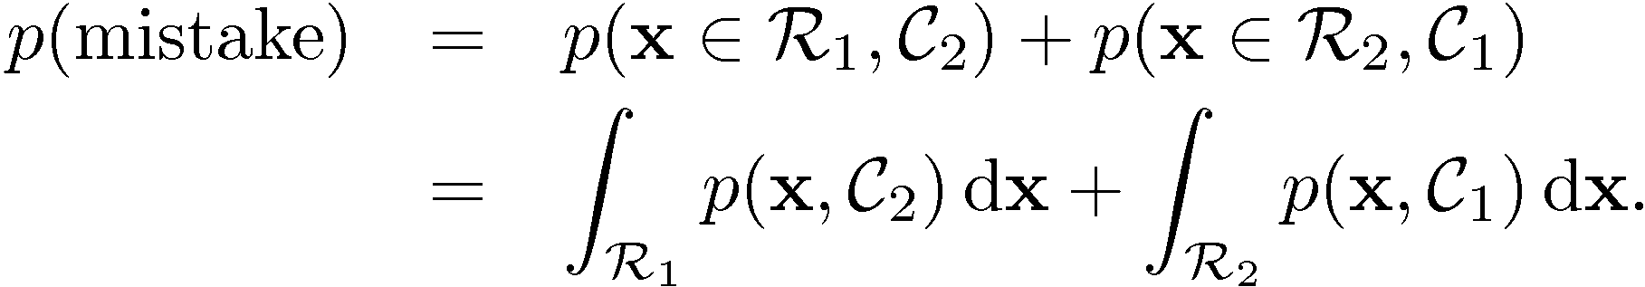
Minimum Misclassification Rate
Illustration with more
general distributions,
showing different error areas.

Slide 67
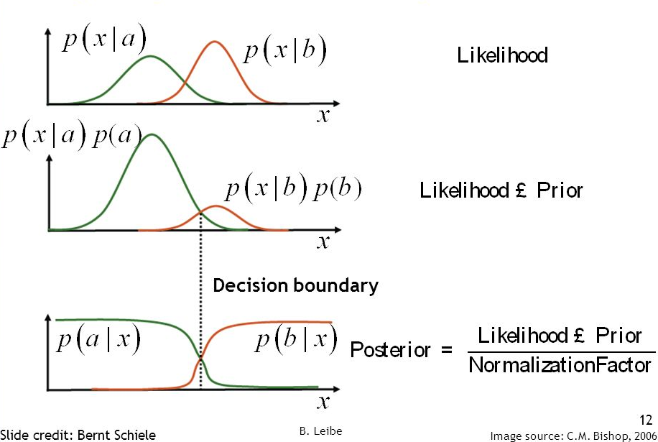

Slide 68

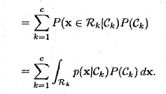
Justification for the Decision Criteria based on max. Posterior probability
For the more general case of K classes, it is slightly easier to maximize the probability of being correct:

Slide 69
Rest Not COVERED

Slide 70
Mitchell Chp.6
Maximum Likelihood (ML) &
Maximum A Posteriori (MAP)
Hypotheses

Slide 71
Advantages of Bayesian Learning
Bayesian approaches, including the Naive Bayes classifier, are among the most common and practical ones in machine learning
Bayesian decision theory allows us to revise probabilities based on new evidence
Bayesian methods provide a useful perspective for understanding many learning algorithms that do not manipulate probabilities

Slide 72
Features of Bayesian Learning
Each observed training data can incrementally decrease or increase the estimated probability of a hypothesis – rather than completely eliminating a hypothesis if it is found to be inconsistent with a single example
Prior knowledge can be combined with observed data to determine the final probability of a hypothesis
New instances can be classified by combining predictions of multiple hypotheses
Even in computationally intractable cases, Bayesian optimal classifier provides a standard of optimal decision against which other practical methods can be compared

Slide 73
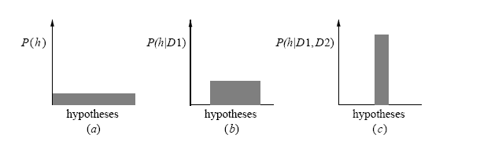
Evolution of Posterior Probabilities
    The evolution of the probabilities associated with the hypotheses
    As we gather more data (nothing, then sample D1, then sample D2),
inconsistent hypotheses gets 0 posterior probability and consistent ones share the remaining
probabilities (summing up to 1). Here D_{i} is used to indicate one training instance.

Slide 74
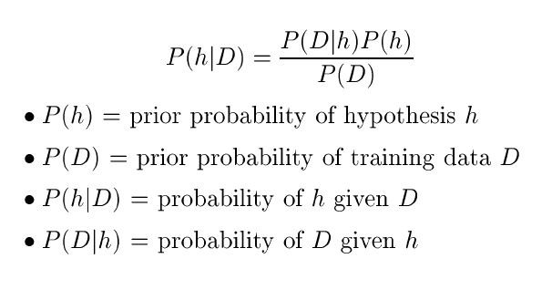
Bayes Theorem
- also called likelihood
We are interested in finding the “best” hypothesis from some space H, given the observed data D + any initial knowledge about the prior probabilities of various hypotheses in H

Slide 75
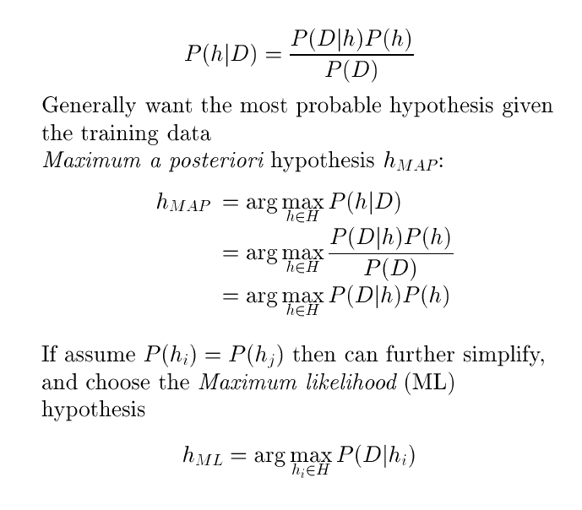
Choosing Hypotheses

Slide 76
Choosing Hypotheses

Slide 77
Bayes Optimal Classifier
Mitchell [6.7-6.9]

Slide 78
Bayes Optimal Classifier
Skip Mitchell 6.5 (Gradient Search to Maximize Likelihood in a Neural Net)
So far we have considered the question "what is the most probable hypothesis given the training data?
In fact, the question that is often of most significance is
"what is the most probable classiffication of the new
instance given the training data?
Although it may seem that this second question can be answered by simply applying the MAP hypothesis to the new instance, in fact it is possible to do better.

Slide 79
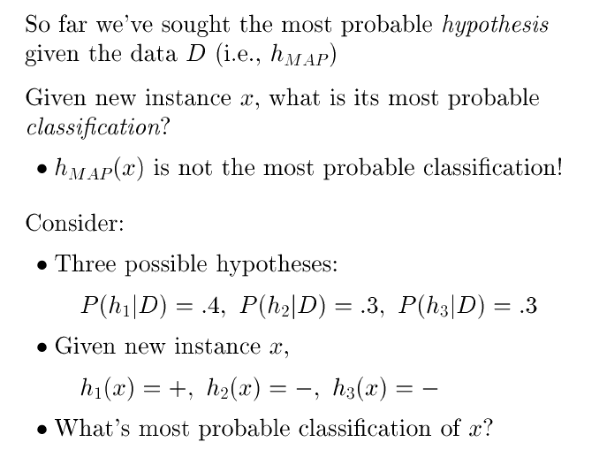
Bayes Optimal Classifier

Slide 80
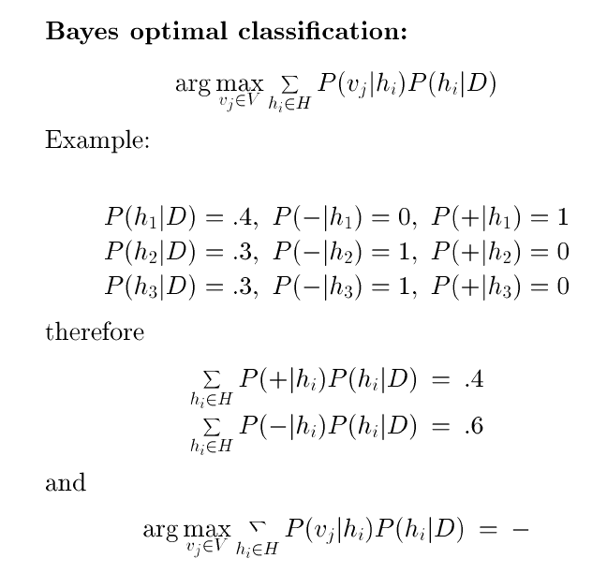
Bayes Optimal Classifier
No other classifier
using the same hypothesis space
and same prior knowledge
can outperform this method
on average

Slide 81
The value v_{j} can be a classification label or regression value.
Instead of being interested in the most likely value v_{j,} it may be clearer to specify our interest as calculating:
p(v_{j}|x) = Σ p(v_{j}|h_{i}) p(h_{i}|D)
h_{i}
where the dependence on x is implicit on the right hand side.
Then for classification, we can use the most likely class (v_{j} here is the class labels) as our prediction by taking argmax over v_{j}s.
For later: For regression, we can compute further estimates of interest, such as the mean of the distribution of v_{j} (which is the possible regression values for a given x).

Slide 82
Bayes Optimal Classifier
Bayes Optimal Classification: The most probable classification of a new instance is obtained by combining the predictions of all hypotheses, weighted by their posterior probabilities:
argmax_{vj∈V}Σ_{hi∈} _{H}P(v_{h}|h_{i})P(h_{i}|D)
where V is the set of all the values a classification can take and v_{j} is one possible such classification.
The classification error rate of the Bayes optimal classifier is called
the Bayes error rate (or just Bayes rate)

Slide 83
Gibbs Classifier (Opper and Haussler, 1991, 1994)
Bayes optimal classifier returns the best result, but
expensive with many hypotheses.
Gibbs classifier:
  Choose one hypothesis h_{i} at random, by Monte Carlo sampling according to reliability P(h_{i}|D).
  Use this hypothesis so that v = h_{i}(x).
Surprising fact: The expected error is equal to or less
than twice the Bayes optimal error!
E[error_{Gibbs}] <= 2E[error_{BayesOptimal}]

Slide 84
Bayesian Belief Networks
The Bayes Optimal Classifier is often too costly to apply.
The Naïve Bayes Classifier uses the conditional independence assumption to defray these costs. However, in many cases, such an assumption is overly restrictive.
Bayesian belief networks provide an intermediate approach which allows stating conditional independence assumptions that apply to subsets of the variables.

