Slide 1

SABANCI UNIVERSITY
CS512
MACHINE LEARNING
PROJECT: FRUIT IMAGE RECOGNITION
Instructor: Prof. Dr. Berrin Yanıkoğlu
Assistant: Figen Beker Fikri
Prepared by: Emre Yılmaz
    Diyar Khalis Bilal
1 / 9

Slide 2
Problem Definition
Classification of fruit images into one of 755 classes
Features:
1024 CNN Features
Date, Family, Genus, ... etc.
2 / 9

Slide 3
Methodology
ZeroR
Decision Tree
Neural Network
3 / 9

Slide 4
Results and Discussion
ZeroR
Min. Accuracy Exceptation : 1.08 %
Decision Tree (size: 4701, leaves: 2351)
by using Training Set;
Correctly classified instances : 6143 (79.57 %)
Incorrectly classified instances : 1577 (20.43 %)
by using 10-Fold Cross Validation;
Correctly classified instances : 1649 (21.36 %)
Incorrectly classified instances : 6071 (78.64 %)
4 / 9

Slide 5
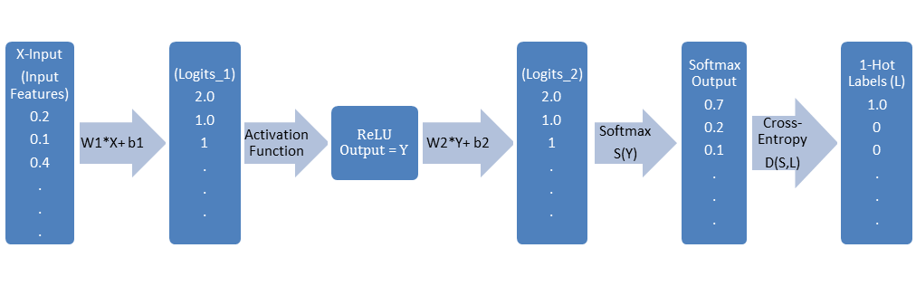
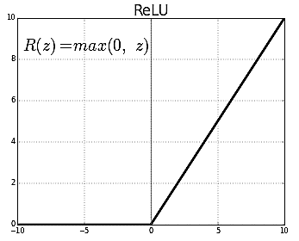
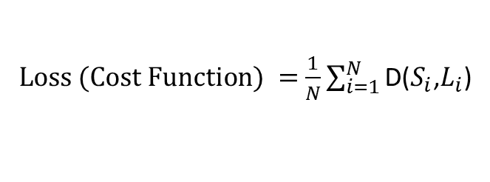
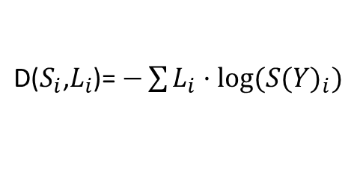

Neural Network based on Multinomial Logistic Classification
$$S\left(Y\right)=\frac{e^{y_{i}}}{\sum{e^{y_{j}}}}$$
$\text{D}\text{(}S_{i}\text{,}L_{i}$)= $−\sum{L_{i}·log⁡{(S(Y)}_{i})}$
$Loss (Cost Function) =$ $\frac{1}{N}\sum_{i=1}^{N}{\text{D}\text{(}S_{i}\text{,}L_{i}\text{)}}$
5 / 9

Slide 6
Results and Discussion
Model No | Type | Features | Nodes | Activ. Func. | Steps | Regulariz. Coef. | Normalization | Dropout | Validation (on Suppl. Train Set)
Model 1 | 1-HL NN | CNN + Date | 3000 | Relu | 6000 | 0.0001 | Yes | No | 86.1 % (6650 +, 1070 - )
Model 2 | 1-HL NN | CNN (1024) | 2000 | Relu | 1800 | 0.01 | Yes | No | 90 % (6946 +, 774 - )
Model 3 | 1-HL NN | CNN (1024) | 3000 | Relu | 1500 | 0.001 | Yes | with 0.5 keeping ratio | 90 % (6946 +, 774 - )
6 / 9

Slide 7
Results and Discussion
7 / 9

Slide 8
Results and Discussion
8 / 9

Slide 9
Conclusion
Model Types | Matching Number of Predicted Indexes (on Test Data)
Model 1 (w/Date-No Dropout) = Model 3 (No Date-w/Dropout) | 851 out of 1423 (60%)
Model 1 (w/Date-No Dropout) = Model 2 (No Date-No Dropout) | 878 out of 1423 (62%)
Model 3 (No Date-w/Dropout) = Model 2 (No Date-No Dropout) | 1192 out of 1423 (84%)
9 / 9

