Slide 1
Fruit Image Recognition Using Neural Network
Ekin Yagis
Zain Fuad

Slide 2
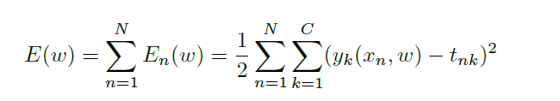
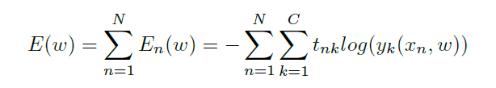
Error Functions
Sum of Squared Errors
Cross-Entropy

Slide 3
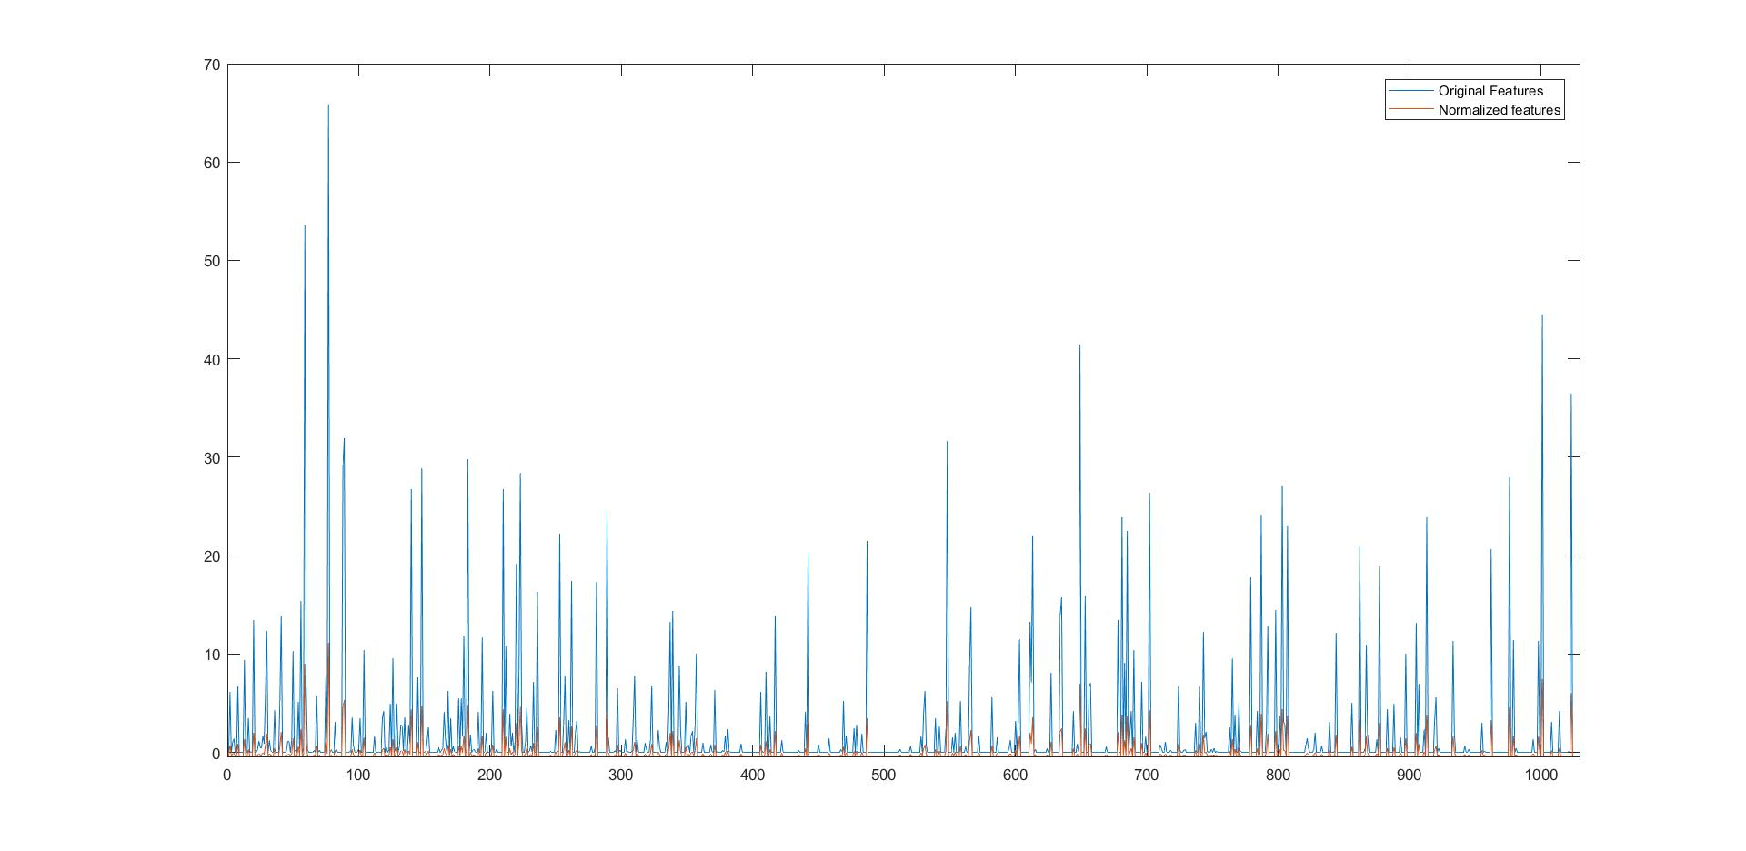
Data Pre-Processing
-`Standardize’ the data
-Standardization of class ID 2584

Slide 4
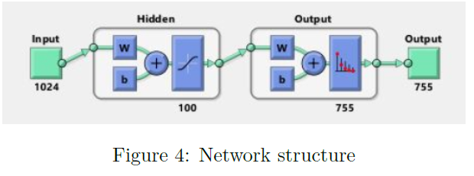
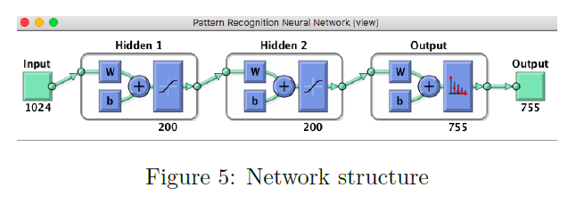
Neural Network Structure

Slide 5
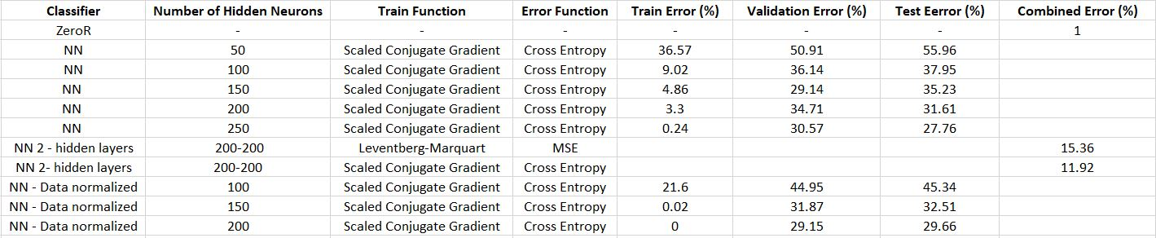
Results

Slide 6
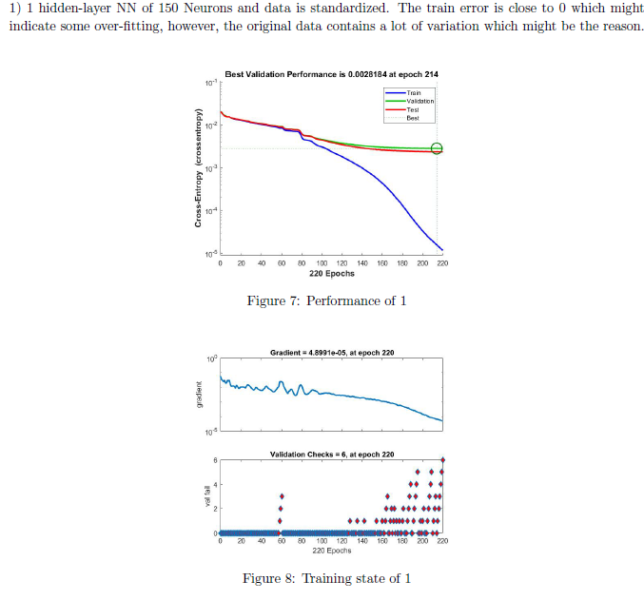
Best Networks

Slide 7
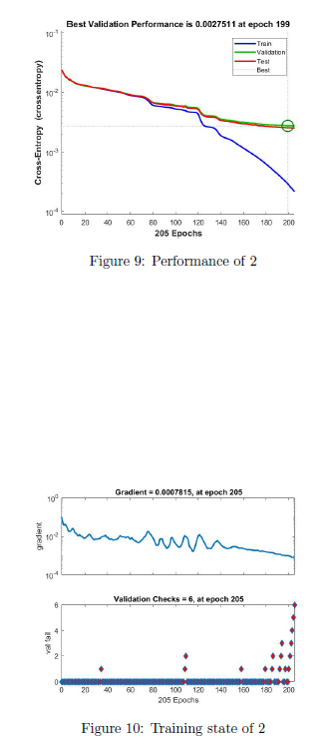

Best Networks

