Slide 1
Fruıt ımage recognıtıon wıth weka
Ahmet Sapan 17693
Itır Ege Deger 19334
Mehmet Fazıl Tuncay 17528

Slide 2
AIM & method
Finding the best/accurate classifier and effective features to classify data with the given fruit features.
Method uses deep-learning techniques for feature extraction and classification
Various classification methods are tested in order to achieve the best results

Slide 3
Method#1 – 1031 attrıbute, zeror and cross val wıth 10 folds
ZeroR simplest classification method, relies on target and ignores all predictors
Selects the most frequent value as target (in our case selects the most frequent ClassId)
Our aim was to find the features that affects the results/accuracy of the classifier, but zeroR ignores all of these features
Total 7720 instance, 83 of them correctly classified
Accuracy : 1.07%
Classification took very short time
Also tested with only first 1024 features and ClassId, accuracy was the same

Slide 4

Method#2 – 1031 attrıbute, j48 and cross val wıth 10 folds
J48 is a class for generating pruned or unpruned decision tree
Pruned tree, classification made with confident factor (c) = 0.25
Total 7720 instance, 6244 of them correctly classified
Accuracy: 80.88%
Method#3 – 1031 attrıbute, j48 and use traınıng set
Uses only training set
Tests on the same data that was learned
7578 of the instances correctly classified
Accuracy: 98.16%
Might be overfitting, accuracy of unseen data might be poor
Not very reliable

Slide 5
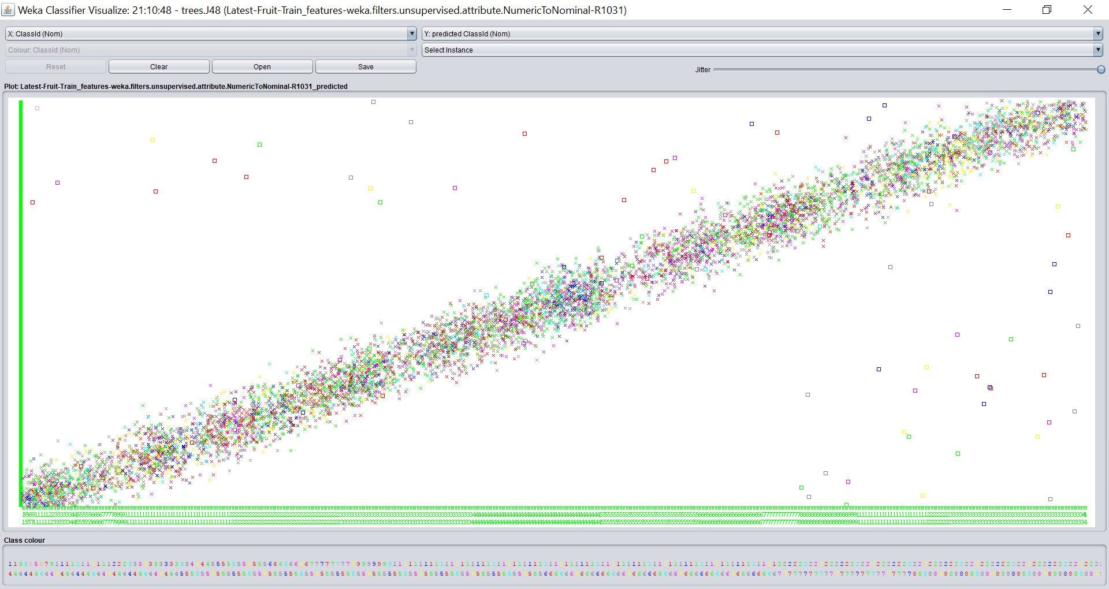
Figure1. Visualization of classification errors (using training set, accuracy: 98%)

Slide 6
Method#4 – 1025 attrıbute, j48 and cross val wıth 10 folds
Features such as MediaId, Family, Genus, Date, Latitude, Longitude is removed
1617 correctly classified instance
Accuracy: 20.94%
Also tried adding MediaId and accuracy was same, so MediaId has no effect
Method#5 – 1024+Famıly+classıd, j48 and cross val wıth 10 folds
4470 correctly classified instance
Accuracy: 57.90%
Almost 40 percent increase

Slide 7
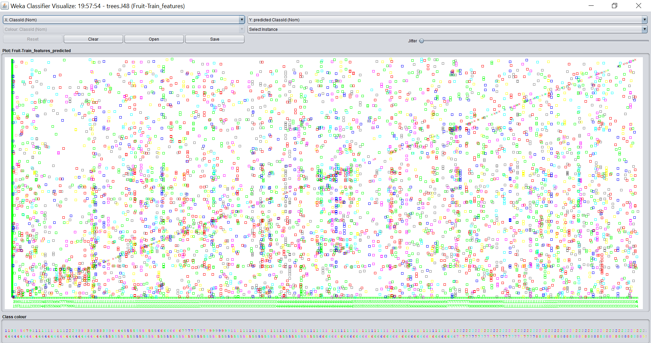
Figure 2. Visualization of classification errors (for method#4, accuracy: 21%)

Slide 8
Method#6 – 1024+Genus+classıd, j48 and cross val wıth 10 folds
6233 correctly classified instance
Accuracy: 80.73%
Almost the same accuracy as when we included all the features
Tree size: 1176
«Genus» is distinctive, divides decision tree efficiently
Method#7 – 1024+DATE+classıd, j48 and cross val wıth 10 folds
4470 correctly classified instance
Accuracy: 45.14%
Almost 40 percent increase
Tree size: 3684

Slide 9
Method#8 – 1024+Latıtude+classıd, j48 and cross val wıth 10 folds
1616 correctly classified instance
Accuracy: 20.93%
Almost the same accuracy as when we only used first 1024 features
Has no effect
Method#9 – 1024+Longıtude+classıd, j48 and cross val wıth 10 folds
Accuracy: 20.93%
Same as Latitude

Slide 10
Method#10 – 1031 Features, confırmatıon wıth bestfırst
Up to now «Genus» seems as the best feauture that boosts up accuracy
Attribute evaluator «CfsSubsetEval» and search method «bestFirst» is used
İdentify a subset of attributes that are highly correlated with target while
not being strongly correlated with one another.
Selected «Genus»
«Genus» is correlated with target but not very much with other attributes

Slide 11
Conclusıon
Best classifier: J48
Best test method: Cross Validation
Distinctive feature that highly affects accuracy: Genus
MediaId, Latitude, Longitude has no effect on accuracy
Date and Family has a considerable amount of effect

Slide 12
references
Why does the C4.5 algorithm use pruning in order to reduce the decision tree and how does pruning affect the predicion accuracy? (n.d.). Retrieved December 19, 2017, from https://stackoverflow.com/questions/10865372/why-does-the-c4-5-algorithm-use-pruning-in-order-to-reduce-the-decision-tree-and
Tutorial Exercises for the Weka Explorer (n.d). Retrieved December 19, 2017, from
http://cobweb.cs.uga.edu/~khaled/DMcourse/Weka-Tutorial-Exercises.pdf
Weka: Decision Trees – J48 (n.d). Retrieved December 19, 2017, from
http://stp.lingfil.uu.se/~santinim/ml/2016/Lect_03/Lab02_DecisionTrees.pdf

