Slide 1
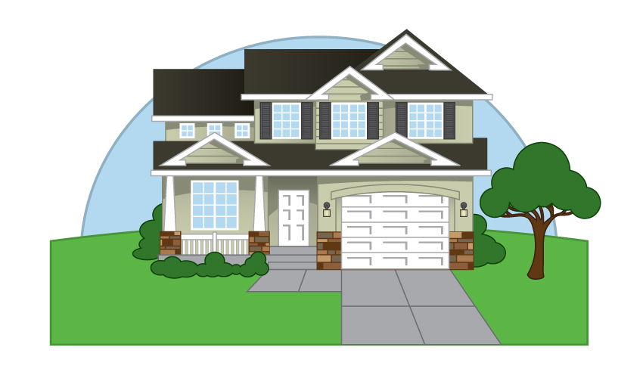
CS 412 Term Project Presantation
Kaggle, House Pricing
Ahmet Ege Güldalı, Elit Açılan, Eylül Dicle Yurdakul, Şemsettin Oğuz Yüksek

Slide 2

What Is Our Problem?
  Our problem was to estimate the house prices of a test group based on a train data; for each Id in the test set, we must have predicted the value of the ‘SalePrice’ variable.
  While we were trying to predict the ﬁnal price of each home, we started oﬀ with 79 explanatory variables describing (almost) every aspect of residential homes in Ames, Iowa.

Slide 3
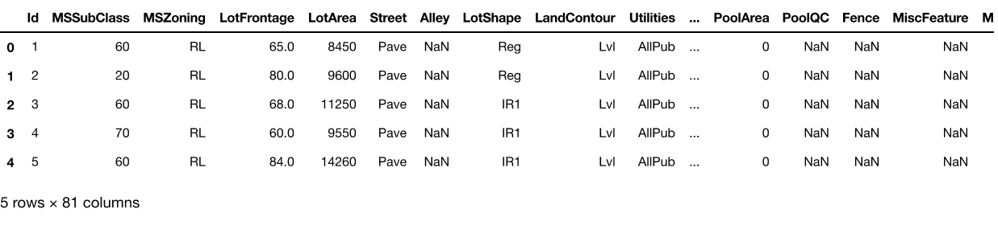
What we were dealing with?

Slide 4
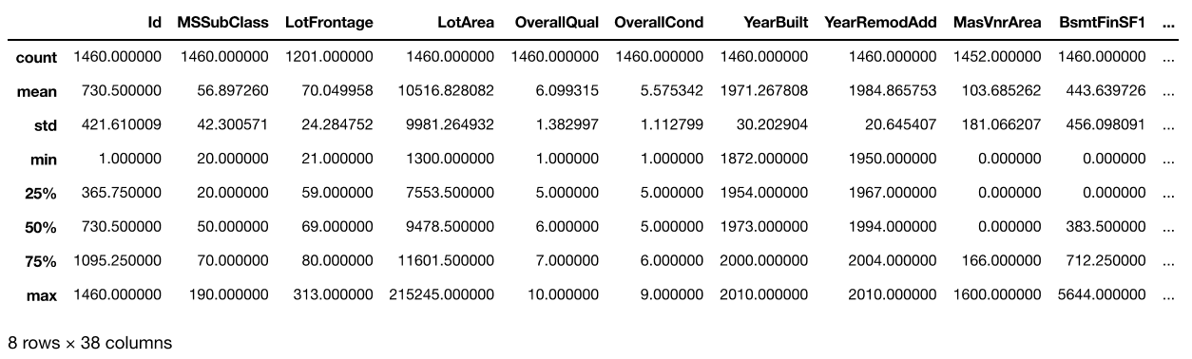
What we were dealing with?

Slide 5
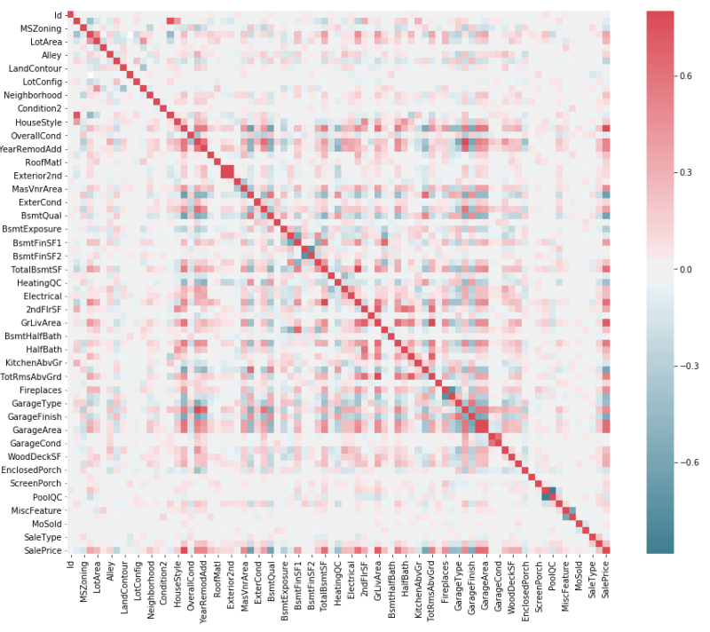
We have plotted the correlation between each feature.
This also helped us to observe the most correlated features with SalePrice.

Slide 6
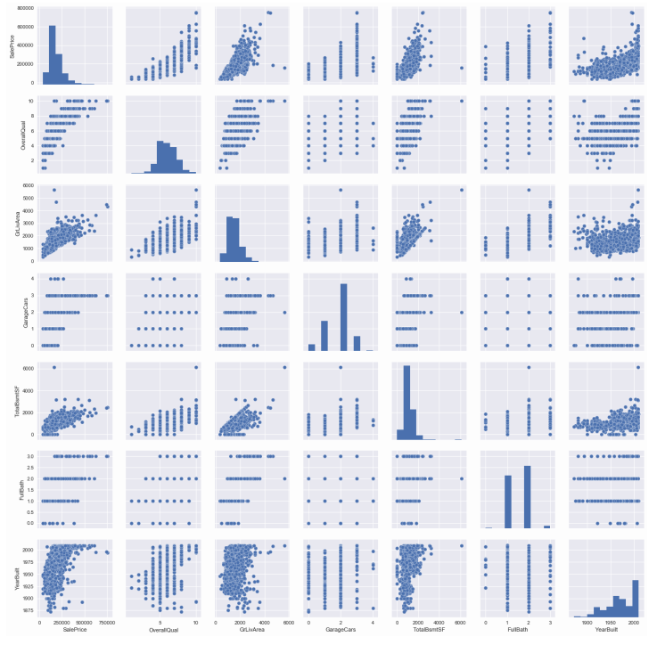
To observe the relation between the most correlated features, we plotted their scatters.

Slide 7
Our Solution!
1- Random Forest
We ﬁrst wanted to use a tree based method such as random forest for regression, since it empowers predictive models with high accuracy, stability and ease of interpretation.
For this we used RandomForestRegressor from sklearn module. First, we calculated the importance coeﬃcients of the features used to reach a SalePrice value.

Slide 8
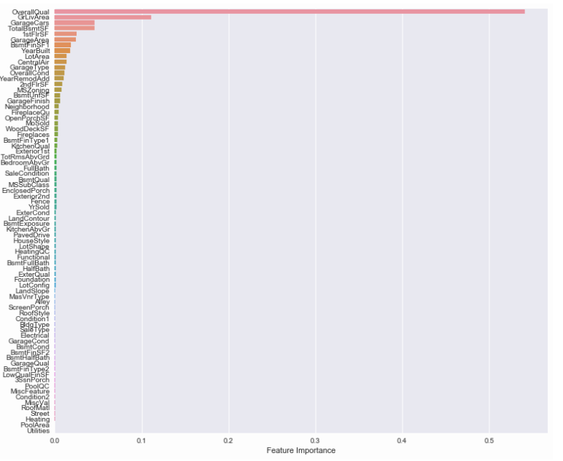
Training done using Random Forest

Slide 9

We noticed that ‘OverAllQual’ and ‘SF’ values are very dominant in the result we got. So we created a cumulative feature from them and named it as interaction. Then we created a new random forest and found the new coeﬃcients.

Slide 10
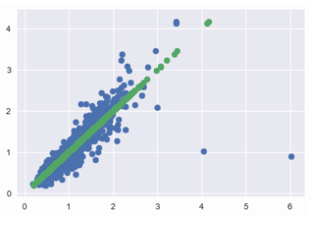
We used these new coeﬃcients on train data to calculate new SalePrice values and compared these new values to actual SalePrice values of the train data to see the correlation between them.
Here we also removed the outliers using their numeric distance from mean squared error. We did these with the 30 most dominant features.

Slide 11
2- Keras
We applied Keras on top of Random Forest importance coeﬃcients to try out neural network compared to our results, since Keras is compatible with Python and it is a fast and easy-to-implement deep learning algorithm.
We use Random Forest importance coeﬃcients to choose the features we will train the Keras with. 30 features did not provide enough deﬁnition, so we reduced the feature count from 30 to 6.
Then we let Keras to ﬁgure out its own coeﬃcients.

Slide 12
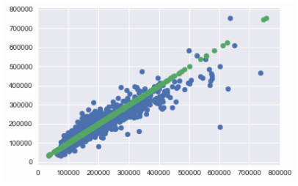
We applied the model generated by Keras to our training data, denormalize the outputs and plotted them onto a scatter graph to see the revelance.
It was not as deterministic as the linear regression we did with Random Forest coeﬃcents. Most of the time it yielded close results to the previous graph if not better.

Slide 13
3- Lasso
Despite the resulting graph looks more promising compared to what we had from Random Forest coeﬃcents, it still looked improvable. So, we proceeded with our research and found some more methods such as Lasso.

Slide 14
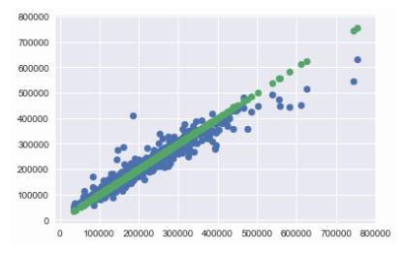
We applied Lasso with the alpha value 0.0004.
Then we ﬁt the Lasso model according to training data and then formed the solution to test data based on the model.

Slide 15
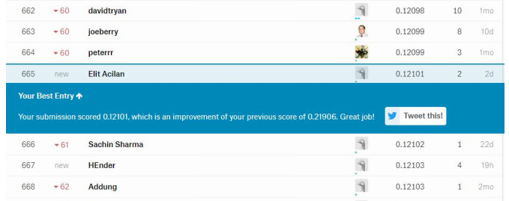
Our Best Solution, Lasso
Lasso model gave us the best results among other methods we applied. When we uploaded the result of it to the Kaggle website, we got an RMS that is equal to 0.12101, that placed us to the 665th spot in the scoreboard.

Slide 16
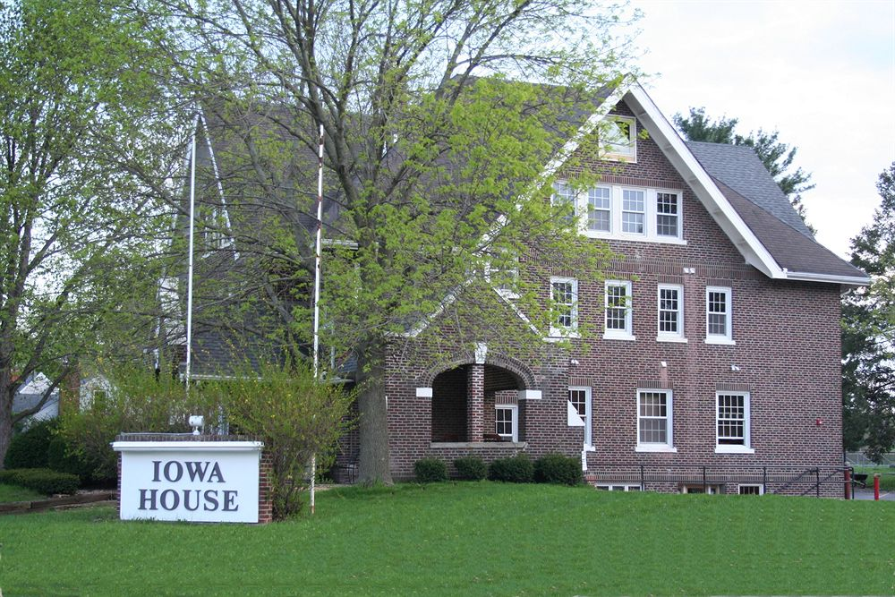
Thank You!

