Slide 1

CS412 – Machine Learning
Sentiment Analysis - Turkish Tweets
17610 - Berke Dilekoğlu
17912 - Burak Aksoy
19080 - Berkan Teber
19459 - Arda Olmezsoy

Slide 2
I. Introduction to Problem
Given: A number of tweets written about banks in Turkish
Goal: Classify how bad or good a review is.
Features: Initially 21 Features are given.
Score Scale: Continuous, [-1(Very Bad), +1(Very Good)]
So: A REGRESSION problem.

Slide 3
II. Initial Data Analysis
Training Set: 757 tweets are given with their labels.
01
Test Set: 200 tweets are going to be tested.
02
Before starting our analysis we wanted to examine the 21 features given to us. We plotted how features are distributed over labels.
03

Slide 4
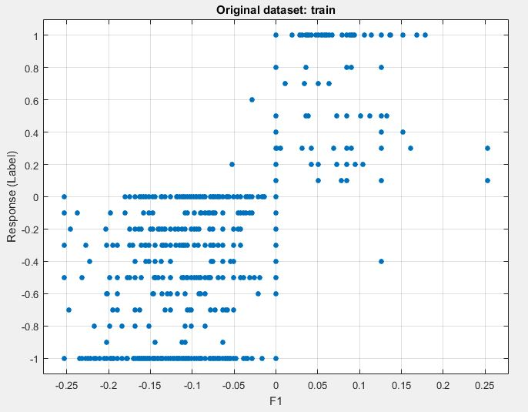
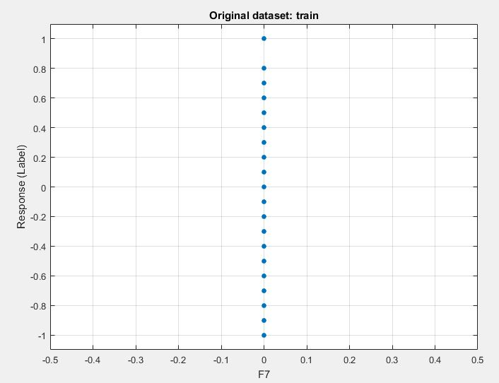
Example of a Good Feature
Example of a Bad Feature
We realized that Features 6,8,12,15,16,17,18 and 19 are similarly bad.

Slide 5
III. Additional Features
Since most of the features are not very informative, we decided to create our own features such as;
Feature Name | Explanation
F22 | Whether tweet has :) or not
F23 | Whether tweet has :)) or not
F24 | Whether tweet has :))) or not
F25 | Whether tweet has :D or not
F26 | Whether tweet has :( or not
F27 | Whether tweet has :(( or not
F28 | Whether tweet has :(((or not
Feature Name | Explanation
F29 | Whether tweet has ! or not
F30 | Whether tweet has ? or not
F31 | Whether tweet has capital words or not
F32 | Whether tweet has repeated letters/not
F33 | Position of the @ in the tweet
F34 | Common words score of the tweet

Slide 6
IV. Building Models
First we tried the training set without additional features on different Training Models such as Linear Regression, Decision Trees, Ensemble Methods, and SVMs.
Model Name | RMSE
Ensemble – Boosted Trees | 0.39
Ensemble – Bagged Trees | 0.39
Tree – Simple Tree | 0.41
Tree – Medium Tree | 0.43
SVN – Median Gaussian SVM | 0.44
Trees performed better!
-Why? Because…

Slide 7
Removed features numbered 6,7,8,12,15,16,17,18 and 19
Model Name | RMSE
Ensemble – Boosted Trees | 0.39
Ensemble – Bagged Trees | 0.40
Tree – Simple Tree | 0.41
Tree – Medium Tree | 0.43
SVN – Medium Gaussian SVM | 0.43
It seems like there is no significant improvement. However other models performed better. Because…
With additional features 22 to 34
On High order models and Overfitting…
Model Name | RMSE
Ensemble – Boosted Trees | 0.37
Ensemble – Bagged Trees | 0.37
Tree – Simple Tree | 0.40
Tree – Medium Tree | 0.40
SVN – Medium Gaussian SVM | 0.41
Finally, with meaningful additional features better results achieved!!

Slide 8
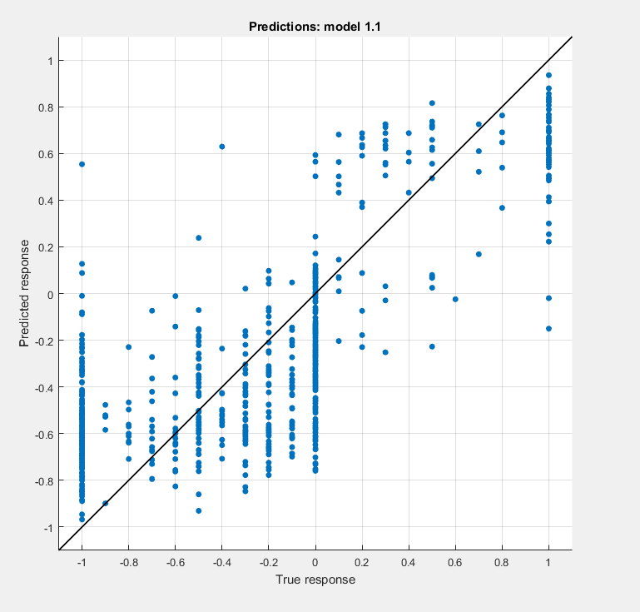
V. Conclusion
At the very end, we ended up with 5% better accuracy in our best model after removing some of the features and adding our own features.
Also, our correctly guessing rate has increased 81% to 85%.

