Slide 1
TURKISH Sentıment Analysıs on twıtter data
Mehmet cem aytekin 17899
Betül günay 17000
Deniz naz bayram 16623

Slide 2
Gatherıng large amount of Data:
We made modifications on an existing project to automatize the tweet collecting process.
We gathered 1717 negative sentimental data and 687 positive sentimental data at the end.
Total of 2404 training tweets.

Slide 3
Labeling large amount of data
First we labelled them manually and then we automatized the process as follows :
For each tweet we calculated the probability of it being positive or negative based on the previous manually labelled data and if this probability is higher than a certain threshold, we made the program label the data as positive or negative automatically.
This approach can be an example of semi-supervised learning technique.

Slide 4
Traınıng the classıfıer
Bag of Words approach.
Constructing Vocabulary :
most common 2200 words : [('icin', 349), ('tesekkurler', 276), ('cok', 241), ('kredi', 200), ('musteri', 199) 'destek', 174), ('yok', 172), ('kart', 167), ('banka', 151), ('neden', 110), ('iyi', 102), ('daha', 97), ('bana', 97),…
Naive Bayes Classifier to train the data with the corresponding featuresets.

Slide 5
Constructıng Feature set
Each word in the vocabulary is a feature.
Total number of features: 2200.
Each feature is boolean, meaning if that word from the vocabulary occurs corresponding feature is set True else set False.
For each tweet we look at 2200 features (words).

Slide 6
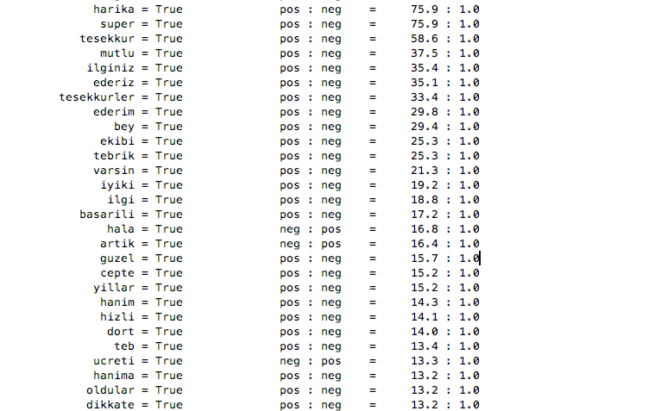
mOST INFORMATIVE FEATURES

Slide 7
classıfıcatıon
In order to, consider this project as classification problem, we converted the regression values of tweets to labels which are positive and negative
. Tweets with regression values greater than or equal to 0 are labelled as positive and others labelled as negative. We applied the same procedure to the both given training and test data.

Slide 8
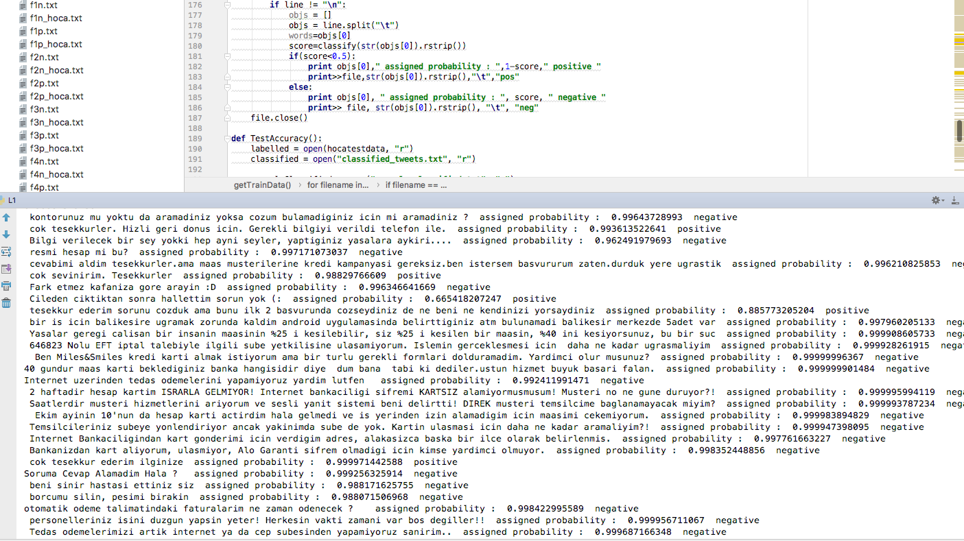
Classıfıcatıon results screenshots

Slide 9

Accuracy when classıfıer traıned by our data and saw the gıven data

Slide 10
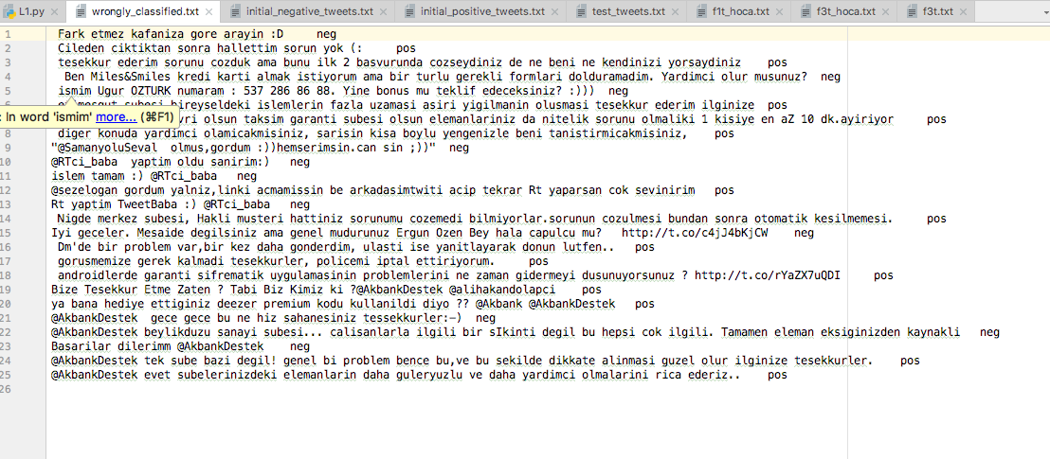
wHICH tweets are mısclassıfıed ?

Slide 11

WHEN CLASSIFIER TRAINED WITH THE GIVEN TRAINING DATA AND SAW THE GIVEN TEST DATA

Slide 12
Why ıs ıt the case ?
Given training data consisted of 459 negative and and 298 positive tweets. So the classifier only trained with 757 tweets.
However in the training set we constructed, it had trained with 2404 tweets.
More training data more accuracy.

Slide 13
SOME CODE SNIPPETS FROM OUR PROJECT
Note that we have only used Python and its NLTK library in the project

Slide 14
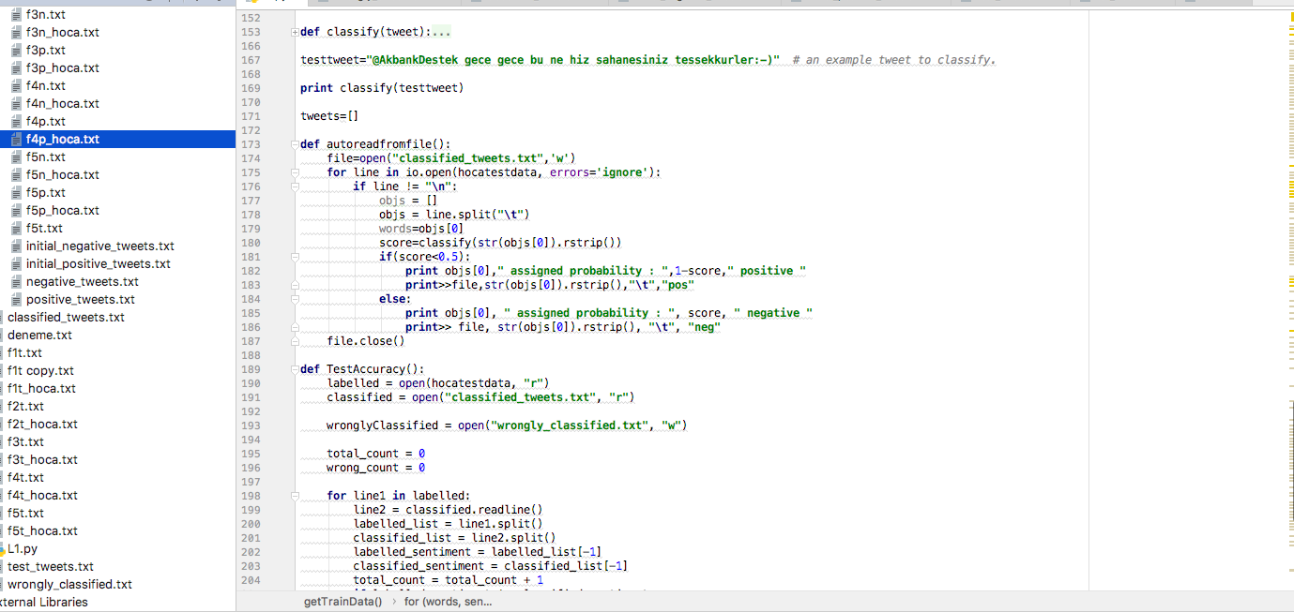
SOME CODE SNIPPETS FROM OUR PROJECT(1)

Slide 15
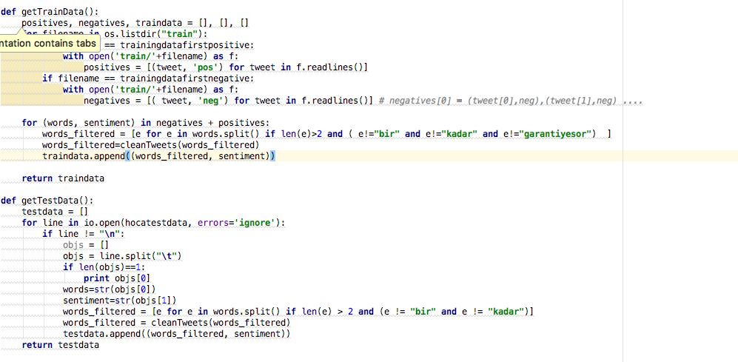
SOME CODE SNIPPETS FROM OUR PROJECT(2)

Slide 16
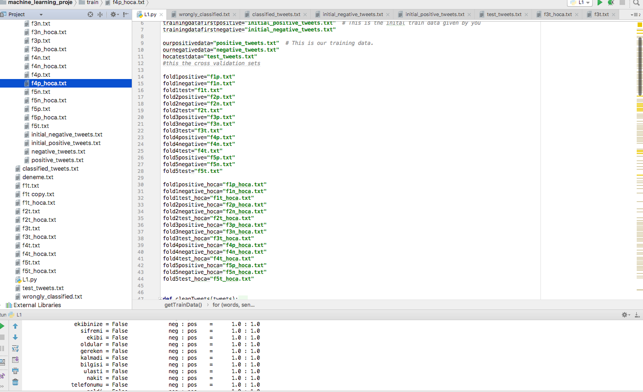
SOME CODE SNIPPETS FROM OUR PROJECT(3)

Slide 17
THANKS FOR LISTENING

