Slide 1
Linear Regression

Slide 2
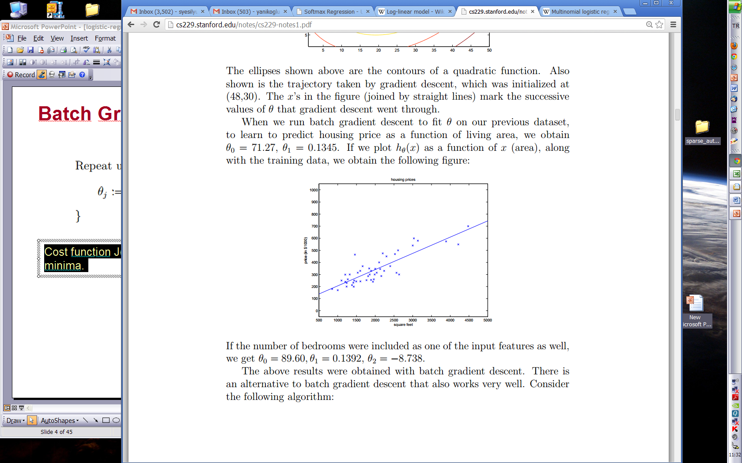


Task: Learning a real valued function f: x->y where x=<x₁,…,x_{n}> as a linear function of the input features x_{i}:
Using x₀=1, we can write as:

Slide 3
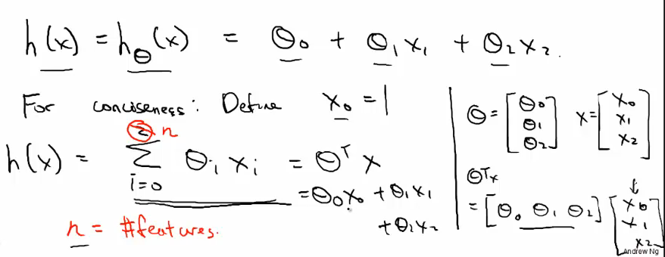
Linear Regression
3
Notes:
3

Slide 4

Cost function
4
We want to penalize from deviation from the target values:
Cost function J(θ) is a convex quadratic function, so no local minima.
Notes:
4

Slide 5
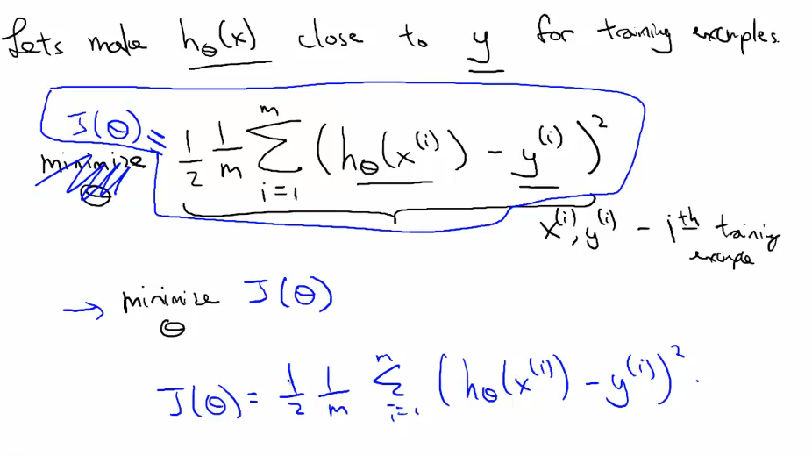
Linear Regression – Cost function
5
Notes:
5

Slide 6
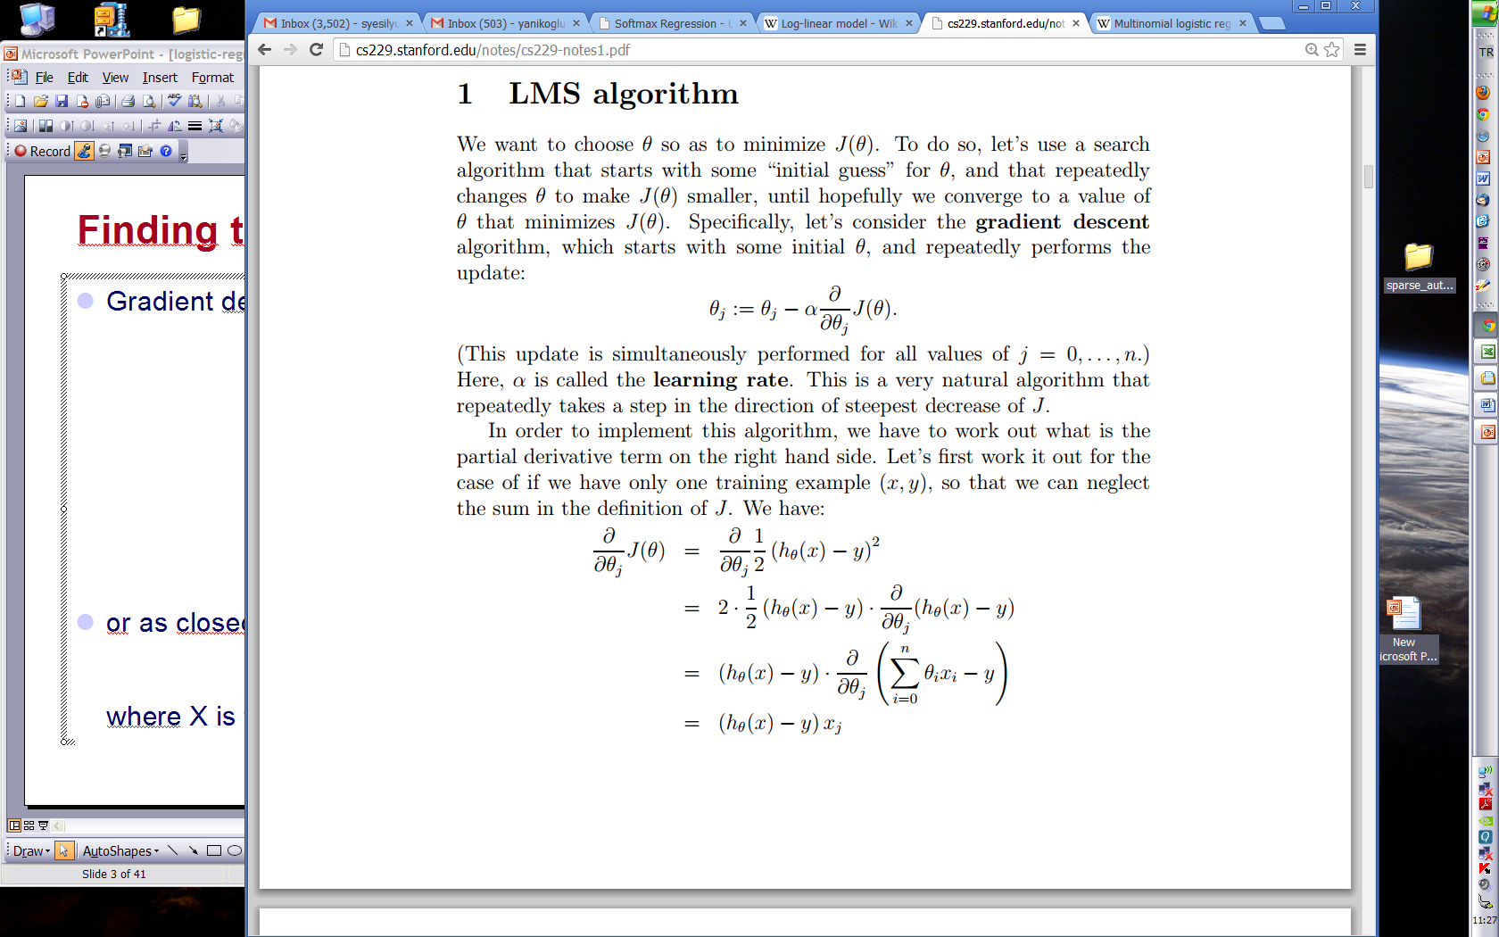
Finding θ that minimizes J(θ)
Gradient descent:
Lets consider what happens for a single input pattern:

Slide 7
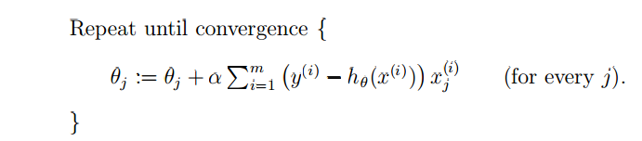
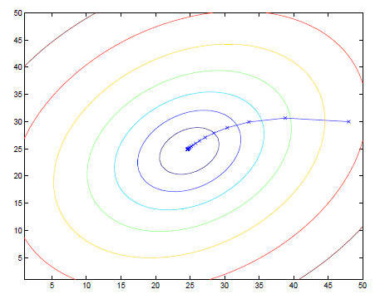
Gradient Descent
Stochastic Gradient Descent (update after each pattern) vs
Batch Gradient Descent (below):

Slide 8
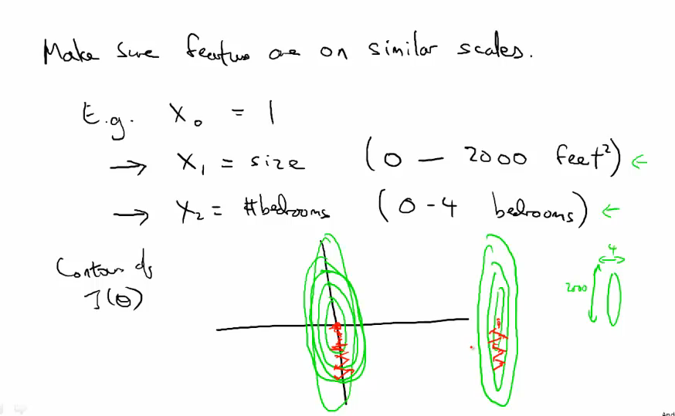
Need for scaling input features
8
Notes:
8

Slide 10
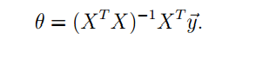
Finding θ that minimizes J(θ)
Closed form solution:
where X is the row vector of data points.:

Slide 11

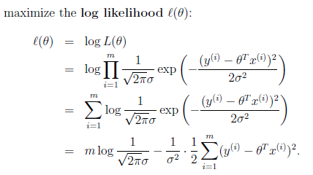
If we assume
with ε^{(i)} being iid and normally distributed around zero.
we can see that the least-squares regression corresponds to finding the maximum likelihood estimate of θ:

Slide 12
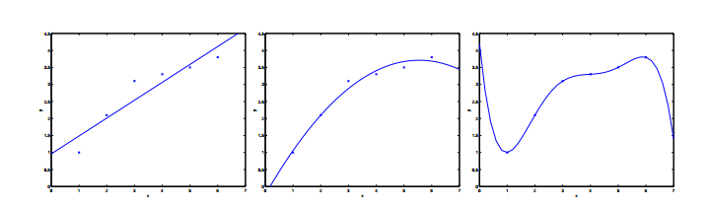
Underfitting: What if a line isn’t a good fit?
We can add more features => overfitting
  ➔ Regularization

Slide 13
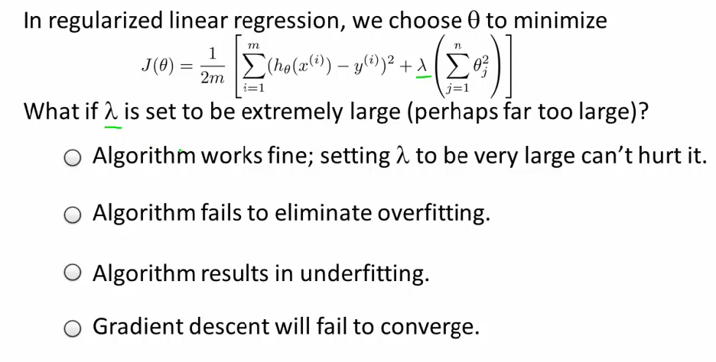
Regularized Linear Regression
13
Notes:
13

Slide 14
Regularized Linear Regression
14
Notes:
14

Slide 15
Skipped
Locally weighted linear regression
You can read more in:
http://cs229.stanford.edu/notes/cs229-notes1.pdf

Slide 16
Logistic Regression

Slide 17
Logistic Regression - Motivation
Lets now focus on the binary classification problem in which
  y can take on only two values, 0 and 1.
  x is a vector of real-valued features, < x₁ … x_{n} >
We could approach the classification problem ignoring the fact that y is discrete-valued, and use our old linear regression algorithm to try to predict y given x.
  However, it is easy to construct examples where this method performs very poorly.
  Intuitively, it also doesn’t make sense for h(x) to take values larger than 1 or smaller than 0 when we know that y ∈ {0, 1}.

Slide 18
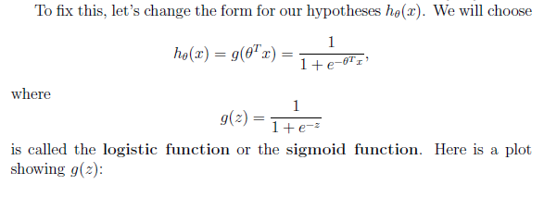
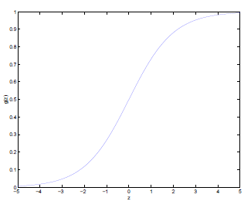
Logistic Function
18
Notes:
18

Slide 19
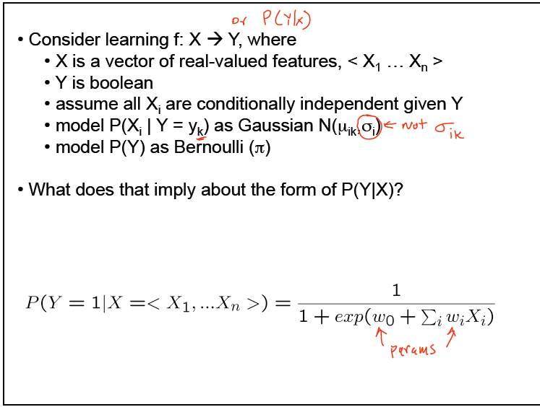

Slide 20
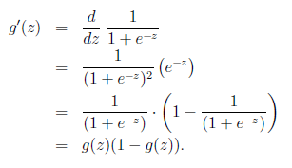
Derivative of the Logistic Function
20
Notes:
20

Slide 21
21
Interpretation:
  h_{θ}(x) : estimate of probability that y=1 for a given x
  h_{θ}(x) = P(y = 1 | x; θ)
  Thus:
  P(y = 1 | x; θ) = h_{θ}(x)
  P(y = 0 | x; θ) = 1 − h_{θ}(x)
  Which can be written more compactly as:
P(y | x; θ) = (h(x))^{y} (1 − h(x))^{1−y}
Notes:
21

Slide 22
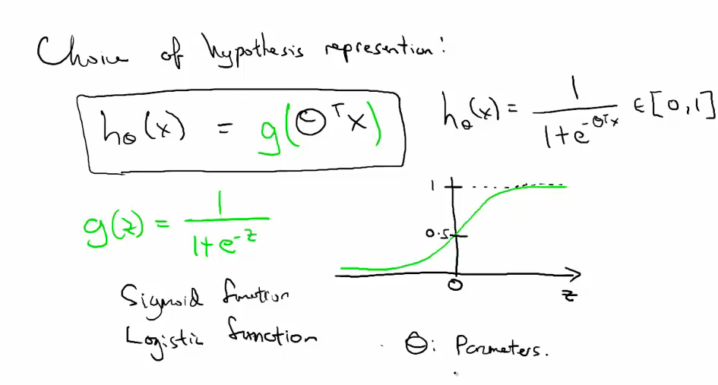
Logistic Regression
22
Notes:
22

Slide 23
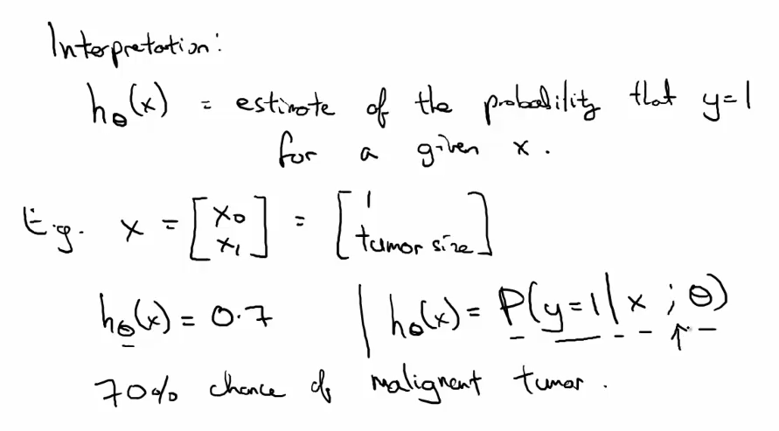
23
Notes:
23

Slide 24
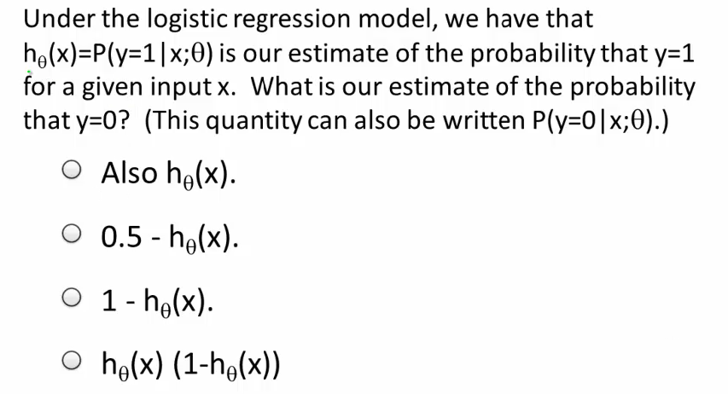
24
Notes:
24

Slide 25
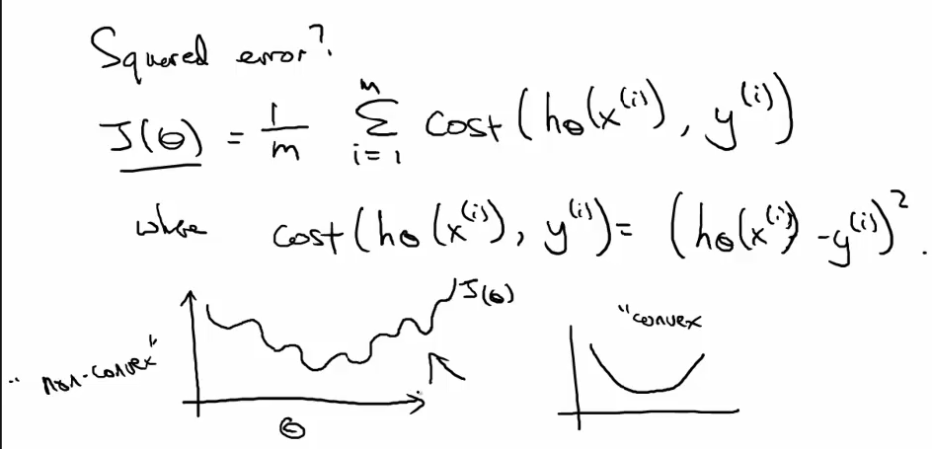
Mean Squared Error – Not Convex
25
Notes:
25

Slide 26
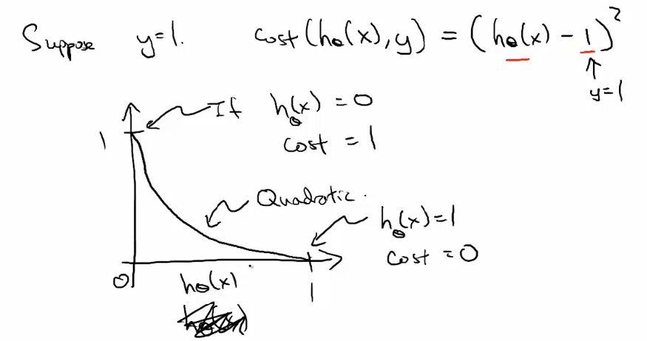
Alternative cost function?
26
Notes:
26

Slide 27
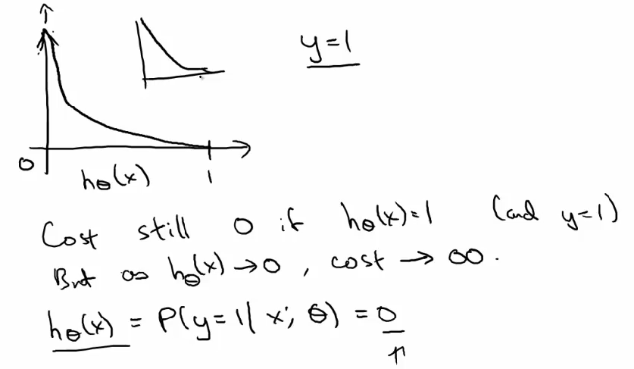
New cost function
27
Make the cost function steeper:
  Intuitively, saying that p(malignant|x)=0 and being wrong should be penalized severely!
Notes:
27

Slide 28
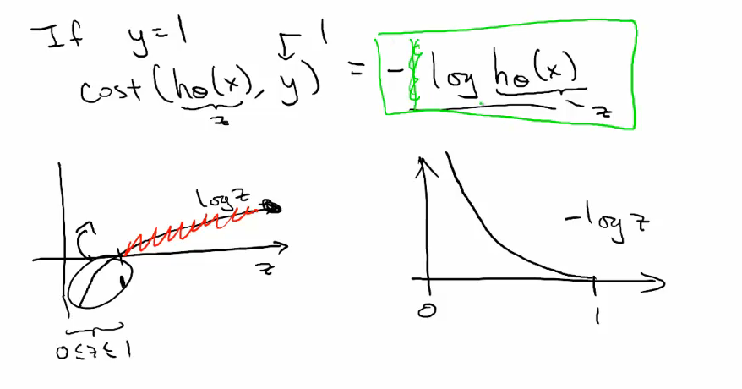
New cost function
28
Notes:
28

Slide 29
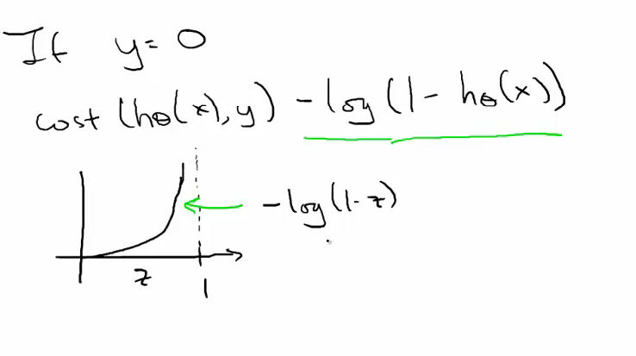
New cost function
29
Notes:
29

Slide 30
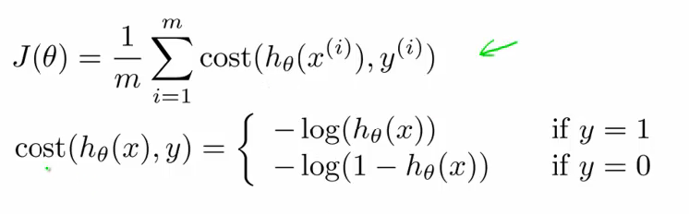
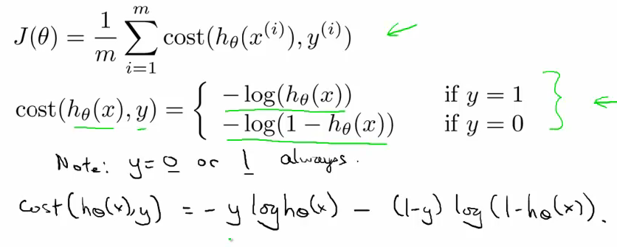
30
Notes:
30

Slide 31
31
Notes:
31

Slide 32
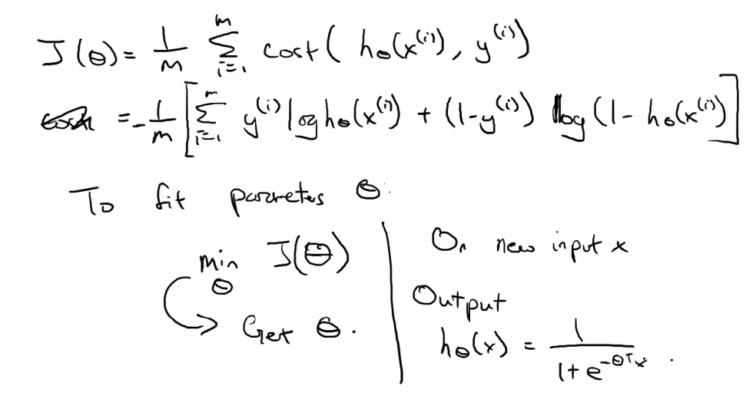
32
Notes:
32

Slide 33
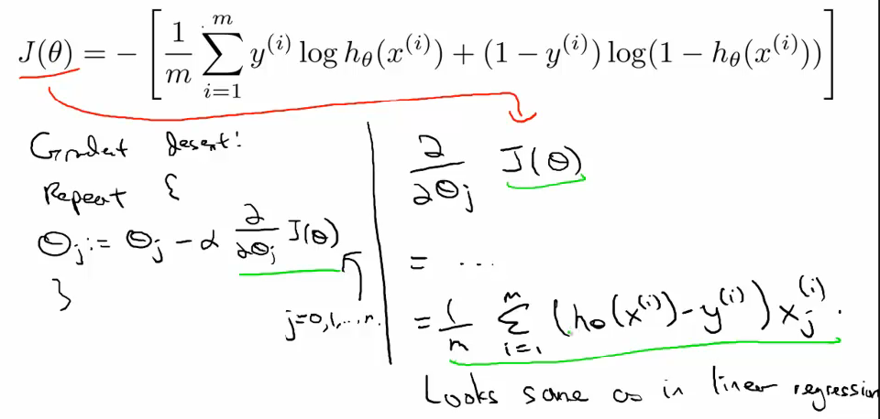
Minimizing the New Cost function
Convex!
33
Notes:
33

Slide 34
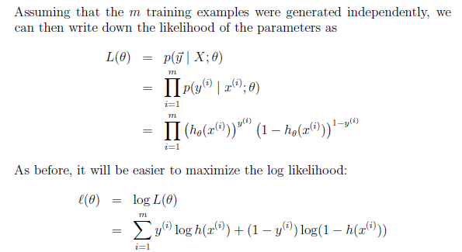
Fitting θ

Slide 35
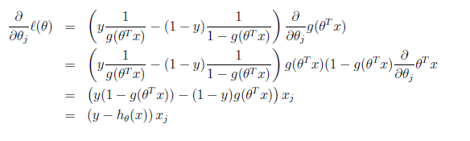
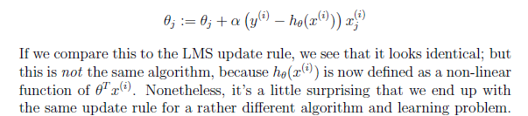
Fitting θ
Working with a single input and remembering h(x) = g(θ^{T}x):

Slide 36
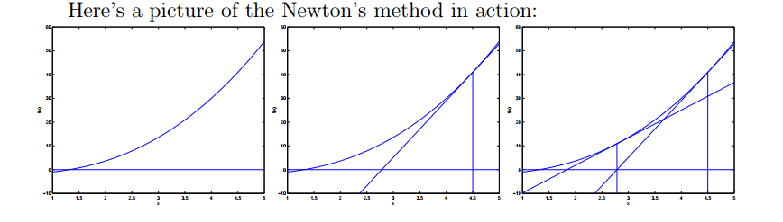
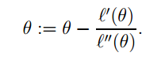
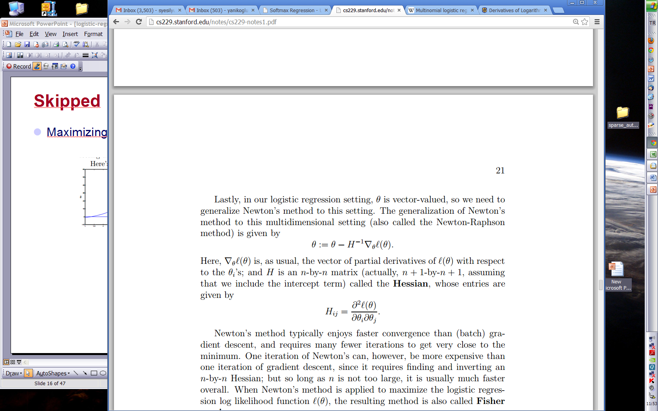
Skipped
Alternative: Maximizing l(θ) using Newton’s method

Slide 38
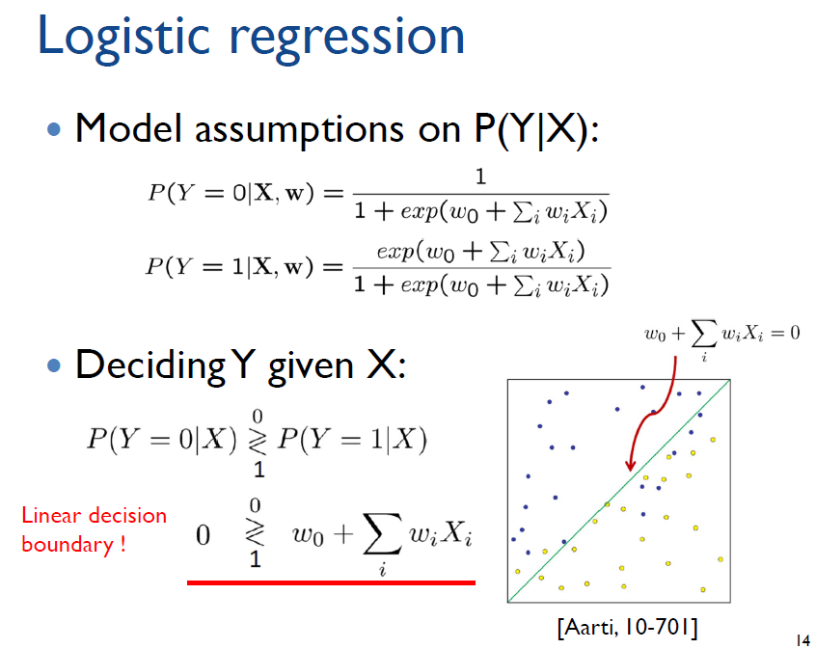
From http://www.cs.cmu.edu/~tom/10701_sp11/recitations/Recitation_3.pdf
38
Notes:
38

Slide 39
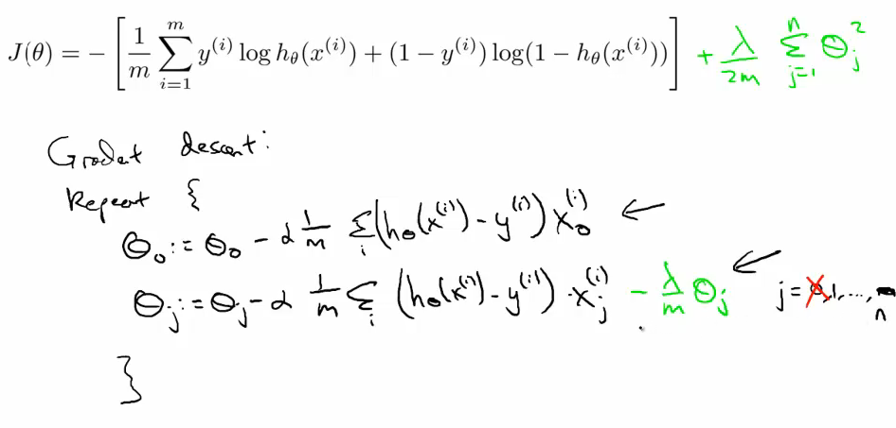
Regularized Logistic Regression
39
Notes:
39

Slide 40
Softmax Regression
Multinomial Logistic Regression
MaxEnt Classifier

Slide 41
Softmax Regression
Softmax regression model generalizes logistic regression to classification problems where the class label y can take on more than two possible values.
  The response variable y can take on any one of k values, so y ∈ {1, 2, . . . , k}.

Slide 42
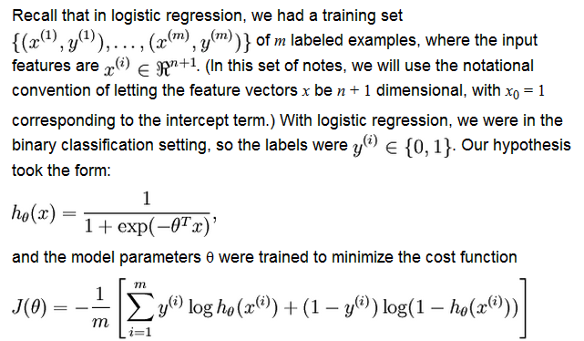

Slide 43
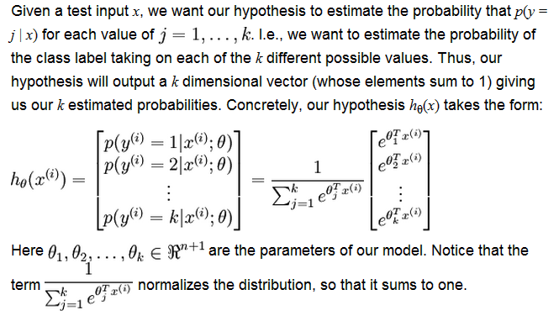

Slide 44
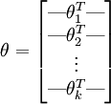
kx(n+1) matrix

Slide 45
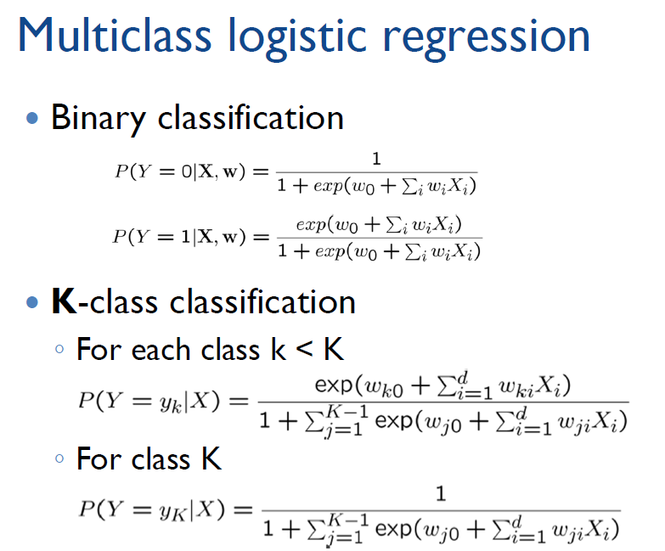
45
Notes:
45

Slide 46
Softmax Derivation from Logistic Regression
46
Notes:
46

Slide 47
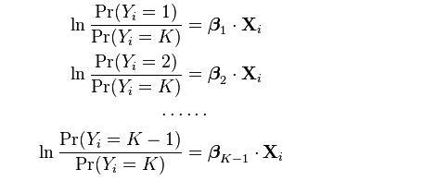
One fairly simple way to arrive at the multinomial logit model is to imagine, for K possible outcomes, running K-1 independent binary logistic regression models, in which one outcome is chosen as a "pivot" and then the other K-1 outcomes are separately regressed against the pivot outcome. This would proceed as follows, if outcome K (the last outcome) is chosen as the pivot:

Slide 48
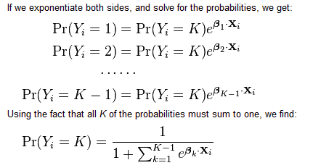
48
Notes:
48

Slide 49
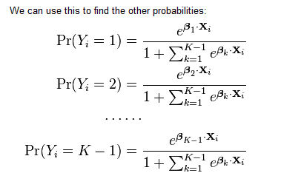
49
Notes:
49

Slide 50

Cost Function
We now describe the cost function that we'll use for softmax regression. In the equation below, 1{.} is the indicator function, so that 1{a true statement} = 1, and 1{a false statement} = 0.
For example, 1{2 + 2 = 4} evaluates to 1; whereas
1{1 + 1 = 5} evaluates to 0.

Slide 51
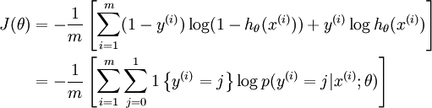
Remember that for logistic regression, we had:
which can be written similarly as:

Slide 52

The softmax cost function is similar, except that we now sum over the k different possible values of the class label.
Note also that in softmax regression, we have that
: logistic
: softmax
.

Slide 53

Fitting θ

Slide 54
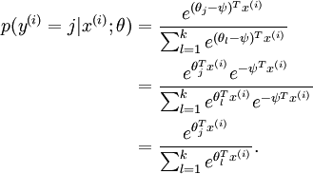
Over-parametrization
Softmax regression has an unusual property that it has a "redundant" set of parameters.
  Suppose we take each of our parameter vectors θj, and subtract some fixed vector ψ from it, so that every θj is now replaced with θj − ψ (for every ).
  Our hypothesis now estimates the class label probabilities as

Slide 55
Over-parametrization
The softmax model is over-parameterized, meaning that for any hypothesis we might fit to the data, there are multiple parameter settings that give rise to exactly the same hypothesis function h_{θ} mapping from inputs x to the predictions.
Further, if the cost function J(θ) is minimized by some setting of the parameters ,
then it is also minimized by
for any value of ψ.
,

Slide 56

Weight Decay

Slide 57

Softmax function
The softmax function will return:
  a value close to 0 whenever x_{k} is significantly less than the maximum of all the values,
  a value close to 1 when applied to the maximum value, unless it is extremely close to the next-largest value.

Slide 58

Thus, the softmax function can be used to construct
  a weighted average that behaves as a smooth function (which can be conveniently differentiated, etc.) and
  which approximates the non-smooth function

Slide 59
Logit
59
Notes:
59

Slide 60
Let's say that the probability of success of some event is .8. Then the probability of failure is 1- .8 = .2.
The odds of success are defined as the ratio of the probability of success over the probability of failure.
  In the above example, the odds of success are .8/.2 = 4.
  That is to say that the odds of success are 4 to 1.
The transformation from probability to odds is a monotonic transformation, meaning the odds increase as the probability increases or vice versa.
  Probability ranges from 0 and 1.
  Odds range from 0 and positive infinity.

Slide 61
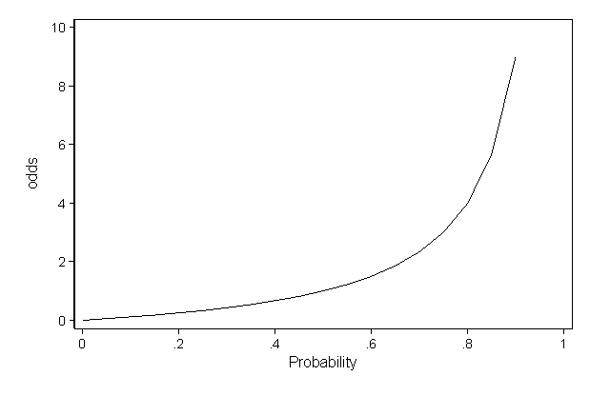

Slide 62
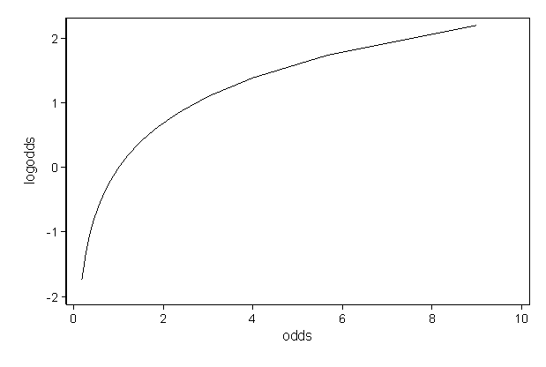

Slide 63
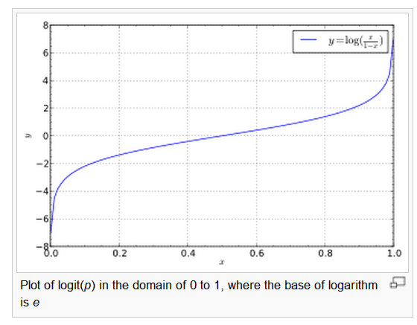

Slide 64
Why do we take all the trouble doing the transformation from probability to log odds? One reason is that it is usually difficult to model a variable which has restricted range, such as probability. This transformation is an attempt to get around the restricted range problem.
  It maps probability ranging between 0 and 1 to log odds ranging from negative infinity to positive infinity.
  Another reason is that among all of the infinitely many choices of transformation, the log of odds is one of the easiest to understand and interpret. This transformation is called logit transformation. The other common choice is the probit transformation, which will not be covered here.
A logistic regression model allows us to establish a relationship between a binary outcome variable and a group of predictor variables. It models the logit-transformed probability as a linear relationship with the predictor variables.
More formally, let y be the binary outcome variable indicating failure/success with 0/1 and p be the probability of y to be 1, p = prob(y=1). Let x1, .., xk be a set of predictor variables. Then the logistic regression of y on x1, ..., xk estimates parameter values for β0, β1, . . . , βk via maximum likelihood method of the following equation.
  logit(p) = log(p/(1-p))= β0 + β1*x1 + ... + βk*xk
In terms of probabilities, the equation above is translated into
  p= exp(β0 + β1*x1 + ... + βk*xk)/(1+exp(β0 + β1*x1 + ... + βk*xk))

