Slide 1
3D Face Modelling and Recognition Survey
Timur Aksoy
Biometrics Course
Fall 2011
Sabanci University

Slide 2
Outline
Background
Approaches
Average Face Model
Iterative Closest Point Algorithm
Regional Models
Hybrid 2D/3D Methods
Conclusions

Slide 3
Background
Gallery Images are of persons enrolled in the system
Probes are the images to identify or authenticate.
One to one match for veriification, one to many for identification.
3D model can be rendered either as depth image, shaded model or mesh of points.
2D image can be thought of texture map of 3D image.
Range images are 2.5D as they only give depth values of x-y coordinates from one view point.
3D images scan the head completely and usually represented by polygonal mesh or cloud of points

Slide 4
3D vs 2D
2D detection performance degrades under
  pose changes,
  nonrigid motions,
  changes in illumination
  occlusion
  aging.
3D detection is considered to be effected less by these factors.

Slide 5
Approaches
Point Clouds
Depth based from Range Images
Geometric Methods
  Differential
  Global
  Local
Shape Descriptors

Slide 6
Point Clouds (ICP)
Point Set: Points with x,y,z coordinates represent the surface.
Probe face is registered to gallery faces using Iterative Closest Point Algorithm and dense match between features and points is obtained.
Most systems use a reference or template face for alignment with ICP (e.g. Average Face) so that alignment is performed only once.
ICP only accounts for rigid motion. It ultimately finds point to point correspondence.

Slide 7
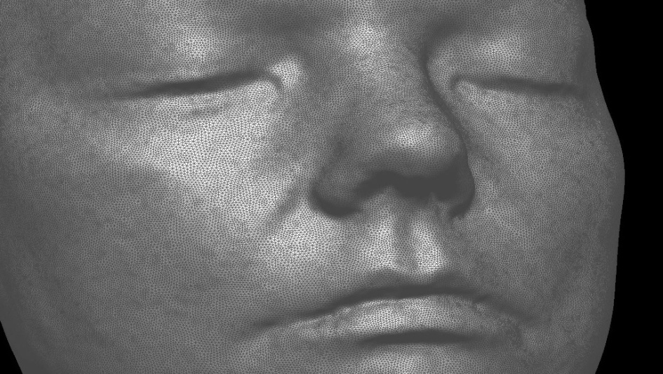
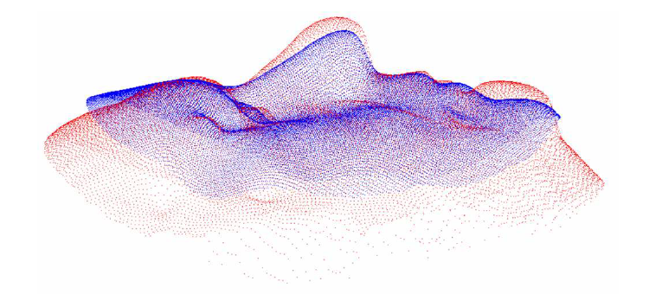
Point Clouds

Slide 8
Point Clouds (Nonrigid)
Landmarks are used for pre-alignment ex: Procrustes Analysis.
After rigid alignment, face may be deformed by splines to fit the reference face. B-Splines and Thin-Plate Splines are common.
Nonrigid registration is needed for robustness against expressions.
Deformation can be performed on both local and global scales.
Subregions of face may be matched independently.

Slide 9
Point Clouds (Similarity)
After fitting, points may be sampled from both surfaces according to average face model
Point set differences may be used for dissimilarity measure after registration.
Alternatively, Hausdorff distances may be used for distance function between 2 point sets.
Hausdorff distance measures the maximum of the smallest distances between the points in both sets.
PCA can also be applied on Point Cloud and new axes with maximum variance are determined.

Slide 10
Depth Image Based
Depth image intensities indicate the depth at that coordinate.
2D image matching techniques can be used such as PCA, LDA and ICA.
Poses are first normalized using features or ICP.

Slide 11
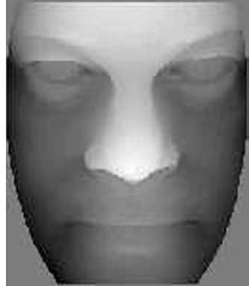
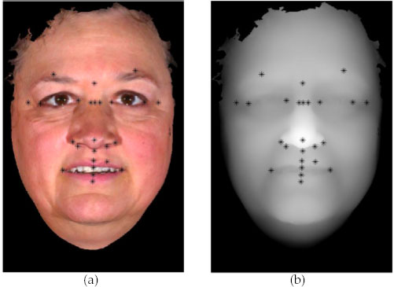
Range Images

Slide 12
Geometric Methods (Profiles)
Curves are extracted from surface and used in 2D analysis
Central and Lateral profiles may be used for recognition.
Iterative Conditional Mode (ICM) optimization is used for matching profiles.
Curvatures along profiles used as features.
Vertical Symmetry Profile curve seen as most discriminative.

Slide 13
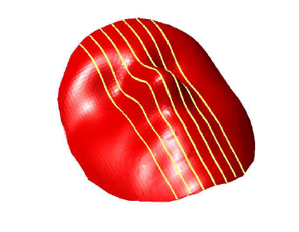
Seven vertical profiles

Slide 14
Geometric Methods (Curvature)
Curvature of surfaces are computed.
Extract landmarks using curvature (i.e. Gaussian curvature) and segment the face
  Gaussian curvature is the product of two principle curvatures at one point.
Maximum and minimum principle curvatures may be represented by two Enhanced Gaussian Images.
  Extended Gaussian Image (EGI), constructed by mapping principal curvatures and their directions at each surface points, onto two unit spheres. Their values are mapped to lengths of vectors like histogram.
  Similarity match is performed by Fisher’s spherical approximation on EGI’s

Slide 15
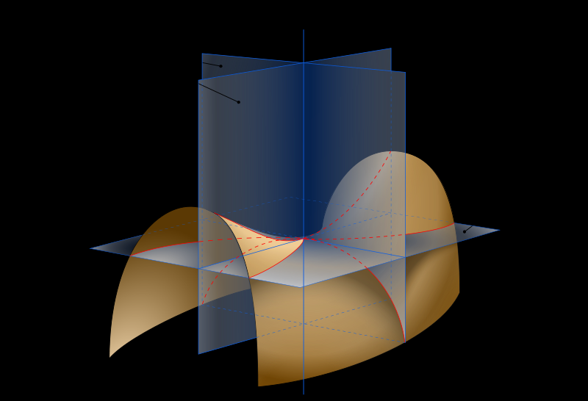
Principle Curvatures of Saddle

Slide 16
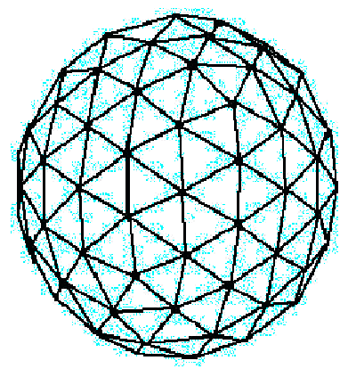
Extended Gaussian Image

Slide 17
Geometric Methods (others)
Normals on the surface may also be computed as 3 component vectors.
  Difference between normals of 2 images may be computed by angle difference histograms.
Landmark distances and angles can also be computed as features
SVM based classifiers can classify faces according to the geometric features.
Expression resistant regions such as nose and eyes have high recognition rates and their scores may be fused.
  Forehead, jaw line, eye corner cavities and cheeks of same person remains same in different range images.
  Local curvatures are also resistant to non-rigid motion since expression changes the face globally.

Slide 18
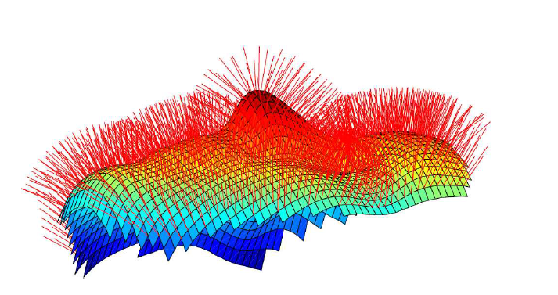
Surface Normals

Slide 19
Shape Descriptor-based
Local and global facial features are extracted
Point Signatures are popular and used in coarse registration and region detection.
  Point Signatures may be computed on rigid regions and compared for expression resistance.
A mesh is fitted to the point cloud and shape descriptors are extracted and their moments are computed.
Sphere Spin Images describe the surface locally.

Slide 20
Point Signatures
Draw a sphere around point p of surface.
Intersect sphere with surface and get a space curve C which may not be planar.
Fit a plane P to this curve approximately.
Call its normal n1 and translate the plane along n1 to include point p. Call the plane P2 and project C to P2 to form a new curve C2.
Distance of points on C2 form signed distance profile
Direction from p to point on C2 with largest positive distance is unit vector n2. Theta is the cw angle of point on C2 about n1 from n2.
We discretize theta and record signed distances which produces the point signature.

Slide 21
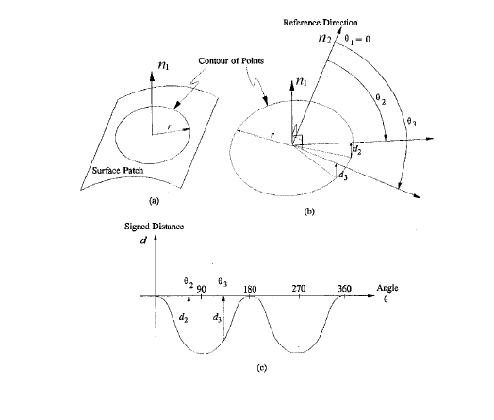
Point Signature

Slide 22
Sphere Spin Images (SSI)
An SSI, associated with a point on the surface, is a 2D histogram constructed from distances of other points in its neighborhood surface falling in the sphere centered at that point
It captures the characteristic of local shape.
Usually small set of points are selected for SSI analysis by minimum principle curvature.
Similarity between series of SSI for each subject is measured by a simple correlation coefficient.

Slide 23
Feature Extraction
Most approaches use coarse to fine localization.
Simplest methods locate valleys such as eye sockets and the peak as the nose however they assume normalized faces.
Appereance based models project image into subspace with PCA, ICA, DCT, Gaussian Derivative Filters or Gabor Wavelets
Geometric-based methods use angles, distances
and areas between landmarks
In the structure-based methods, the ensemble of candidate landmarks is fitted to a model of feature locations and the likelihood is considered.

Slide 24
The Work of Bosphorus Group
Bosphorus University
Computer Engineering

Slide 25
Average Face Model
Instead of aligning each face separately create Average Face Model from gallery.
Instead of registering probe to every gallery image , register it to the AFM. Multiple AFM’s are also possible.
Few landmarks are extracted. Then probe is first coarsely registered, rigidly registered (ICP) then non-rigidly (TPS).
The probe image is resampled after registering.

Slide 26
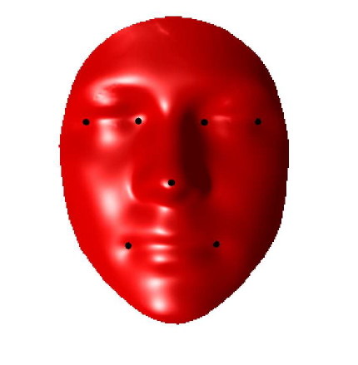
AFM and 7 Landmarks

Slide 27





ICP
Dense correspondence is established and the points without correspondence or with high distance are removed.
The objective function to be minimized is:
where is quaternion rotation matrix, is translation vector, is measured data set and is the model data set.
Points with the same indices correspond to each other and point sets have same size.

Slide 28
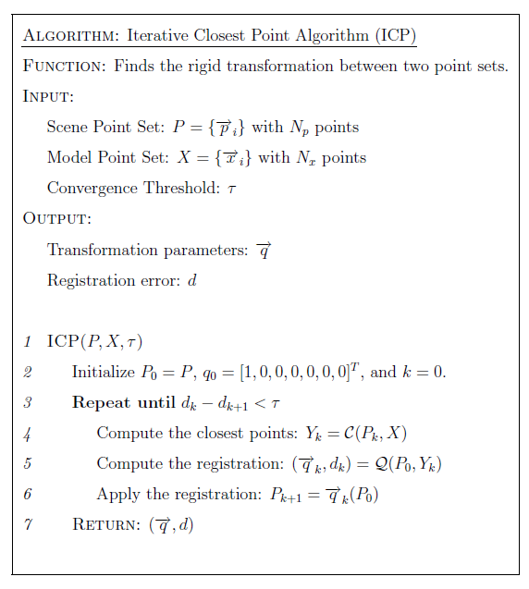

Slide 29
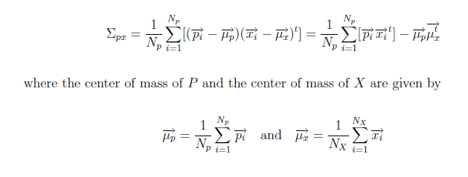
Estimation of Rotation and Translation
The cross variance of sets P and X is given by

Slide 30
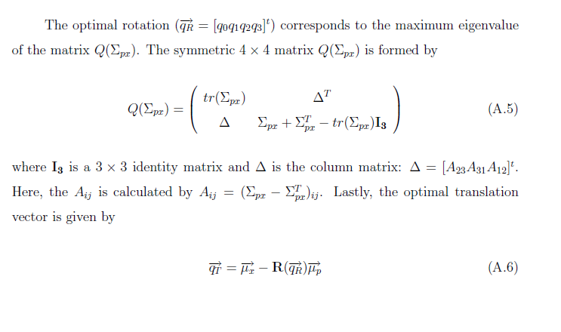

Slide 31
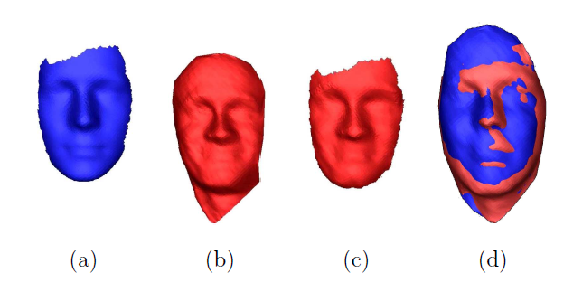
TPS Warped Face
(a) AFM, (b) the original face, (c) the warped/cropped version of the original face, and (d) TPS warped and registered facial surfaces.

Slide 32
Construction of AFM
Consensus landmark distances are computed
Landmark of Consensus shape set to full frontal position
All shapes are warped to consensus by TPS
Depth values are resampled from interpolated faces
Images are cropped by masking
All depth values are averaged to obtain AFM.

Slide 33
Regional Face Model
Landmarks are detected automatically with facial symmetry axis by using principle curvatures (maximum, minimum, Gaussian).
Regional Registration of patches preceded by global is performed by ICP independently to the Average Face Model.
Point Coordinate features i.e. depth values are extracted
LDA is applied on point coordinates of each region to obtain additional features in transformed space.
Normal Curvature Descriptors are also obtained by computing principle curvatures and dissimilarity is computed from them.
Classifier results from different regions are fused.

Slide 34
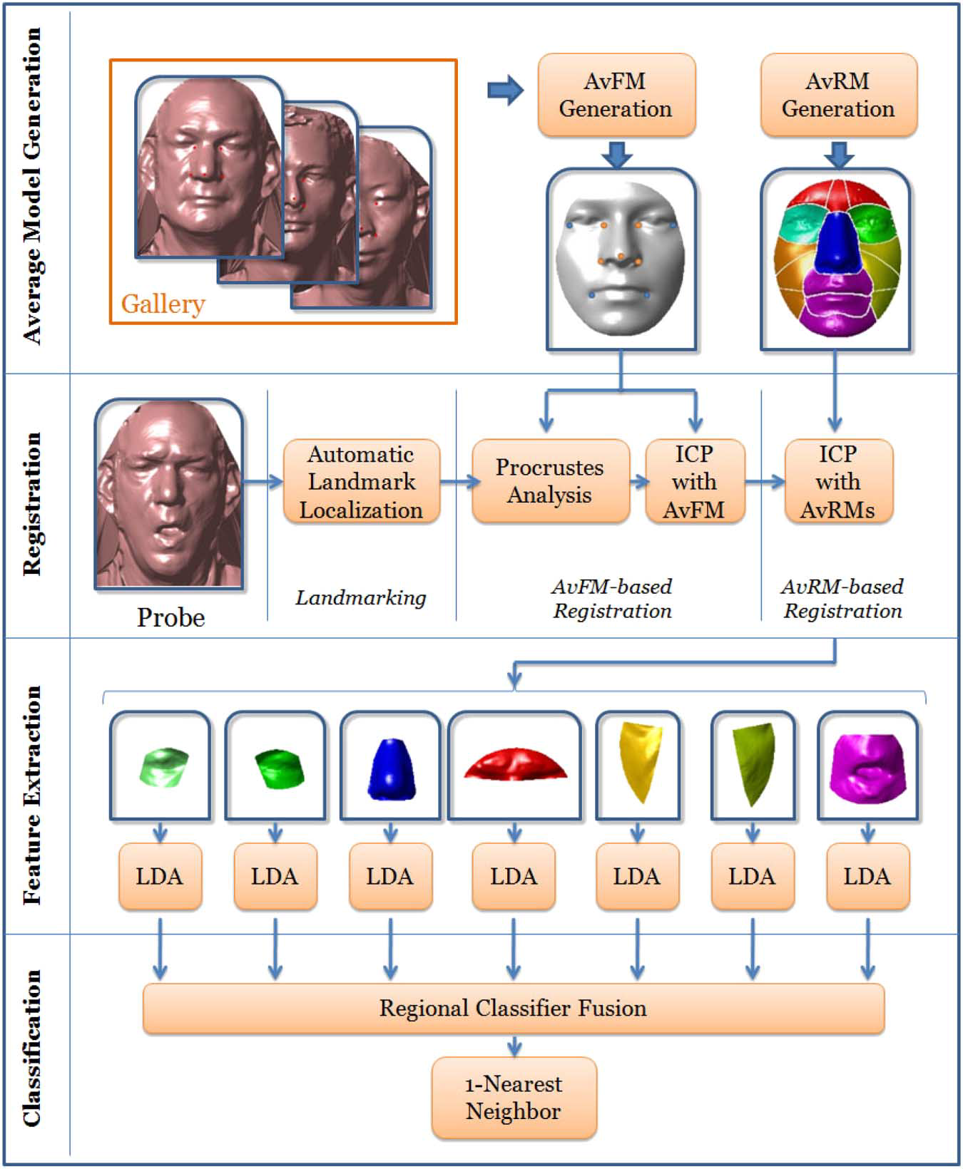

Slide 35
2D/3D Hybrid methods
Information coming from 2D and 3D are combined.
Combination of multiple images increase the accuracy.
2D image mapped to 3D canonical surface as texture
ICP was performed on 4D data (3D + intensity) which uses 4D Euclidean Distance
Intensity and Depth data has been integrated by HMM.

Slide 36
Conclusion
3D face modeling is more robust against environmental conditions.
Multimodal achieves better performance in general.
A method that performs best under all circumstances is not known yet.

Slide 37
References
Andrea F. Abate et al. 2D and 3D face recognition: A survey. Pattern Recognition Letters, 28, 2007.
Kevin W. Bowyer , Kyong Chang, Patrick Flynn. A survey of approaches and challenges in 3D and multi-modal 3D + 2D face recognition. Computer Vision and Image Understanding, 101, 2006.
Berk Gökberk. Three Dimensional Face Recognition. PhD Thesis, Computer Engineering, Bosphorus University, 2006.
Neşe Alyüz, Berk Gökberk, and Lale Akarun. Regional Registration for Expression Resistant 3-D Face Recognition. IEEE Transactions On Informatıon Forensics And Security, Vol. 5, No. 3, 2010.

Slide 38
References
Albert Ali Salah, Neşe Alyüz, Lale Akarun. Registration of three-dimensional face scans with average face models. Journal of Electronic Imaging, vol. 17(1), 2008.
Hatice Çınar Akakın et al. 2D/3D Facial Feature Extraction. Proceedings of SPIE-IS&T Electronic Imaging, SPIE Vol. 6064.
Chin-Seng Chua, Feng Han, Yeong-Khing Ho. 3D Human Face Recognition Using Point Signature. Proceedings of Fourth IEEE International Conference on Automatic Face and Gesture Recognition. 2000.

